Slide 1
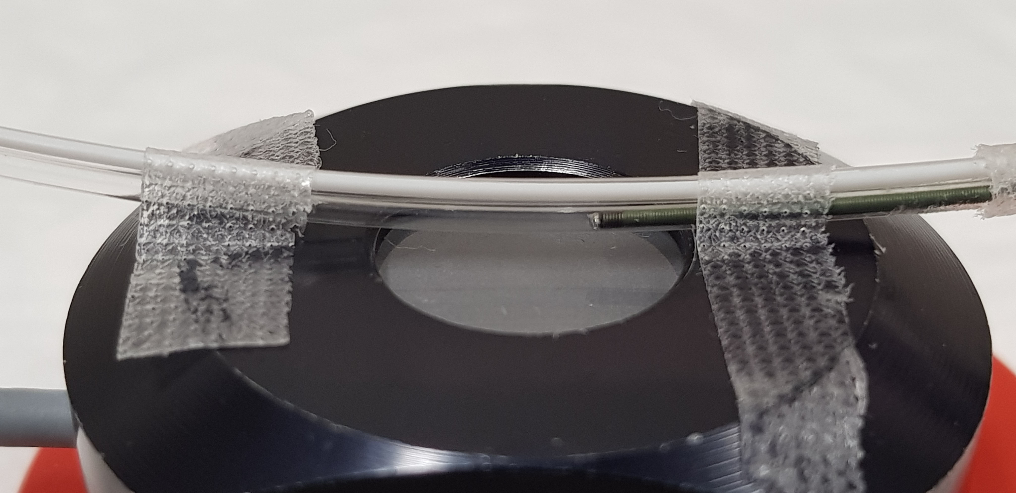
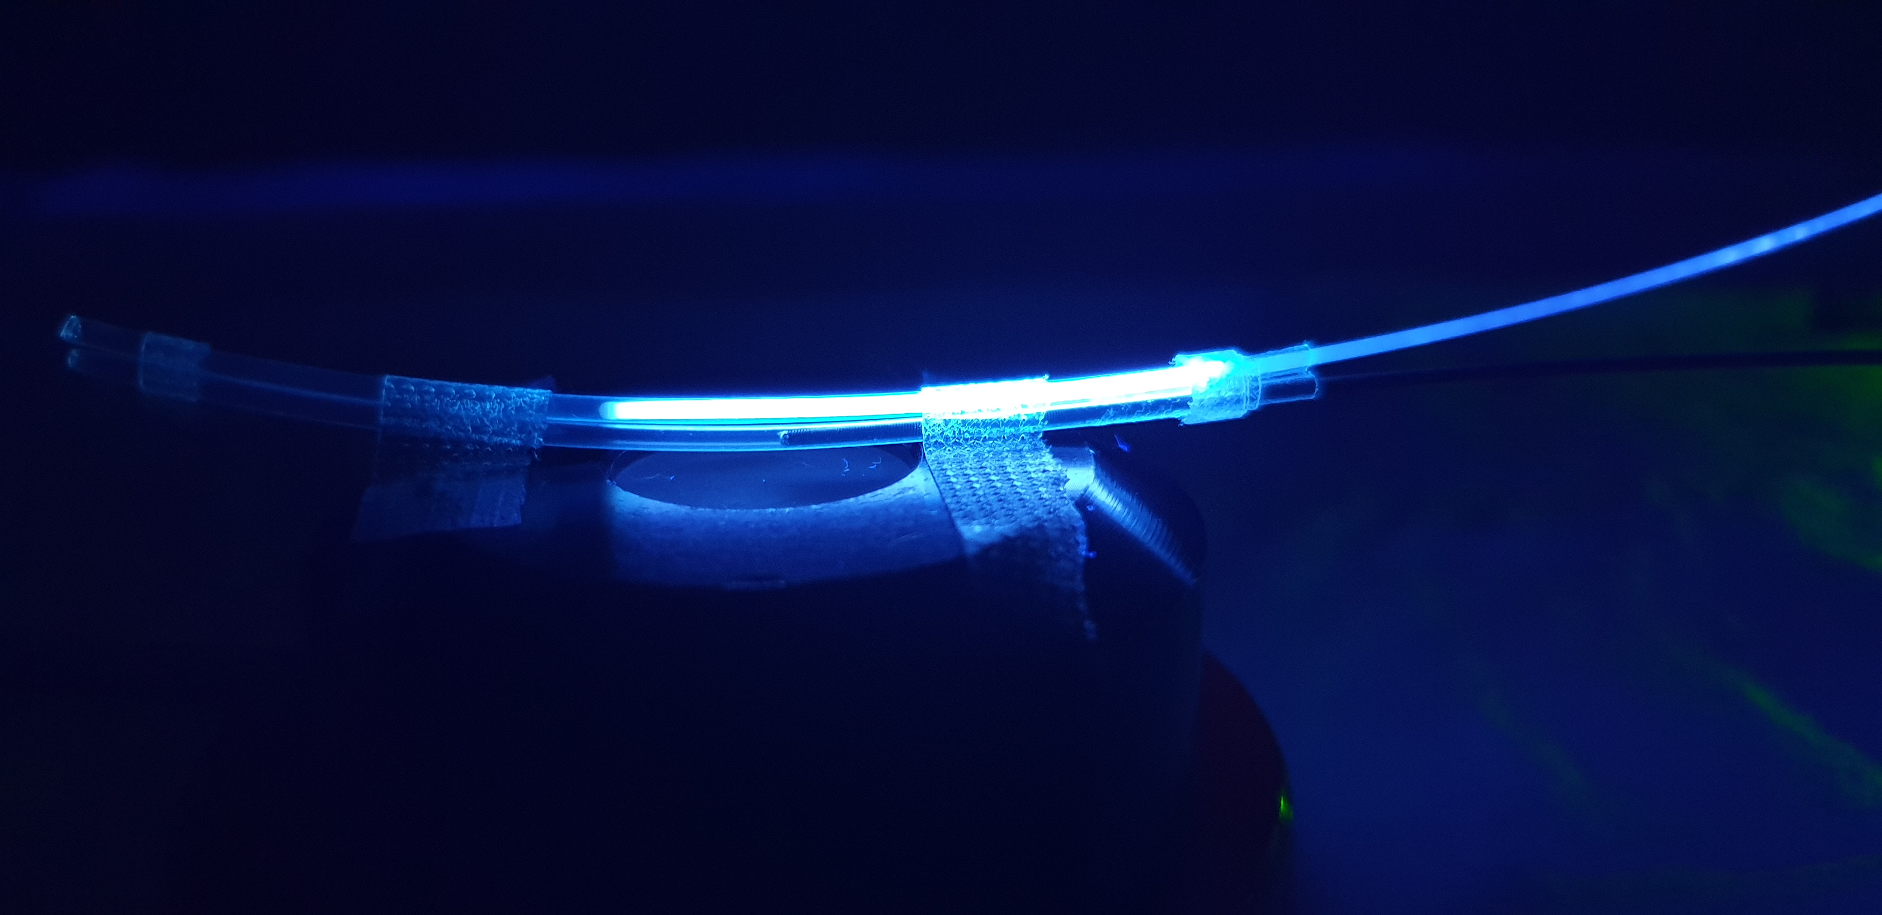
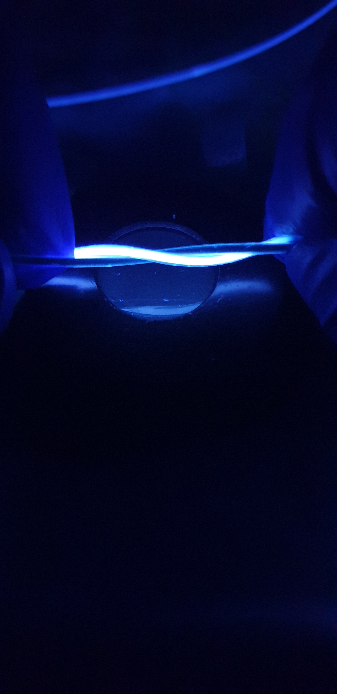
Online Resource 5
a
b
Fibre Optic
GW Port
GW
Fibre parallel to GW
c
Spiraling fibre around GW
UV Sensor

