Slide 1
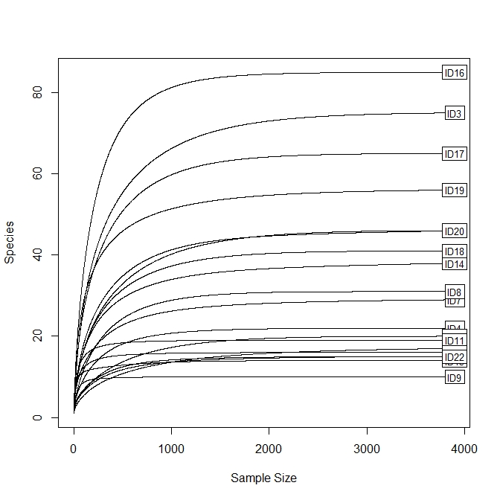
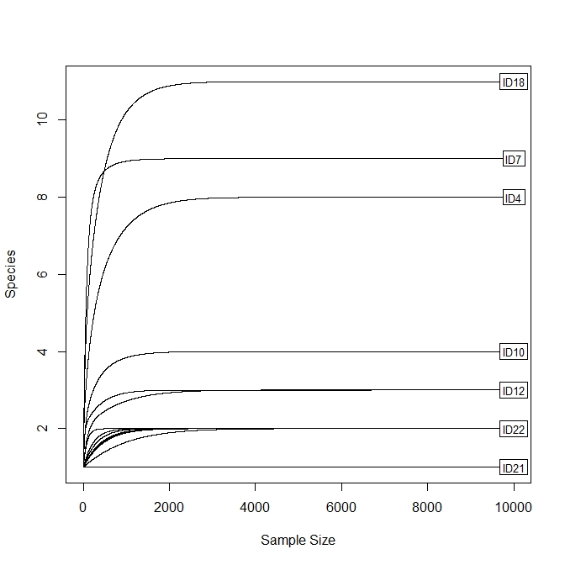
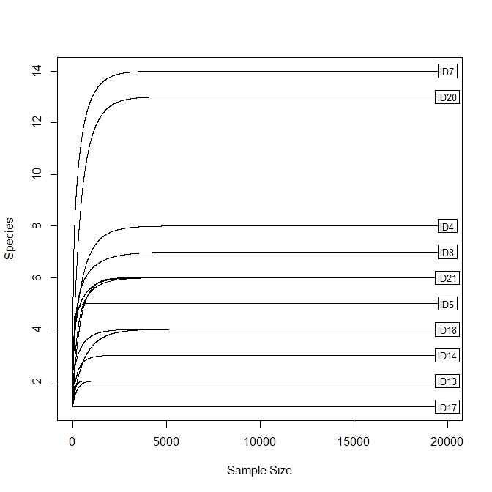
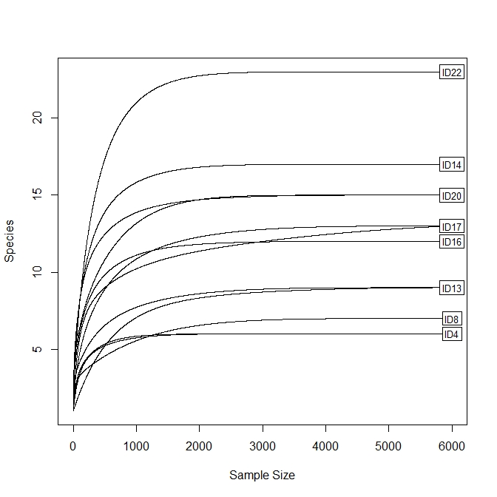
Supplementary Information SI2
COI
16S-epp
16S-kp
trnL
Supplementary Information SI2. Rarefaction curves obtained for each molecular marker.

