Slide 1
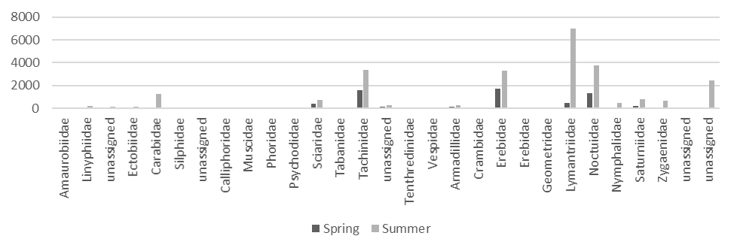
Supplementary Information SI3
COI
Number of reads
Araneae
Coleoptera
Diptera
Hymenoptera
Lepidoptera
Blattodea
Isopoda
Supplementary Information SI3. Rarefied read numbers assigned to each taxonomic category (orders and families) for COI. Chironomidae (Diptera) and unassigned Lepidoptera showing relatively large read numbers of COI were included (see Fig. 1A for the data excluding these reads). Unassigned order was removed. The reads for the nematode, not considered a part of diet of the wood mouse, was also excluded. Because the number of samples in Spring is larger than in Summer, the reads in Spring were rarefied (7/12).

