Slide 1
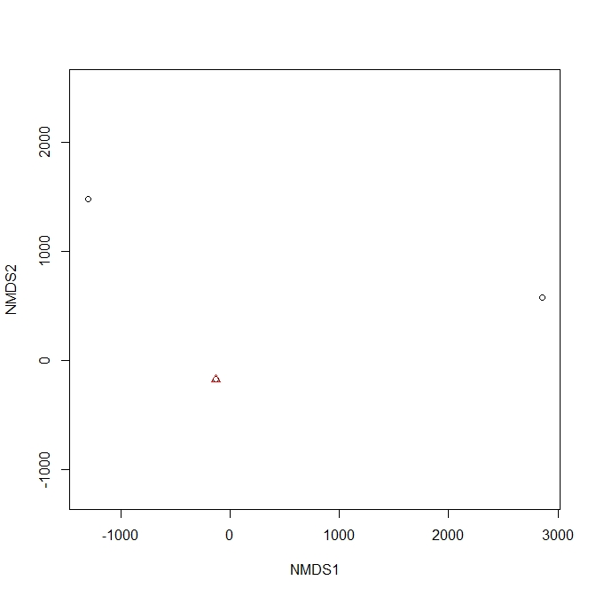
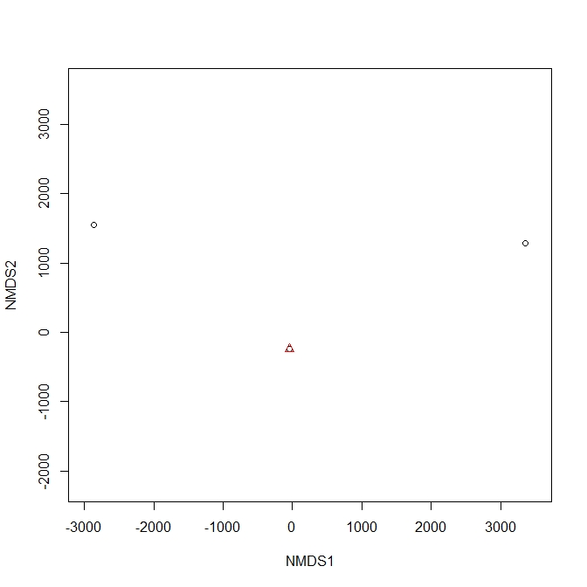
Supplementary Information SI6
(A)
(B)
#13
#13
#14
#14
Other samples
Other samples
Supplementary Information SI6. Non–metric multidimensional scaling (NMDS) plot based on a Bray-Curtis (A) and Jaccard (B) similarity index for the rarefied read data obtained from 16S-kp analyses including outlier samples (#13 and #14). Samples 13 and 14 did not share any OTUs with the other samples (only Lymantria dispar and two unassigned taxa in Lepidoptera in the sample 13 and 14, respectively, were detected). The NMDS plots containing only the other samples are shown in Fig. 2C and 2F.

