Slide 1
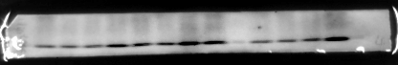
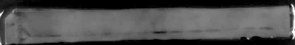
Fig.1B
DLD1
Fig. 1A
SW480
HA-CHIP
CHIP KO
KO Mock
HA-CHIP
pEF-neo
KO Mock
Mock
CHIP KO
CHIP
β-actin
Fig.2G
SW480
KO Mock
CHIP KO
HA-CHIP
Mock
H3K18la
CHIP
β-actin
Fig.2H
DLD1
KO Mock
CHIP KO
HA-CHIP
pEF-neo
H3K18la
CHIP
β-actin
Fig.2I
MEFs
CHIP +/-
CHIP -/-
H3K18la
CHIP
β-actin

Slide 2
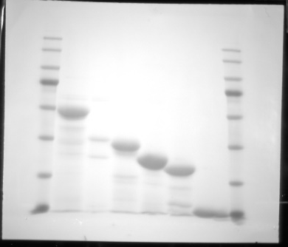
Fig.3C
GST-CHIP
+
-
-
-
-
-
GST-△U-box
-
+
-
-
-
-
Fig.3A
Fig.3B
GST- △TPR
-
-
+
-
-
-
Lysate
IP
GST-TPR
-
-
-
+
-
-
F-LDHA
+
+
+
GST-U-box
-
-
-
-
+
-
Control
-
-
-
-
-
CHIP
Control
CHIP
Myc-CHIP
+
-
-
GST
+
Pull-down:
GST beads
IB: anti-Flag
Myc-CHIP(K30A)
-
+
-
F-LDHA
Myc-CHIP(H260Q)
-
-
+
LDHA
F-LDHA
IP: anti-Myc
IB: anti-Flag
Lysate
IB: anti-Flag
F-LDHA
Myc-CHIP
IP: anti-Myc
IB: anti-Myc
Purified
GST
or
GST-CHIP
proteins
CHIP
GST-CHIP
F-LDHA
Lysate
IB: anti-Flag
IB: anti-Myc
β-actin
Myc-CHIP
GST
Fig.3D
Fig.3E
DLD1/pEF-neo
DLD1/HA-CHIP
F-LDHA
+
+
+
+
+
+
+
CHX(h)
0
4
8
12
0
4
8
12
Myc-CHIP
0
0.1
0.2
0.4
0
0.1
0.2
MG132
-
-
-
-
+
+
+
LDHA
LDHA
CHIP
HA-CHIP
β-tubuin
GFP
β-actin
SW480
Fig.3F
Fig.3G
DLD1
CHIP KO
HA-CHIP
KO Mock
pEF-neo
HA-CHIP
Mock
KO Mock
CHIP KO
LDHA
LDHA
CHIP
CHIP
β-tublin
β-actin
Fig.3H
MEFs
Fig.3I
DLD1 WT
CHIP +/+
SW480 WT
CHIP -/-
LDHA
LDHA
CHIP
CHIP
β-actin
β-actin

Slide 3
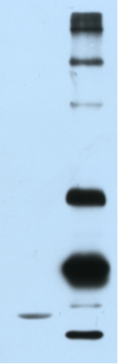
Fig.4A
F-LDHA
+
+
+
+
+
His-Ubi
-
+
+
+
+
HA-CHIP
-
-
+
-
-
HA-K30A
-
-
-
+
-
HA-H260Q
-
-
-
-
+
LDHA-(Ubi)n
Precipitate:
Ni-NTA
IB:anti-LDHA
Lysate:
IB:anti-Flag
IB:anti-HA
IB:anti-β-tubulin
F-LDHA
HA-CHIP
β-tubulin
Fig.4B
Ubi+E1+E2
+
+
F-LDHA
+
+
His-CHIP
-
+
F-LDHA-(Ubi)n

Slide 4
Fig.4C
F-LDHA
+
+
+
+
+
His-Ubi
-
WT
WT
K48
K63
HA-CHIP
-
-
+
+
+
Precipitate:
Ni-NTA
IB:anti-LDHA
LDHA-(Ubi)n
Lysate:
IB:anti-Flag
IB:anti-CHIP
IB:anti-β-actin
F-LDHA
CHIP
β-actin
F-LDHA
WT
WT
WT
K5R
K59R
Fig.4D
K76R
K118R
K155R
His-Ubi
-
+
+
+
+
+
+
+
+
HA-CHIP
-
-
+
+
+
+
+
Precipitate:
Ni-NTA
IB:anti-LDHA
LDHA-(Ubi)n
F-LDHA
Lysate:
IB:anti-Flag
IB:anti-CHIP
IB:anti-β-actin
CHIP
β-actin

Slide 5

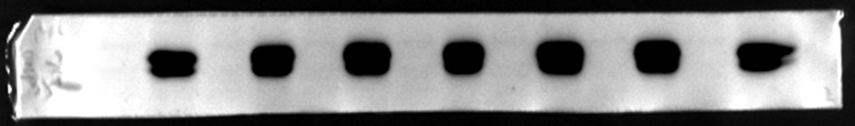
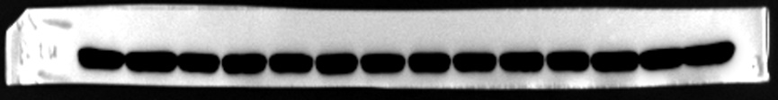
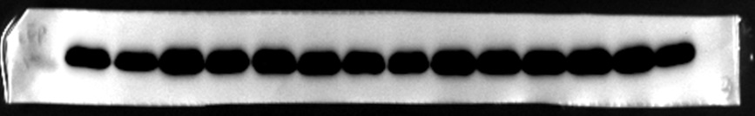
Fig.4E
F-LDHA
WT
WT
K5R
K5R
K155R
K155R
Myc-CHIP
-
+
-
+
-
+
F-LDHA
CHIP
β-tubulin
GFP
Fig.5A
Fig.5B
CHIP KO/shLDHA #11
HA-CHIP/Myc-LDHA #55
CHIP KO/shLDHA #8
HA-CHIP
HA-CHIP/Myc-LDHA #57
CHIP KO/pLL3.7
Mock
HA-CHIP/pLv
KO Mock
CHIP
LDHA
Myc-LDHA
CHIP
β-tubulin
β-tubuin
Fig.5J
CHIP/Myc-LDHA #1
CHIP/Myc-LDHA #2
CHIP/Myc-LDHA #3
CHIP/Myc-LDHA #5
HA-CHIP
CHIP/Myc-LDHA #4
HA-CHIP
CHIP
Myc-LDHA
β-actin
SW480 Tumor

Slide 6

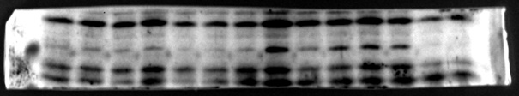






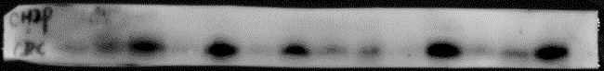
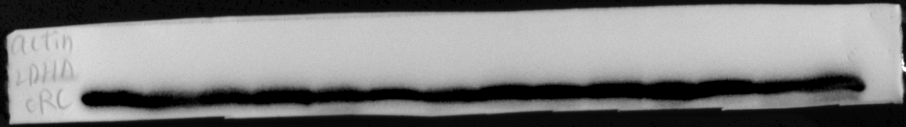
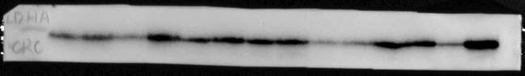


Fig.6G
SW480
Fig.6H
DLD1
HA-CHIP/Myc-LDHA
CHIP KO/Myc-LDHA
HA-CHIP/pLv
CHIP KO/pLL3.7
Mock
KO Mock
HA-CHIP
CHIP KO
H3K18la
H3K18la
Myc-LDHA
LDHA
HA-CHIP
CHIP
LDHA
β-tubulin
CHIP
β-tubulin
Fig.7F
Colorectal cancer
N1
T1
N2
T2
LDHA
CHIP
β-actin
N3
T3
LDHA
CHIP
β-actin
N4
T4
LDHA
CHIP
β-actin
N5
T5
LDHA
CHIP
β-actin
N6
T6
LDHA
CHIP
β-actin

