Slide 1
Bleeding and Clotting Disorders in Pediatric and Adolescent Gynecology
Ozlem Dural, MD¹, Rebecca Richardson, MD², Monica Woll Rosen, MD²
¹ Istanbul University Department of Obstetrics and Gynecology, Istanbul, Turkey,
² University of Michigan Department of Obstetrics and Gynecology Ann Arbor, MI USA

Slide 2
Purpose of review
To explore the diagnosis and management of bleeding and clotting disorders in adolesecents
To assess their impact on contraceptive method preferences and heavy menstrual bleeding (HMB) management.

Slide 3
HMB
Affecting 12–37% of adolescents
Associated with significant physical, psychosocial, and educational consequences.

Slide 4
HMB
Best defined as menstrual bleeding that limits comfort, well-being, daily activities, or quality of life
Most often due to anovulatory cycles, but may also indicate an underlying bleeding disorder (BD)
BD prevalence in girls with HMB is 21–48%, higher in hospitalized cases

Slide 5
When to Screen for BDs
Adolescents with HMB and who meet any of the four criteria
Menses lasting ≥7 days accompanied by flooding or bleeding through a pad or tampon in ≤2 hours with most periods
A history of treatment for anemia
A family history of a diagnosed BD
A personal history of excessive bleeding with tooth extraction, surgery, delivery, or miscarriage

Slide 6
Initial Laboratory Workup
A complete blood count;
Serum ferritin;
Standard coagulation studies (prothrombin time [PT], activated partial thromboplastin time [aPTT], thrombin time, and fibrinogen level);
Testing for VWD (von Willebrand factor [VWF] antigen, ristocetin cofactor activity, and factor VIII [FVIII] levels)

Slide 7
Most common BDs
Von Willebrand disease (VWD),
Platelet function disorders (PFDs),
Thrombocytopenia,
And clotting factor deficiencies

Slide 8
Second-tier testing for who
A significant bleeding history,
Persistent bleeding despite treatment,
Nondiagnostic initial results

Slide 9
Second-tier testing
Consultation with a hematologist is recommended
Particular attention to identifying platelet dysfunction
Extended coagulation factor including factors II, V, VII, VIII, IX, X, XI, and XII

Slide 10
Early recognition of BDs
Reduce hospitalizations and transfusion rates,
Improve quality of life, and
Prevent long-term adverse consequences

Slide 11
VWD
The most prevalent inherited BD
Classified into three main types:
  Type 1, the most common, accounts for approximately 75% of cases and typically results in mild to moderate bleeding
  Type 2 consists of qualitative defects in VWF function
  Type 3 is the rarest and most severe

Slide 12
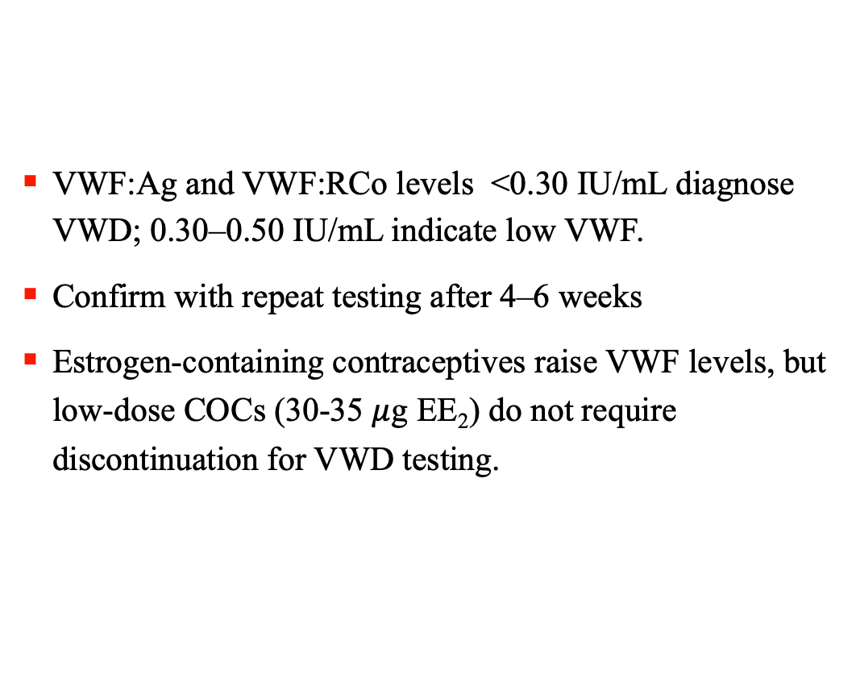
VWD
VWF:Ag and VWF:RCo levels <0.30 IU/mL diagnose VWD; 0.30–0.50 IU/mL indicate low VWF.
Confirm with repeat testing after 4–6 weeks
Estrogen-containing contraceptives raise VWF levels, but low-dose COCs (30-35 $μ$g EE₂) do not require discontinuation for VWD testing.

Slide 13
Adolescent BD Management
HMB is the most frequently reported symptom, affecting an estimated 75-80% of them
Hemorrhagic corpus luteum with hemoperitoneum from cyst rupture is another gynecologic manifestation
Multidisciplinary clinics (gynecologists, hematologists, and social workers) improve convenience and continuity
Providing anticipatory guidance before menarche and a proactive plan are essential

Slide 14
Management of acute HMB
Hospitalize adolescents with severe anemia (hemoglobin ≤8 g/dL), hemodynamic instability, or active HMB:
  Resuscitation with crystalloid,
  Undergo blood typing and crossmatching
  But avoid transfusion when possible; base decisions on clinical status, reassessing after each unit
Avoid medications that impair platelet adhesion such as aspirin and other nonsteroidal anti-inflammatory drugs

Slide 15
Management of acute HMB
IV conjugated estrogen 25 mg every 4–6 hours or oral monophasic COCs (30–50 μg EE) every 6–8 hours until bleeding stops
Followed by a COC tapering regimen
Should be given along with antiemetics.
No standard taper exists; continue the lowest effective dose until hemoglobin improves

Slide 16
Recent Findings
There are insufficient data directly comparing the timing of bleeding cessation between IV estrogen and high-dose COCs
IV estrogen followed by COC tapering may increase hospital stay and nausea vs high-dose COCs alone
High-dose COC tapering does not seem to shorten time to bleeding control vs standard-dose regimens
If bleeding persists after 24-48 hours, adjunctive therapy such as tranexamic acid (TXA) may be added and escalation of care, including consultation with a hematologist

Slide 17
Management of acute HMB
For those unable to use estrogen, progesterone-only regimens can effectively control bleeding
  Oral medroxyprogesterone (10-20 mg every 6-12h)
  Norethindrone acetate (NETA) (5-10 mg every 6h)
NETA is partially converted to EE, but the clinical impact on VTE risk remains unclear.

Slide 18
Management of acute HMB
In adolescents with specific clotting factor deficiencies, management may necessitate administration of clotting factors
Desmopressin raises VWF/FVIII and helps control HMB in VWD and some PFDs.

Slide 19
Management of acute HMB
If bleeding persists, uterine tamponade with a 30 cc Foley catheter is an effective, reversible option
Consider exam under anesthesia ± hysteroscopy; LNG-IUD may be placed but has higher expulsion risk
Surgical options are last resort.

Slide 20
Management of chronic HMB
Hormonal and nonhormonal treatment options
Evidence is limited; ~53% fail first-line therapy,
Often requiring combined hormonal and nonhormonal treatment

Slide 21
Hormonal treatments
Combined hormonal contraceptives (CHCs; e.g., pill, patch, or vaginal ring)
Oral, injectible, or implantable progestins

Slide 22
CHCs
Continuous or extended-cycle associated with more favorable bleeding patterns
Lower-dose EE₂ (10–20 μg) reduces withdrawal bleeding but increases breakthrough bleeding
Continuation and perfect use remain suboptimal across short-acting methods

Slide 23
Progesterone only regimens
Oral NETA at 5-10 mg/day may be more effective than COCs for treating HMB in individuals with BDs
DMPA induces amenorrhea in ~50%; dosing can be shortened (4–10 weeks) for breakthrough bleeding, with subcutaneous options for those at hematoma risk
The etonogestrel implant is effective for contraception but not first-line for HMB due to frequent breakthrough bleeding.

Slide 24
Progesterone only regimens -
LNG-IUD
The 52 mg LNG-IUD is an effective and increasingly used option with ~89% success
Data are limited, but hematology collaboration is recommended to optimize hemostasis during IUD insertion
Early expulsion risk may be slightly higher, but may be reduced by continuing prior hormonal therapy after insertion

Slide 25
Nonhormonal treatments
Administration of TXA, aminocaproic acid, desmopressin, and other clotting factor replacement
TXA is recommended as an important therapeutic option in adolescents with BDs
TXA may be given as two 650 mg tablets (1300 mg) three times daily for up to five days during menses

Slide 26
Nonhormonal treatments
Screen for iron deficiency in all HMB patients
Iron therapy (60–120 mg daily or alternate-day) is essential for girls with anemia or iron deficiency,
Inadequate iron stores can contribute to fatigue and cognitive difficulties, even when hemoglobin levels are normal

Slide 27
VTE
Includes DVT and PE, is a rare but serious adverse event in children and adolescents
In female adolescents, the incidence of VTE is approximately 2-3 in 10,000

Slide 28
VTE
Risk factors include obesity, immobility, recent surgery, autoimmune conditions, inherited and acquired thrombophilias, pregnancy, tobacco use, contraception use, infections, and malignancy
And certain pediatric conditions, such as congenital heart disease and venous malformations
Estrogen promotes a procoagulant state, increasing VTE risk, especially with additional risk factors

Slide 29
CHCs - VTE
COCs increase VTE risk 3–6-fold, but the absolute risk remains low (4-6 per 10,000 in users)
Patches and rings may have similar or slightly higher risk
Overall, the VTE risk remains substantially lower than that observed during pregnancy (5–20 per 10,000 woman-years) and particularly during the postpartum period (approximately 40–116 per 10,000 woman-years)

Slide 30
COCs - VTE
New ‘low-dose’ COC options (≤20 μg EE):
  Thought to reduce VTE risk, but comparative data vs 30–35 μg are limited
  May impair bone accrual in adolescents.
Progestin type also affects VTE risk; newer progestins have higher relative risk than levonorgestrel, but absolute risk remains low.

Slide 31
Progesterone only options - VTE
DMPA may increase VTE risk 2–3-fold, but the absolute risk remains low (~1–2 to 3–6 per 10,000)
High-dose NETA may increase VTE risk due to EE₂ conversion, though again, the absolute risk remains modest

Slide 32
Inherited thrombophilias
The most common: Factor V Leiden (FVL), Prothrombin G20210A (PGM), Protein S deficiency (PS), Protein C deficiency (PC), and Anti-Thrombin (AT) deficiency
Low-risk thrombophilias (e.g., heterozygous FVL and PGM) have a two-three-fold increased risk of VTE
High-risk thrombophilias (e.g., AT deficiency and homozygous FVL) have a 12-fold and up to 80-fold increased risk, respectively

Slide 33
Inherited thrombophilias
Routine screening before contraception is generally not recommended due to cost-effectiveness
Targeted screening may be reasonable for those with a significant personal or family history of VTE, or a known family history of thrombophilia
Avoiding CHCs in high-risk patients as a practical, cost-effective alternative to genetic testing

Slide 34
Acquired thrombophilias
Such as antiphospholipid syndrome (APS)
The prevalence in adolescents is not well known
The prevalence of positive antibodies in children with VTE is as high as 24%

Slide 35
Contraception in Patients with Prior VTE
Not all contraceptives increase VTE risk
Safe alternatives should be offered, as pregnancy carries a much higher VTE risk, especially postpartum!

Slide 36
Contraception in Patients with Prior VTE
The US MEC recommends against CHCs
DMPA is also not recommended in patients with prior VTE
2024 CDC US MEC: All methods, including CHCs, are category 2 for patients with VTE on anticoagulation.
Other progesterone-only methods considered generally safe

Slide 37
Menstrual management in anticoagulated patients
Stopping hormonal therapy often increases the risk of HMB
HMB occurs in ~76% of adolescents on anticoagulation, with high anemia rates, supporting use of safe hormonal therapy for prevention.

Slide 38
Menstrual management in anticoagulated patients
Another observed potential consequence is a risk of developing hemorrhagic ovarian cysts
Ovulation-suppressing CHCs reduce ovarian cyst risk and may be used in selected anticoagulated patients
Also the use of ovulation-suppressing progestin-only methods, such as implants or DMPA, can be considered

Slide 39
Conclusion
Individualized care is essential for adolescents with BDs and VTEs
Balancing menstrual management, contraception, and thrombotic safety
Further research is needed to guide personalized, long-term management
Multidisciplinary teams play a key role optimizing evaluation, treatment, and ongoing care

