Slide 1
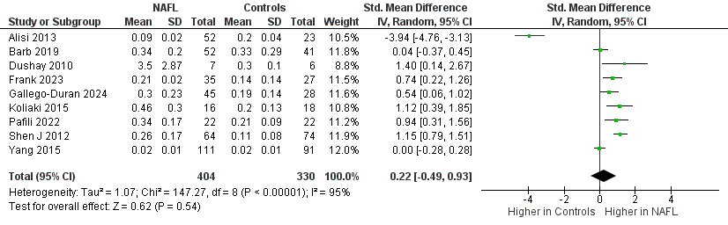
Supplementary Figure 2a
Notes:
Supplementary Figure 2a Forest plot for the comparison of circulating FGF-21 between patients with hepatic steatosis (NAFL) and controls
Abbreviations: CI, confidence intervals; FGF-21, fibroblast growth factor-21; IV, inverse variance; n, number of studies included in the analysis; NAFL, nonalcoholic fatty liver; NAFLD, nonalcoholic fatty liver disease; SD, standard deviation

Slide 2
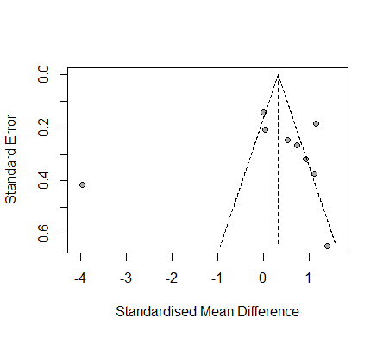
Supplementary figure 2b
Notes:
Supplementary figure 2b Funnel plot for the comparison of circulating FGF-21 between patients with hepatic steatosis (NAFL) and controls
Abbreviations: FGF-21, fibroblast growth factor 21; NAFL, nonalcoholic fatty liver; NAFLD, nonalcoholic fatty liver disease; n,number of studies included in the analysis

Slide 3
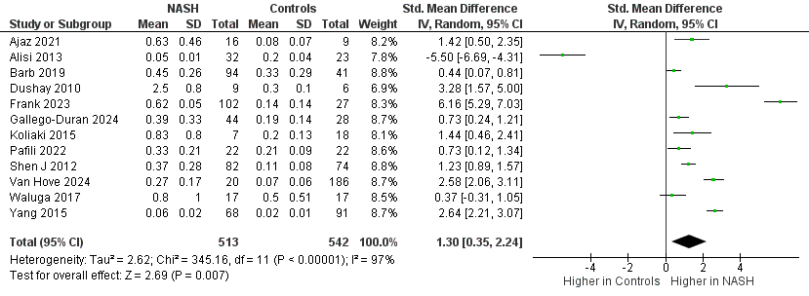
Supplementary Figure 2c
Notes:
Supplementary Figure 2c Forest plot for the comparison of circulating FGF-21 between patients with NASH and controls
Abbreviations: CI, confidence intervals; FGF-21, fibroblast growth factor-21; IV, inverse variance; n, number of studies included in the analysis; NASH, nonalcoholic steatohepatitis; NAFLD, nonalcoholic fatty liver disease; SD, standard deviation

Slide 4
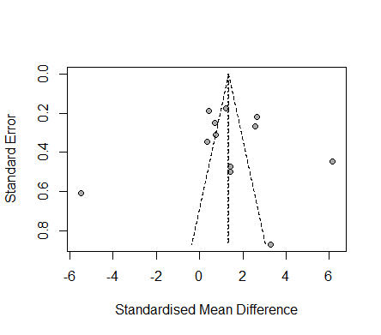
Supplementary figure 2d
Notes:
Supplementary figure 2d Funnel plot for the comparison of circulating FGF-21 levels between patients with NASH and controls
Abbreviations: FGF-21, fibroblast growth factor-21; NAFLD, nonalcoholic fatty liver disease; NASH, nonalcoholic steatohepatitis; n,number of studies included in the analysis

Slide 5
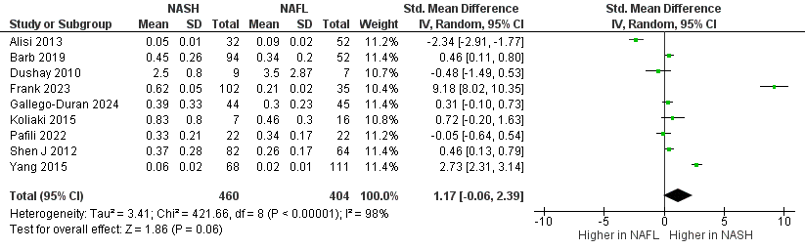
Supplementary Figure 2e
Notes:
Supplementary Figure 2e Forest plot for the comparison of circulating FGF-21 between patients with NASH and hepatic steatosis (NAFL)
Abbreviations: CI, confidence intervals; FGF-21, fibroblast growth factor-21; IV, inverse variance; n, number of studies included in the analysis; NAFL, nonalcoholic fatty liver; NAFLD, nonalcoholic fatty liver disease; NASH, nonalcoholic steatohepatitis; SD, standard deviation

Slide 6
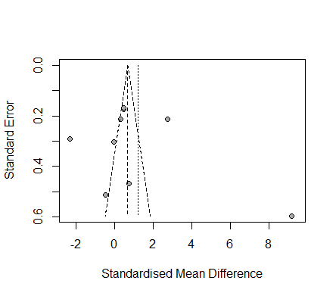
Supplementary figure 2f
Notes:
Supplementary figure 2f Funnel plot for the comparison of circulating FGF-21 between patients with NASH and hepatic steatosis (NAFL)
Abbreviations: FGF-21, fibroblast growth factor-21; NAFL, nonalcoholic fatty liver; NAFLD, nonalcoholic fatty liver disease; NASH, nonalcoholic steatohepatitis. n, number of studies included in the analysis

Slide 7
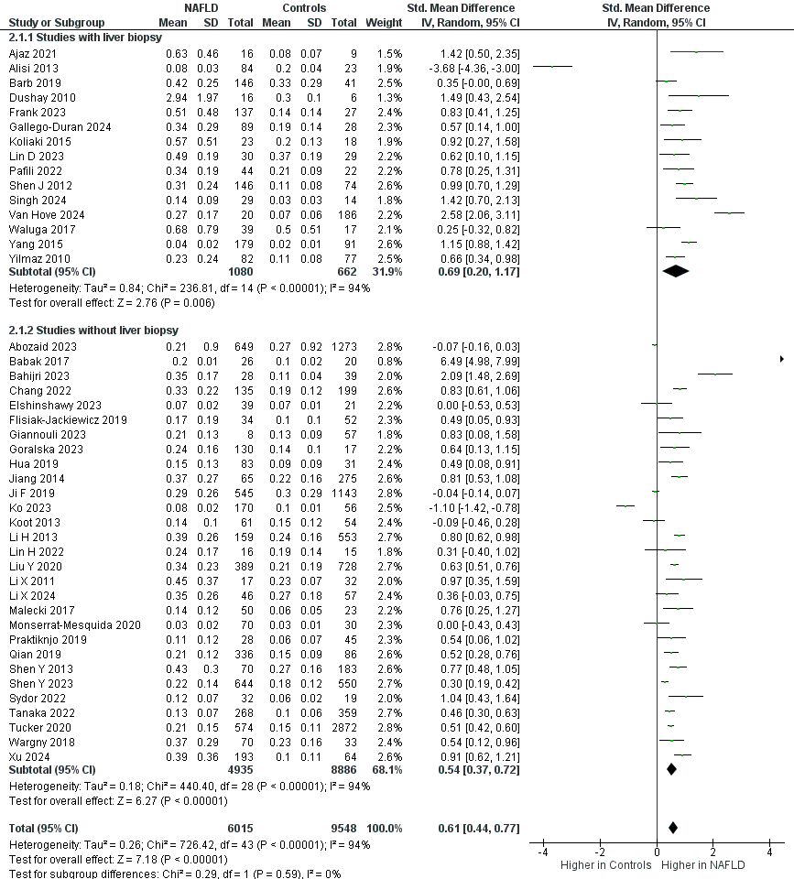
Supplementary Figure 2g
Notes:
Supplementary Figure 2g Forest plot for the comparison of circulating FGF-21 between patients with NAFLD and controls, in subgroup analysis within studies with and without histological confirmation of NAFLD
Abbreviations: CI, confidence intervals; FGF-21, fibroblast growth factor-21; IV, inverse variance; n, number of studies included in the analysis; NAFLD, nonalcoholic fatty liver disease; SD, standard deviation

Slide 8
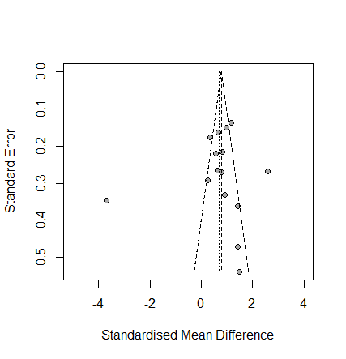
Supplementary Figure 2h
Notes:
Supplementary Figure 2h Funnel plot for the comparison of circulating FGF-21 between patients with NAFLD and controls, in studies with histological confirmation of NAFLD
Abbreviations: FGF-21, fibroblast growth factor-21; NAFLD, nonalcoholic fatty liver disease; n, number of studies included in the analysis

Slide 9
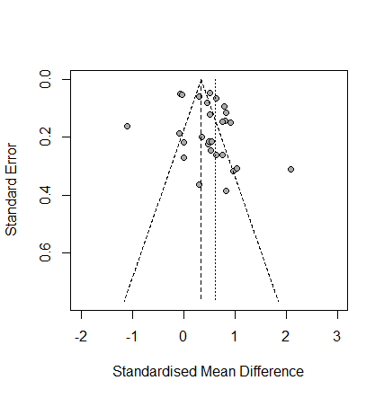
Supplementary Figure 2i
Notes:
Supplementary Figure 2i Funnel plot for the comparison of circulating FGF-21 between patients with NAFLD and controls, in studies without histological confirmation of NAFLD
Abbreviations: FGF-21, fibroblast growth factor-21; NAFLD, nonalcoholic fatty liver disease; n, number of studies included in the analysis

Slide 10
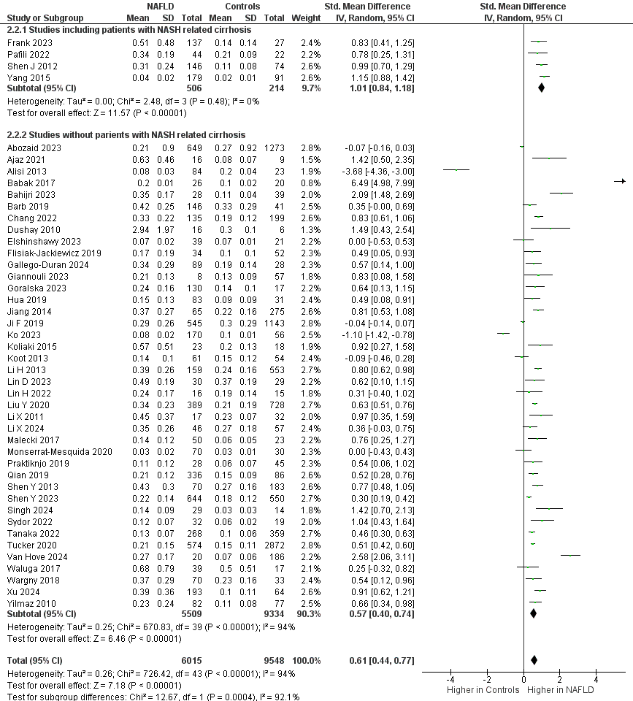
Supplementary Figure 2j
Notes:
Supplementary Figure 2j Forest plot for the comparison of FGF-21 levels between patients with NAFLD and controls, in subgroup analysis within studies with and without the inclusion of patients with NASH-related cirrhosis
Abbreviations: CI, confidence intervals; FGF-21, fibroblast growth factor-21; IV, inverse variance; n, number of studies included in the analysis; NAFLD, nonalcoholic fatty liver disease; SD, standard deviation

Slide 11
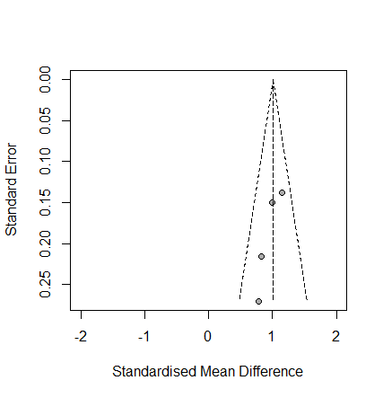
Supplementary Figure 2k
Notes:
Supplementary Figure 2k Funnel plot for the comparison of circulating FGF-21 between patients with NAFLD and controls, in studies with the inclusion of patients with NASH-related cirrhosis
Abbreviations: FGF-21, fibroblast growth factor-21; NAFLD, nonalcoholic fatty liver disease; NASH, nonalcoholic steatohepatitis; n, number of studies included in the analysis

Slide 12
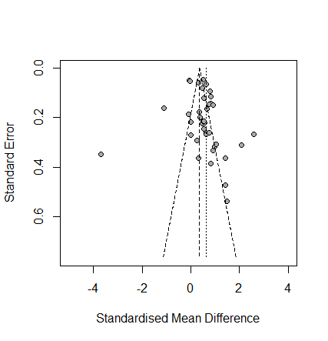
Supplementary Figure 2l
Notes:
Supplementary Figure 2l Funnel plot for the comparison of circulating FGF-21 between patients with NAFLD and controls, in studies without the inclusion of patients with NASH-related cirrhosis
Abbreviations: FGF-21, fibroblast growth factor-21; NAFLD, nonalcoholic fatty liver disease; NASH, nonalcoholic steatohepatitis; n, number of studies included in the analysis

