Slide 1
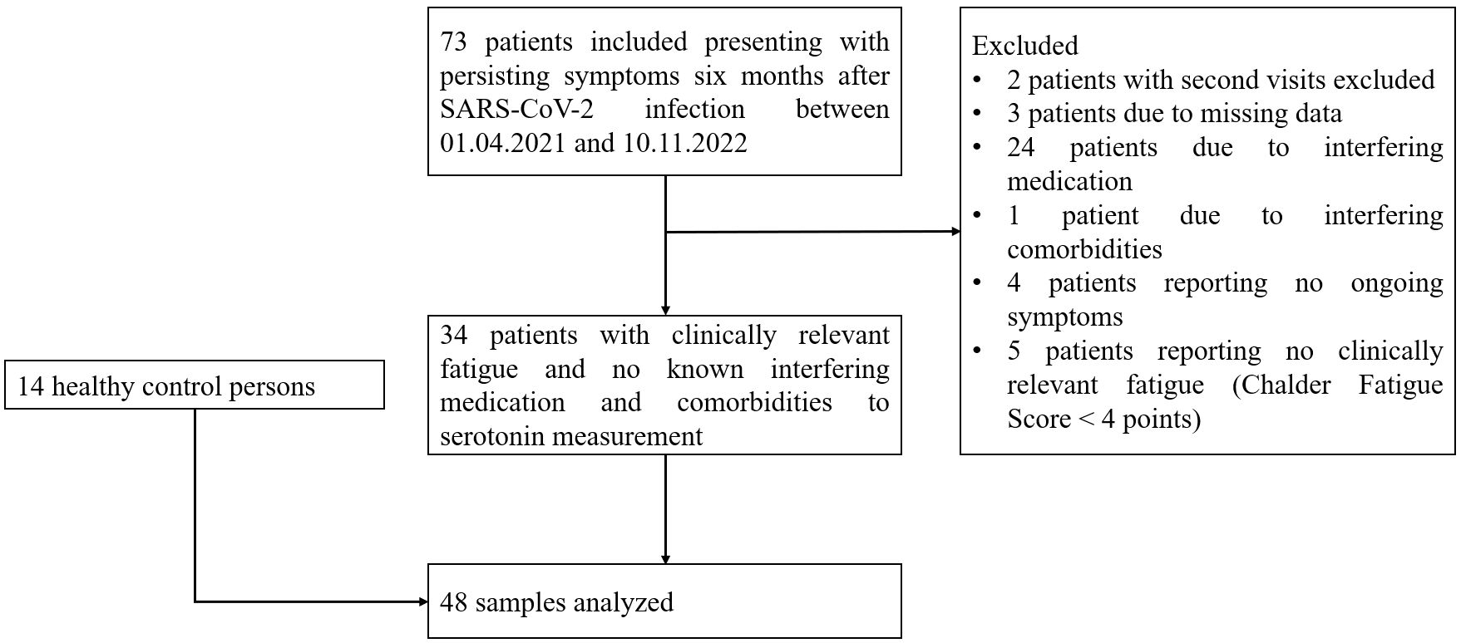
Supplemental Fig. 1: Flowchart of patient inclusion

