Slide 1
Supplementary Exhibit 6 - Wearables and Robots Images for Interviews
Title: Attitudes Towards the Adoption of Remote Patient Monitoring and Artificial Intelligence in Parkinson's Disease Management: Perspectives of Patients and Neurologists
Journal: The Patient – Patient-Centered Outcomes Research
Main and Corresponding author: Carlos Antonio Godoy Junior, MD, MSc
Erasmus School of Health Policy and Management, Erasmus University Rotterdam, Rotterdam, Netherlands
Email: godoyjunior@eshpm.eur.nl
ORCID: 0009-0008-0871-459X
Address: Burgemeester Oudlaan 50, 3062 PA Rotterdam
Tel. +31 10 4088867

Slide 2
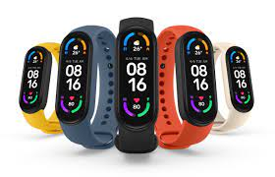
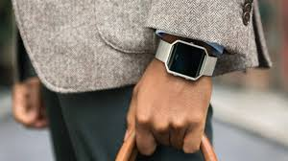
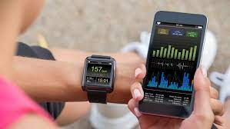
Wearables
Supplementary Exhibit 6 - Wearables and Robots Images for Interviews

Slide 3
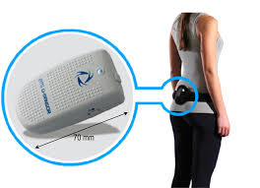
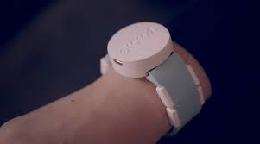
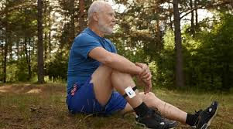
Wearables for Clinical Applications
Supplementary Exhibit 6 - Wearables and Robots Images for Interviews

Slide 4
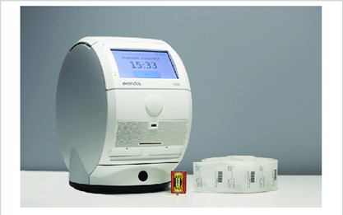
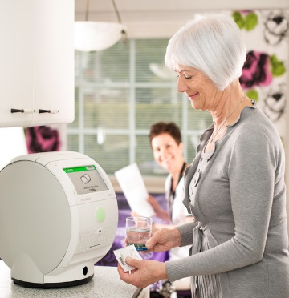
Robotics
Supplementary Exhibit 6 - Wearables and Robots Images for Interviews

