Slide 1
Electronic supplementary material
IDEATE manuscript

Slide 2
Supplementary Figure 1: Data linkage and flow into SeRP
Abbreviations: SeRP = The Secure e-Research Platform; NHS =National Health Service; CANISC = Cancer Network Information System Cymru; DHCW = Digital Health and Care Wales; ONS =Office for National Statistics; APC = Admitted Patient Care; OPA = Outpatient Appointments; EDD = Emergency Department Dataset; IDEATE = Innovation in Data to Evolve Agreements That Enhance patient health outcomes

Slide 3
Supplementary Figure 2: Illustration of (a) a linear payment model with 100% cap and
(b) a threshold payment model with a 100% cap
a)
b)
Linear Measurement
Threshold Measurement
= Benchmark
= Measurement
= Target
= Payment cap
= Benchmark
= Measurement
= Payment cap

Slide 4
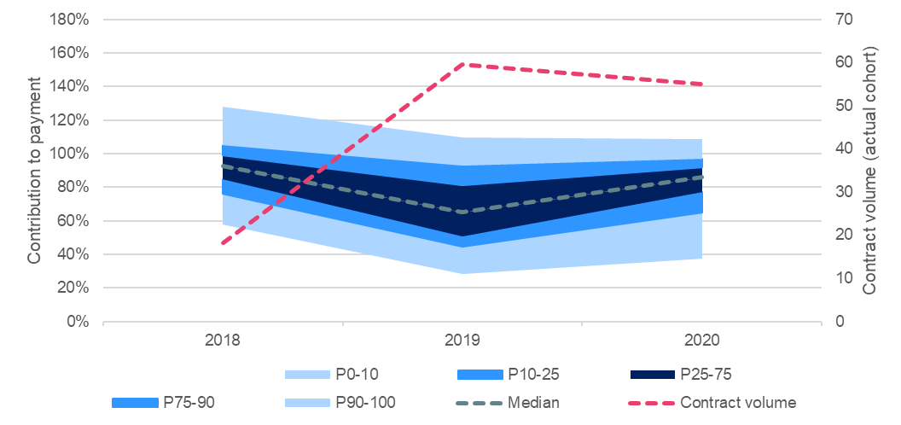
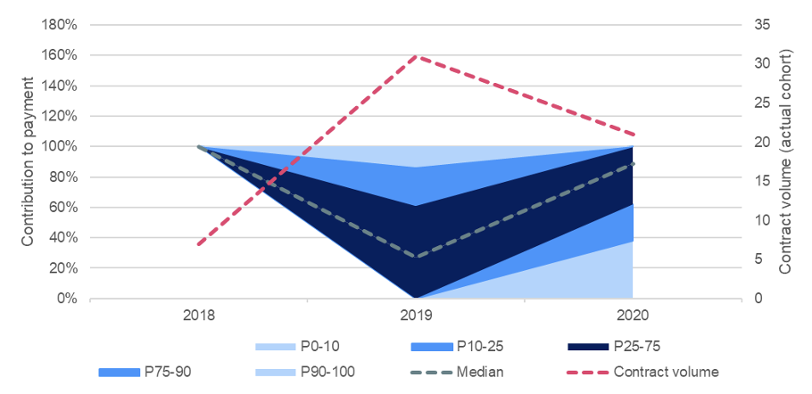
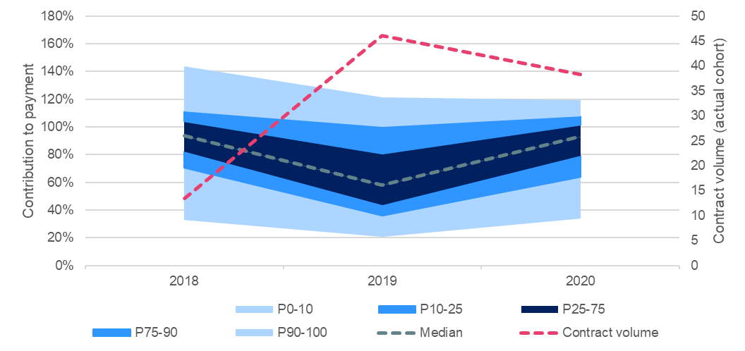
Supplementary Figure 3. All three OBA scenarios using a population-based, linear payment model with the M1 treatment cohort (2018-2020), including volatility analysis
a) Primary scenario, all outcomes
c) One year survival
b) One year survival and days disrupted by care
Abbreviations: OBA= Outcomes-based agreement; M1 = metastatic disease at inclusion, P = Percentile

