Slide 1
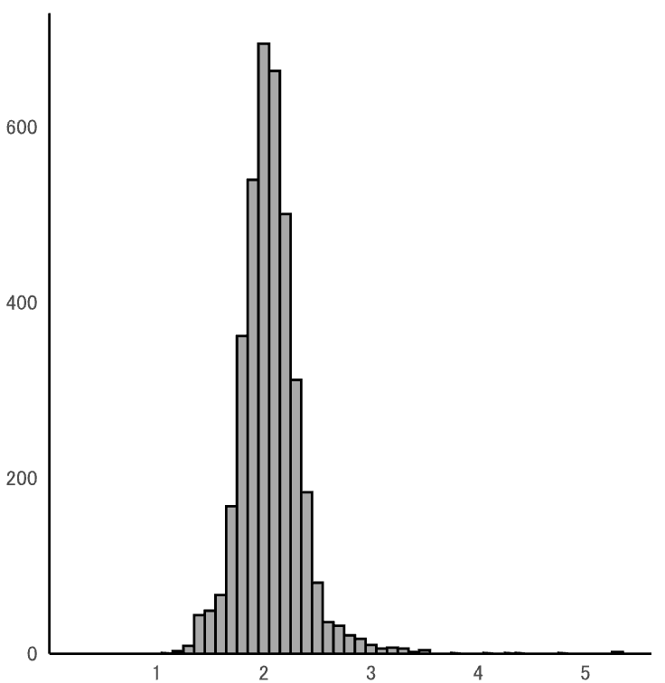
600
400
data count
200
0
1.0
2.0
3.0
4.0
5.0
serum Mg (mg/dL)

