Slide 1
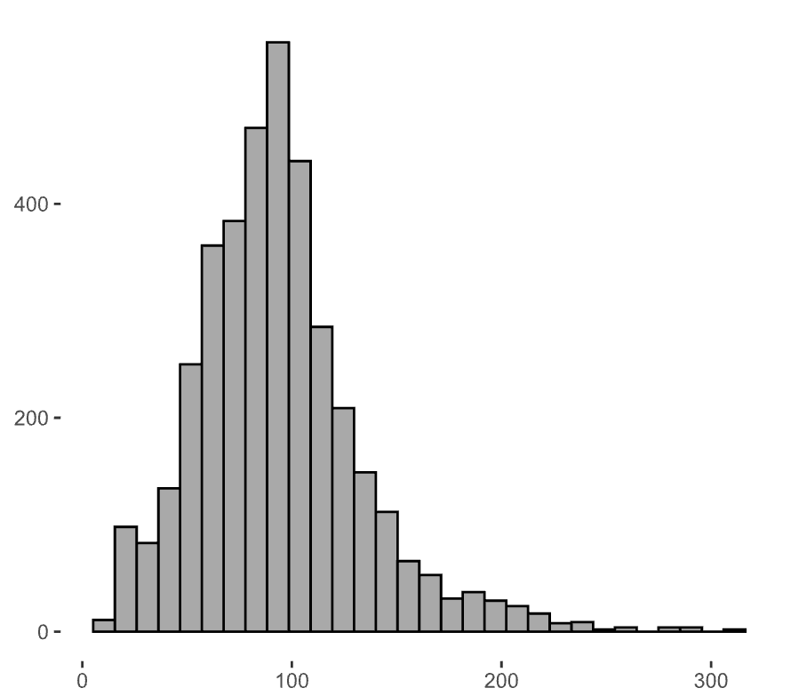
400
Frequency (data)
200
0
0
100
200
300
eGFR (mL/min/1.73 m²)
Notes:
eGFR, estimated glomerular filtration rate

