Slide 1








Figure S1
- ascr#18
- ascr#18
- ascr#18
- ascr#18
Zentos
C. Spring
Arina LR
Chinofuz

Slide 2
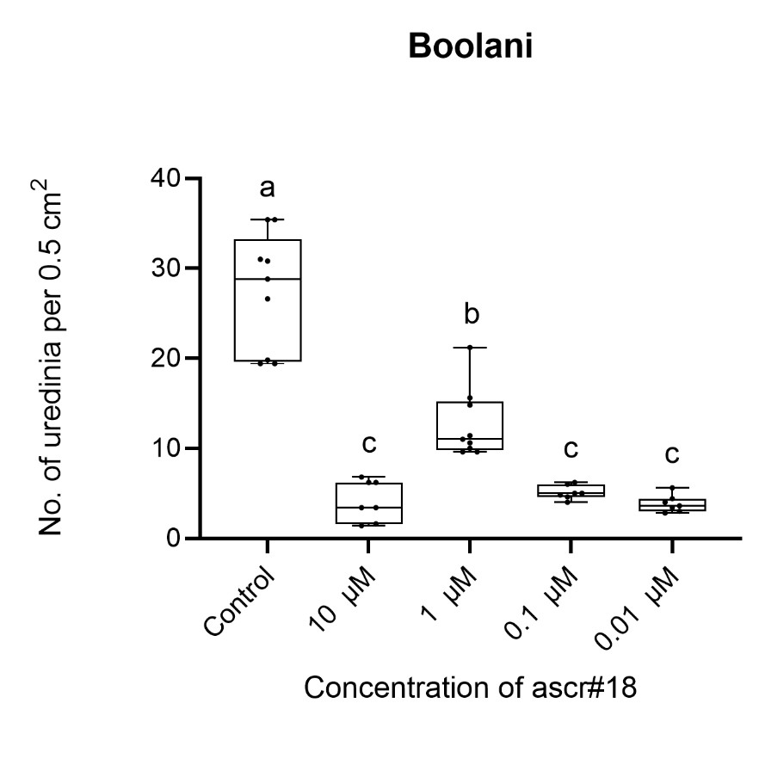
Figure S2

