Slide 1
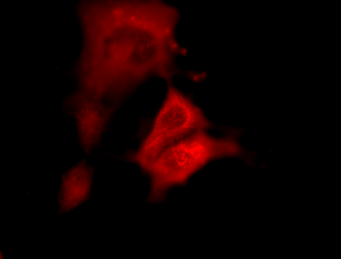
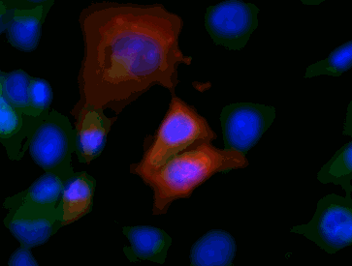
Supplementary figure 1
LINH patient serum
V5
DAPI
Merge
COS-7 cells transfected
with full-length human RPH3A
Untransfected
COS-7 cells
Supplementary figure 2
Healthy subject serum
V5
DAPI
Merge
COS-7 cells transfected
with full-length human RPH3A
Untransfected
COS-7 cells

Slide 2
Supplementary figure 3
Patient serum (Case1)
V5
DAPI
Merge
COS-7 cells transfected
with full-length human RPH3A
Untransfected
COS-7 cells
Supplementary figure 4
Patient serum (Case2)
V5
DAPI
Merge
COS-7 cells transfected
with full-length human RPH3A
Untransfected
COS-7 cells

