Slide 1
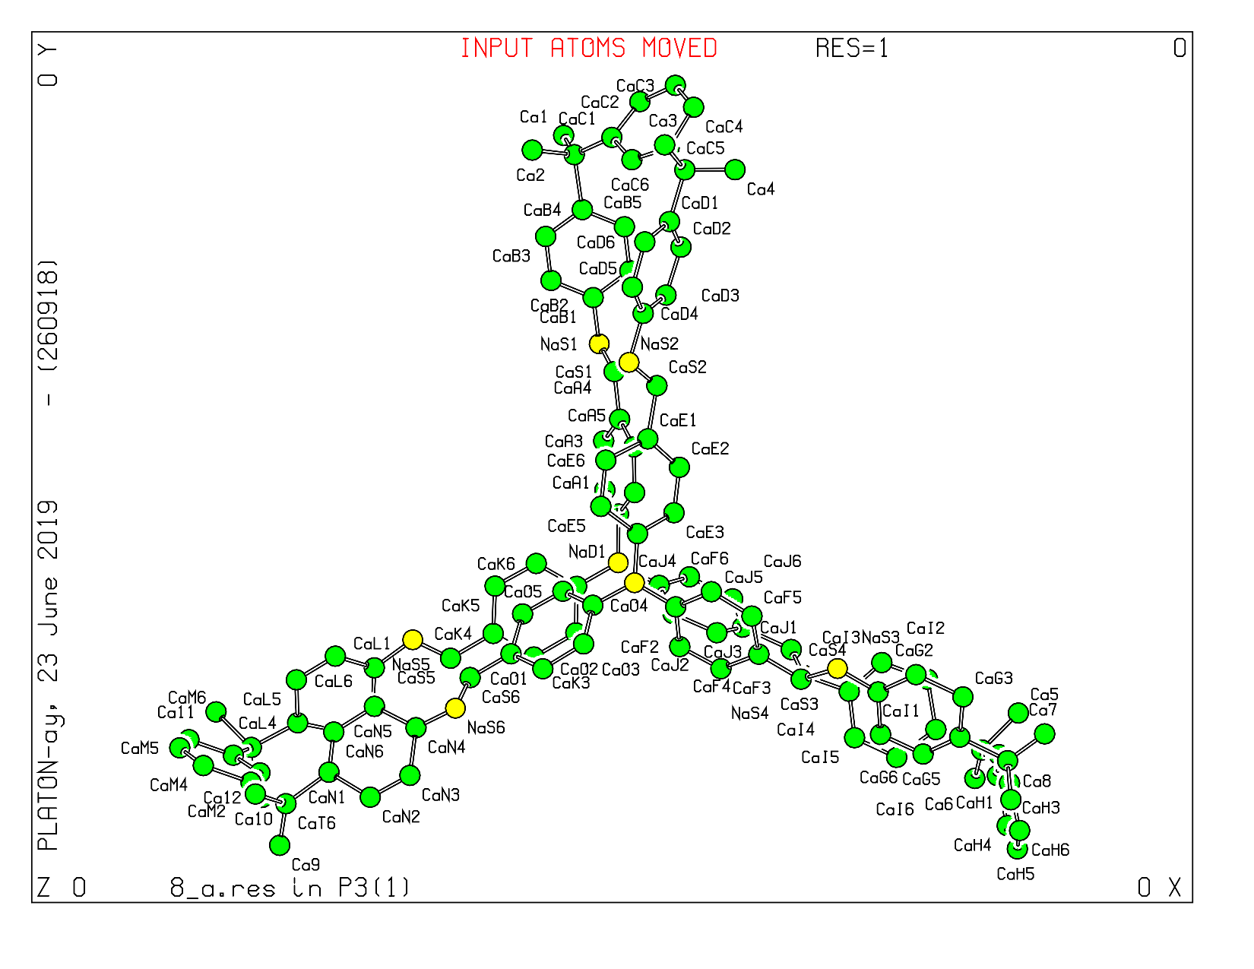
Figure S1: Monomeric unit of labelled Imine based macrocyclic cage.

Slide 2
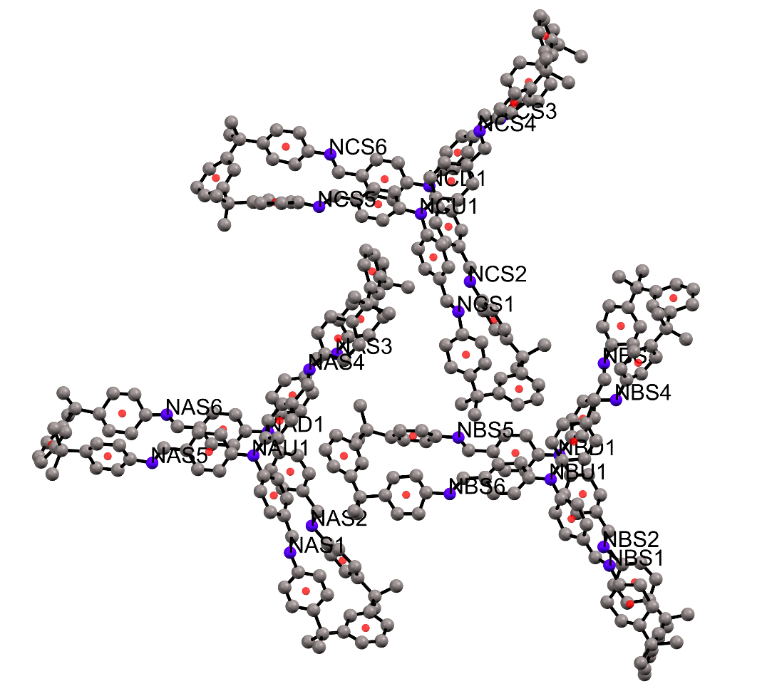
Figure S2: Average distance between nitrogen atoms of imine linker connected by three gem-dimethyl moiety.

Slide 3
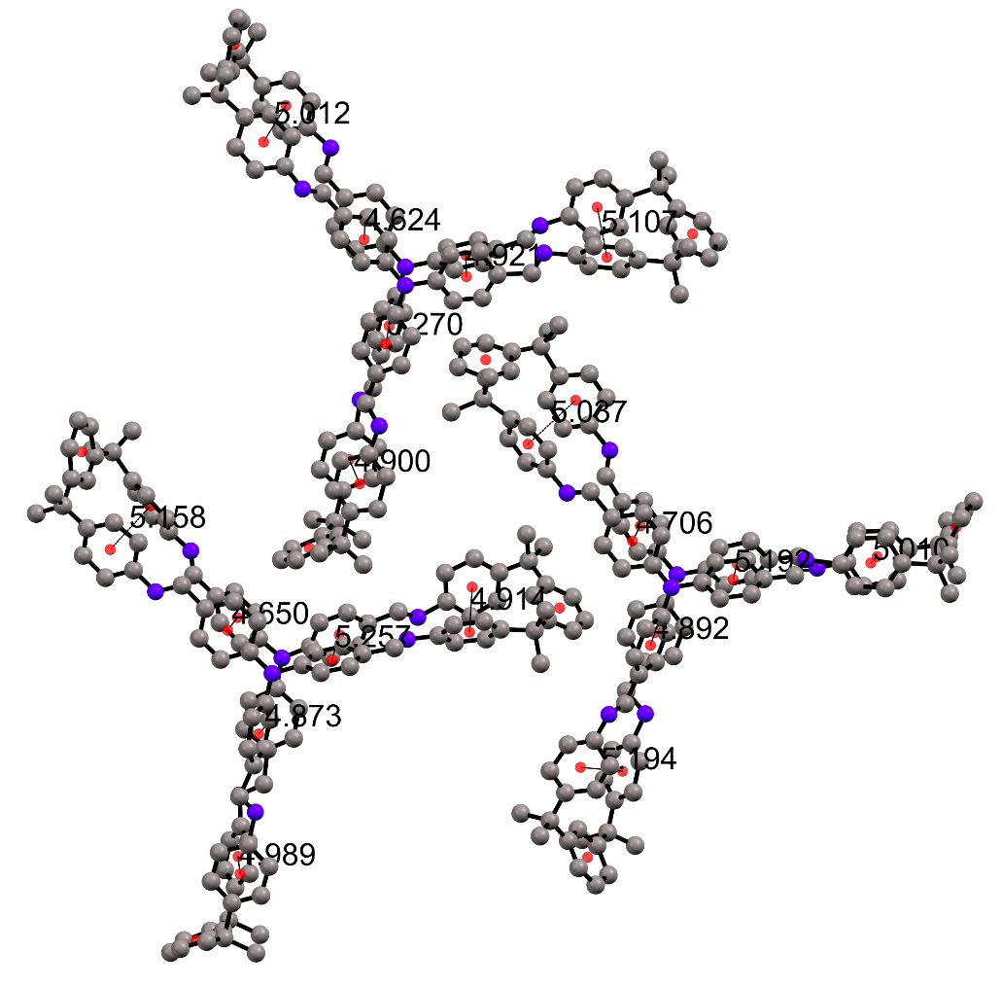
Figure S3: Residual Distance plot of inter phenyl centroid plane in imine macrocyclic cage.

Slide 4
Figure S4: Contact map of IMC with molecular packing interaction patterns. Orange colour shows largely hydrophobic and pi-pi interactions and blue colour shows interactions due to uncharged amine group.

Slide 5
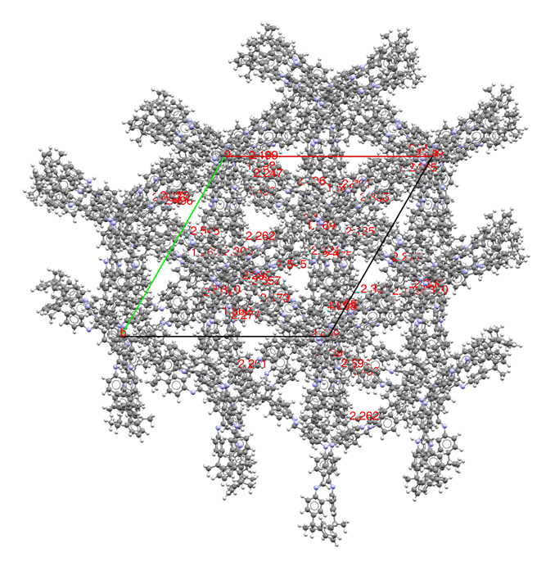
Figure S5: Molecular arrangement of IMC in close proximity with distance map where the molecules are closely packed under 2.3 Å giving spatial stability.

Slide 6
Figure S6: Contact surface and void space calculated with probe radius 1.2 Å shown in solid surface with IMC molecules represented in ball and stick representation.

Slide 7
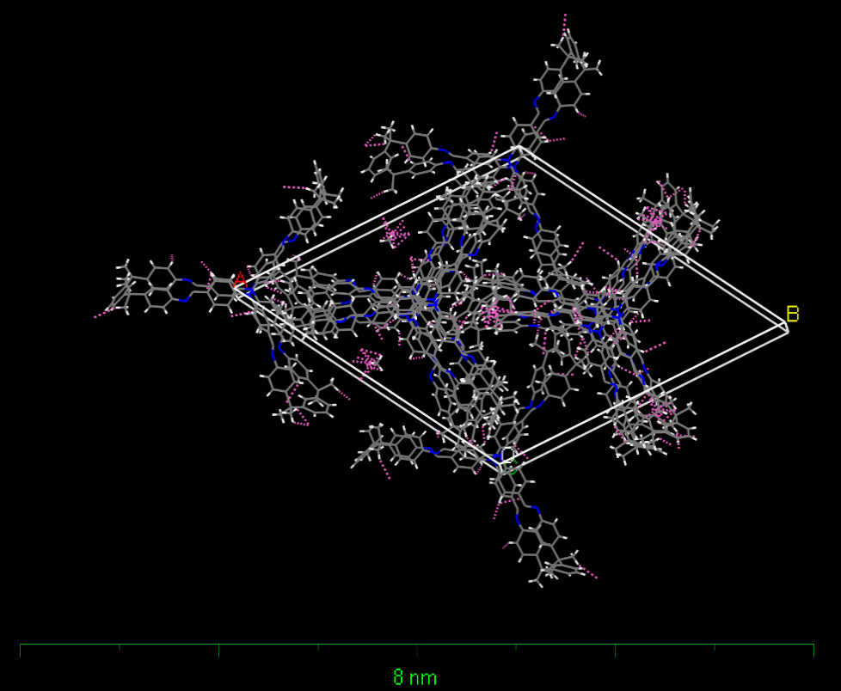
Figure S7: Unit cell of IMC packed with 15 molecule with interacting contact dotted lines.

Slide 8
Figure S8: The packing fraction of IMC with first three clusters represented by lattice energies shown in red dotted lines.

