Slide 1
Proppants
Fracture

Slide 2
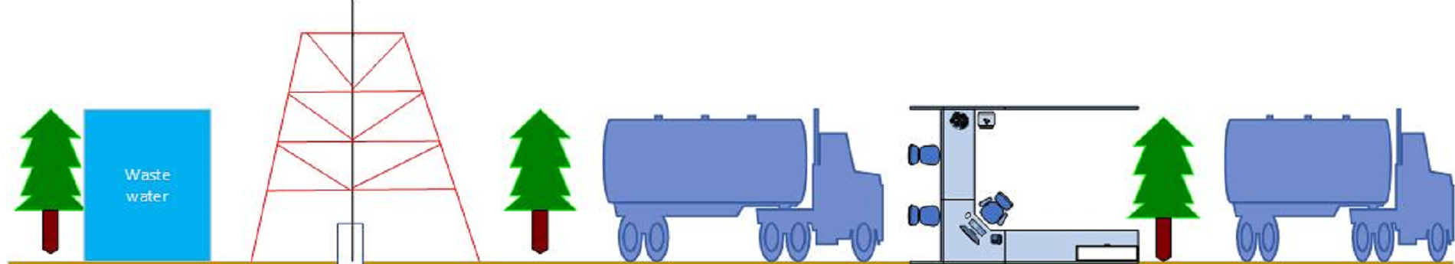
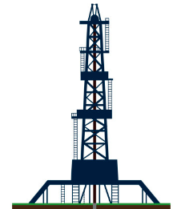
Storage and transportation of fracturing fluid and solid particles
Air pollution
Landfall of Returned Materials and Solid Landfill Pollution
节流
岩层
Leakage due to casing damage
岩层
Leakage from the formation
岩层
Induced earthquake

Slide 3

Storage and transportation of fracturing fluid and solid particles
Landfall of Returned Materials and Solid Landfill Pollution
节流
岩层
Leakage due to casing damage
岩层
Leakage from the formation
岩层

Slide 4
节流
岩层
岩层
岩层

Slide 5
TANK
节流
岩层
岩层
岩层

Slide 6
井井流
TANK
节流
岩层
岩层
岩层

Slide 7
井井流
TANK
节流
岩层
岩层
岩层

Slide 8
井井流
TANK
节流
岩层
岩层
岩层

Slide 9



Slide 10
Natural gas
Fracturing fluid
Pore pressure diffusion
Aseismic creep
Primary fault

Slide 11
Natural gas
Fracturing fluid
Pore pressure diffusion
Aseismic creep
Primary fault

