Slide 1
Fig S1 Distribution of SNPs in WW (grey) and SW (black) in A, B and D Genomes

Slide 2
Fig S2 Frequency distribution of initial germination (IG) (a), germination after AA (GAA) (b) and CD (GCD) (c) in WW.
Black arrows indicate mean

Slide 3
Fig S3 Frequency distribution of initial germination (IG) (a), germination after AA (GAA) (b) and CD (GCD) (c) in SW.
Black arrows indicate mean

Slide 4
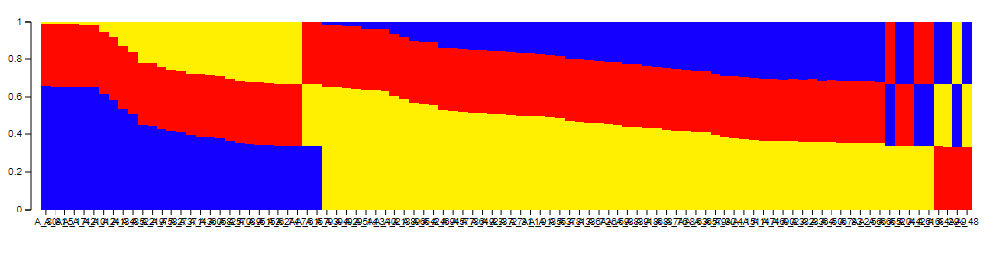
Figure S4 Distribution of WW accessions in three Q groups as identified from STRUCTURE

Slide 5
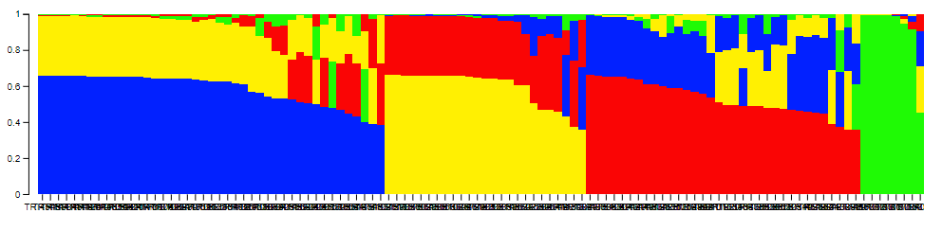
Figure S5 Distribution of SW accessions in four Q groups as identified from STRUCTURE

