Slide 1
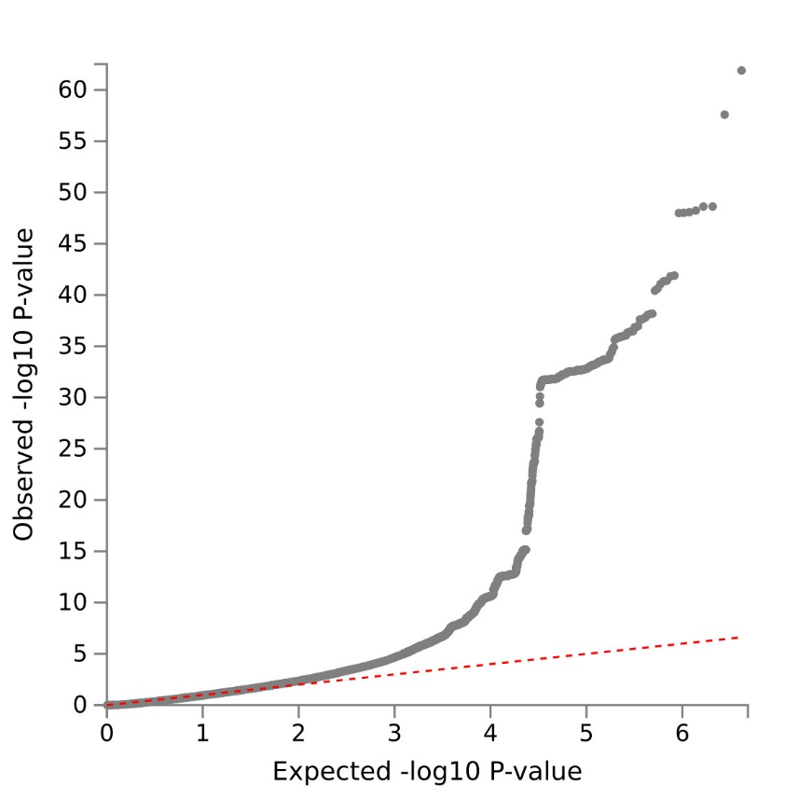
Supplementary Figure 1: The Q-Q plot of the GWAS meta-analysis on headaches

