Slide 1
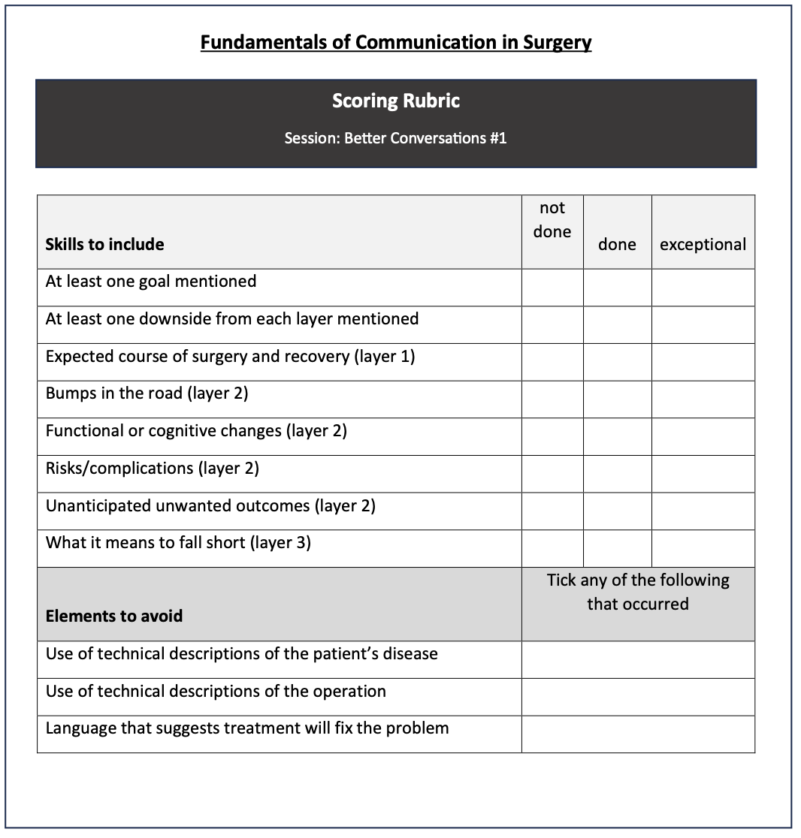
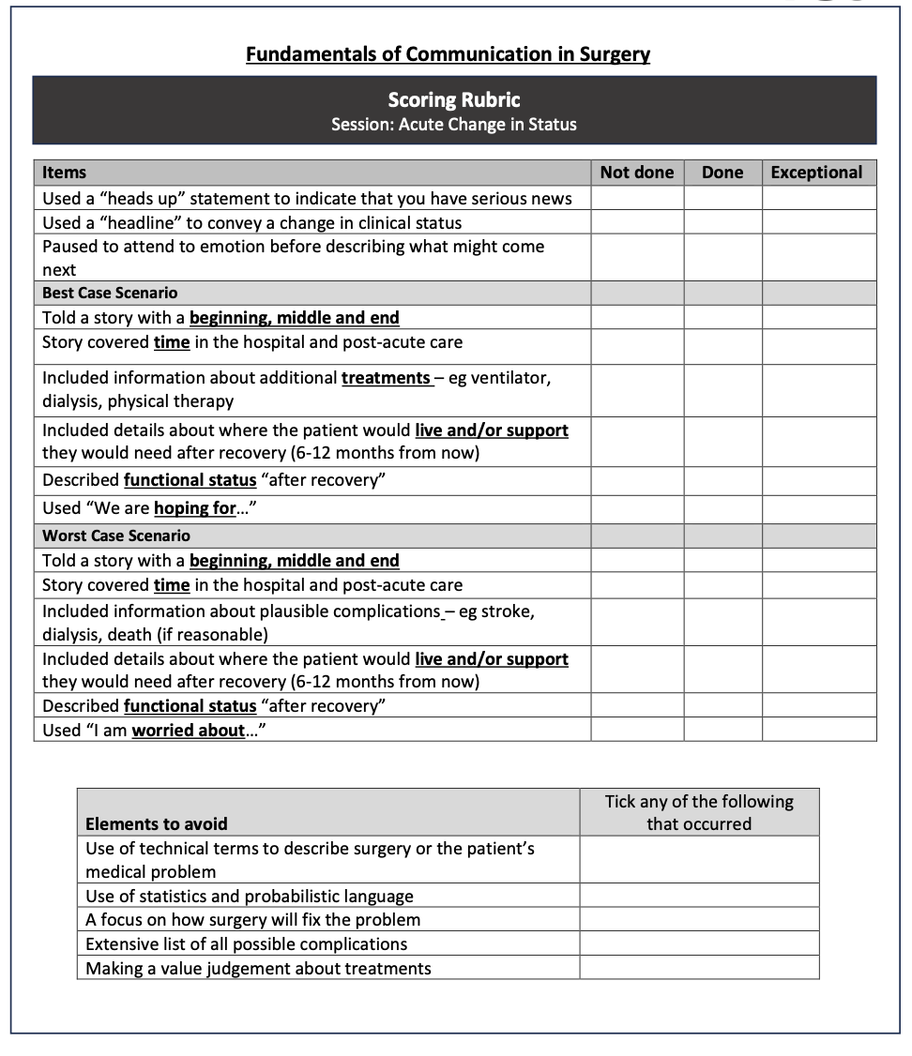
(a)
(b)
Fig. 6a Scoring Rubric used for Better Conversations #1 peer-evaluation role play exercise, and Fig. 6b Scoring Rubric used for Acute Change in Status peer-evaluation role play exercise, both demonstrating key elements of the core communication skills and elements to avoid to demonstrate competence.
Notes:
Supplemental figure 6

