Slide 1
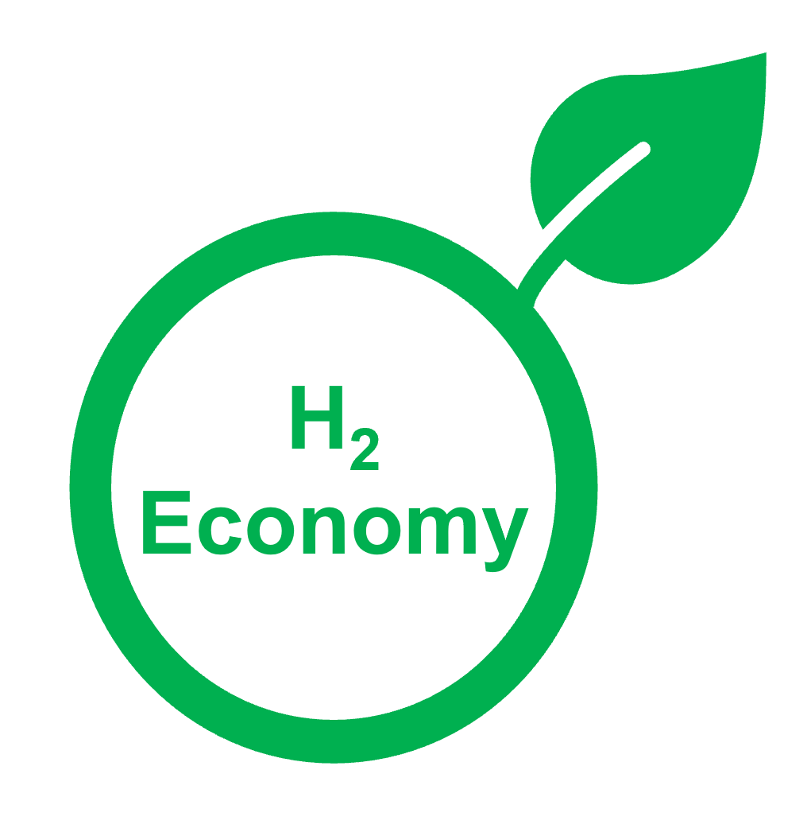
vs.
80% of global energy consumption
Low production rate & high cost
Greenhouse gas emission
Versatility across various fields
Clean energy source
Air pollution

Slide 2

Blue
Grey
H₂
H₂
produced from natural gas or methane
produced from natural gas, but carbon dioxide emissions are captured
Turquoise
Green
H₂
H₂
produced by pyrolyzing methane
produced using renewable energy

Slide 3

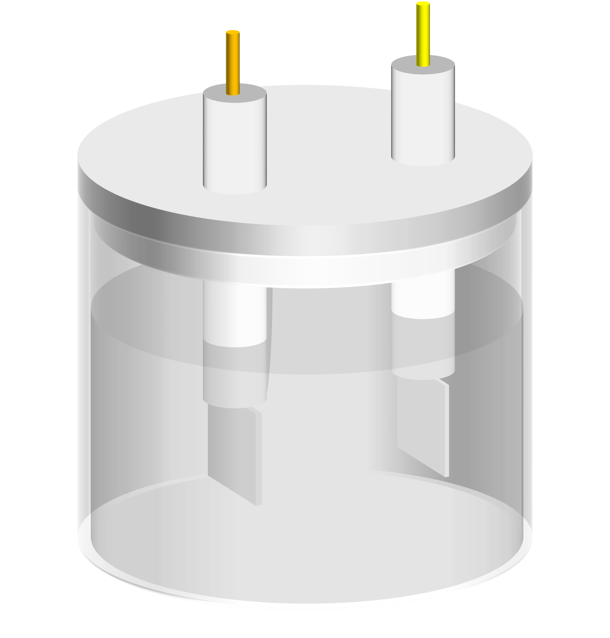



Advanced H₂ Generation Methods
e⁻
e⁻
e⁻
2O₂+ 4H⁺
O₂
H₂
O₂
H₂
H⁺
H⁺
2H₂O₂
O₂
O₂
2H₂O
H⁺
2H₂O
H⁺
2H₂O
H₂
H₂
Cathode
(Photo)Cathode
2H₂O
Anode
(Photo)anode
Electrochemical Water Splitting
Photoelectrochemical Water Splitting
Photothermal
Water Splitting
Photocatalytic
Water Splitting

Slide 4

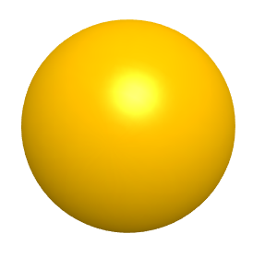


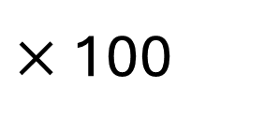
Photons
Light Absorption
H₂O
1
H₂
Photoexcitation
2
h⁺
Surface Redox Reactions
3
4
e⁻
Surface Redox Reactions
4
Charge Separation/Migration
O₂
H⁺
Light
2H₂O
2H₂+O₂
Photocatalyst
Apparent Quantum Efficiency (AQE):
AQE(%)=
$2×$ Number of hydrogen molecules generated
$×$ 100
Number of incident photons in light

Slide 5
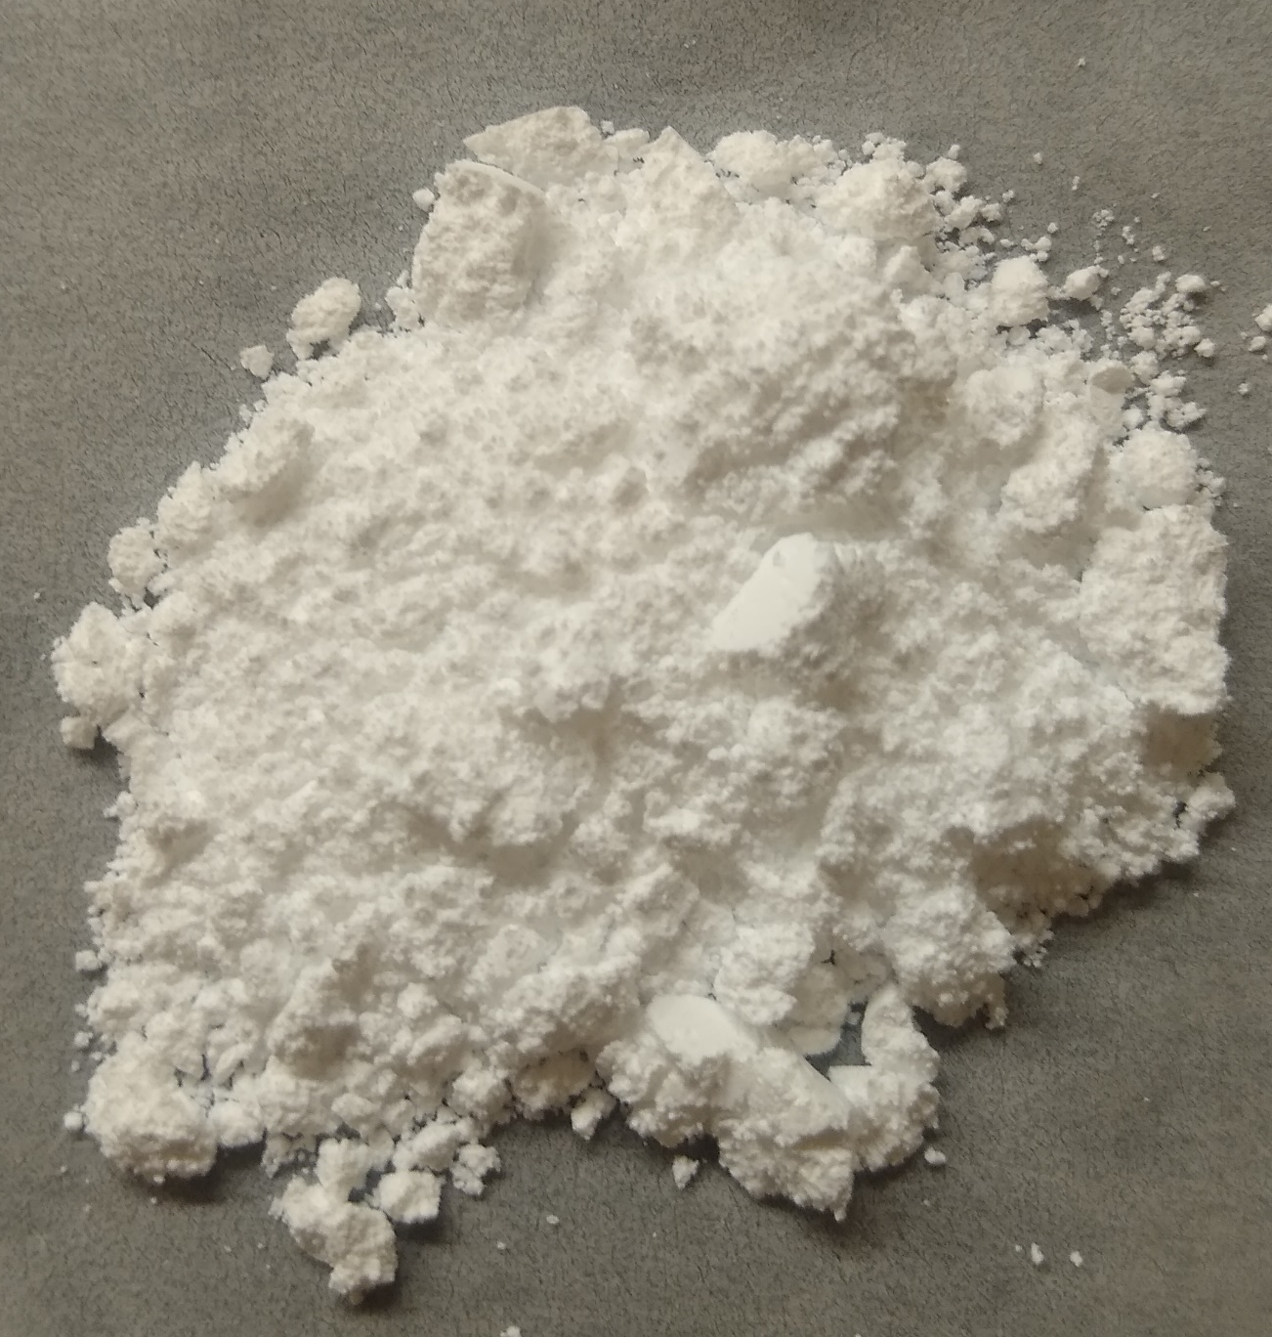
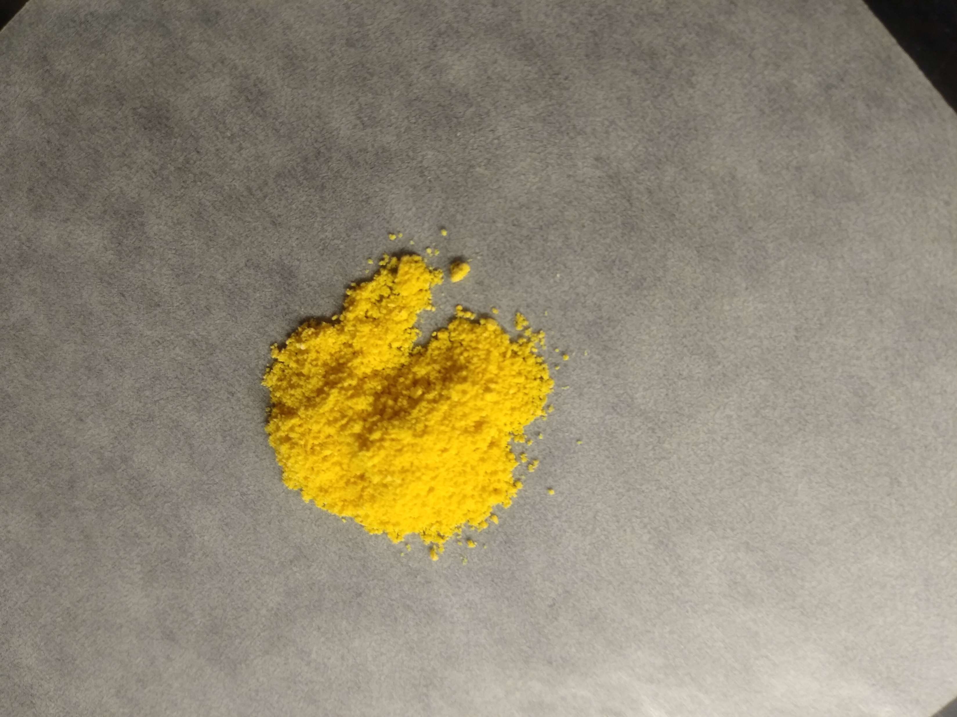
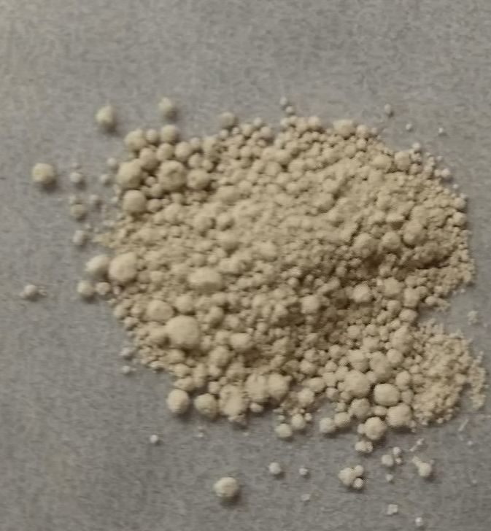
Potential (V vs. NHE)
Photocatalyst Bandgap Diagram
Photocatalyst Characterization
Methods
-2.0
Photons
e⁻
-1.0
e⁻
e⁻
SEM/TEM
0.0
H⁺/H₂
UV-Vis Spectroscopy
1.0
XRD
O₂/H₂O
PL Spectroscopy
2.0
h⁺
3.0
and many other methods
h⁺
h⁺
4.0
TiO₂
g-C₃N₄
SrTiO₃

Slide 6
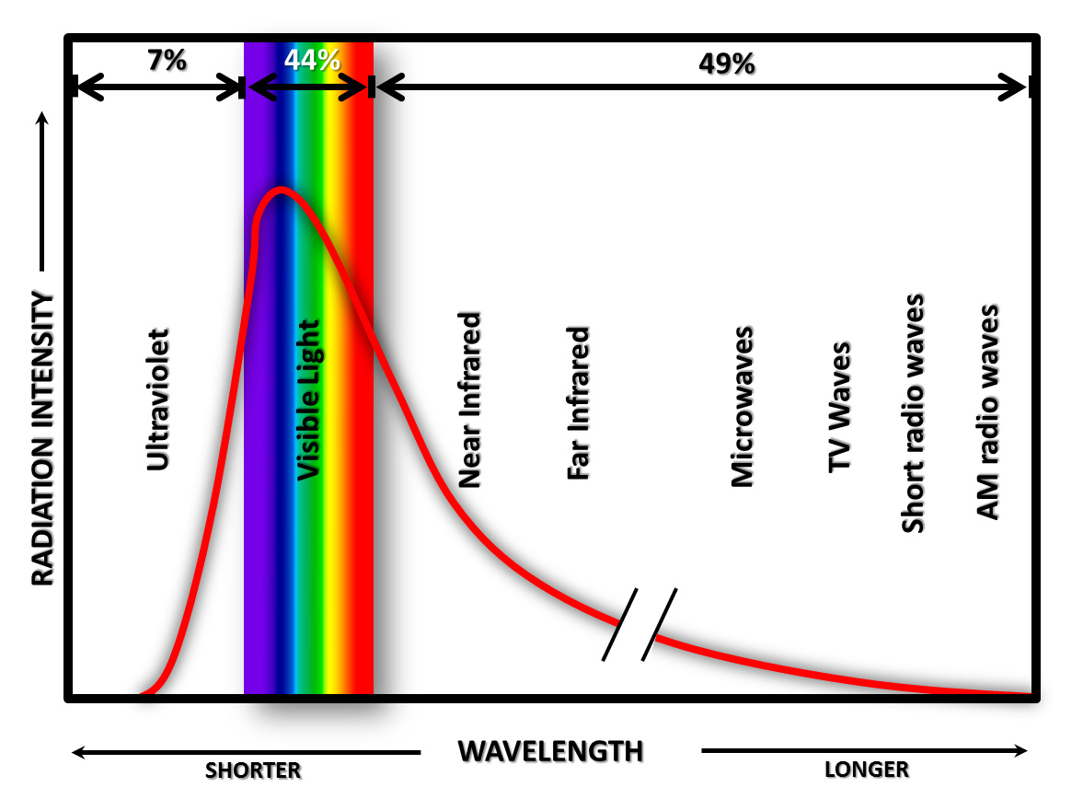
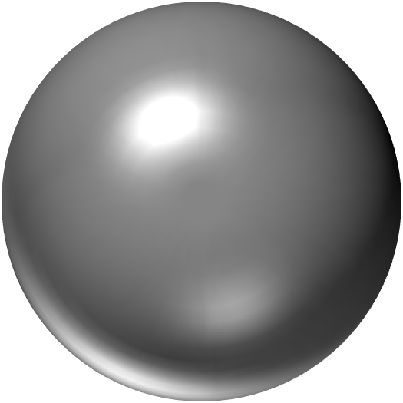
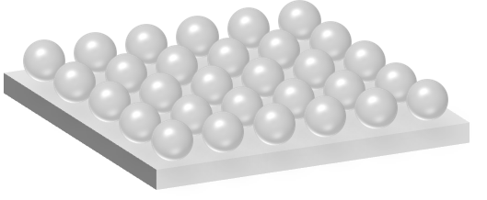

Key Factors Affecting Photocatalyst Efficiency
Light Absorption/Intensity
Exposed Area to Light
Charge Carrier Dynamics
Reaction Environments
pH, temperature,
ions, etc.
h⁺
e⁻

