Slide 1
<Discover Oceans>
Sequence-based identification and characterization of mer operon-related genes from Kongsfjorden sediments
Bhavya Kachiprath^{1,2}*, Neelima Surendran¹, Sajeevan Thavarool Puthiyedathu¹, Chaithanya Earath Ramachandran¹ and Rosamma Philip¹
¹Dept. of Marine Biology, Microbiology & Biochemistry, Cochin University of Science and Technology, Cochin - 682016, Kerala, India.
²Dept. of Marine Science, College of Natural Sciences, Incheon National University, Incheon - 22012, Republic of Korea.
*Corresponding author: Bhavya Kachiprath, Department of Marine Biology, Microbiology and Biochemistry, School of Marine Sciences, Cochin University of Science and Technology, Fine Arts Avenue, Kochi - 682 016, Kerala, India.
Phone: +916282358224; E-mail: bhavyacusat@gmail.com; bhavyainu@gmail.com

Slide 2
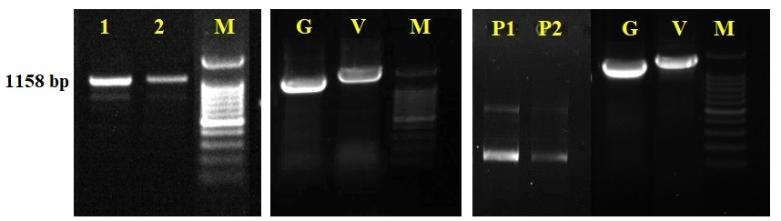
Fig. S1
a
b
c

Slide 3
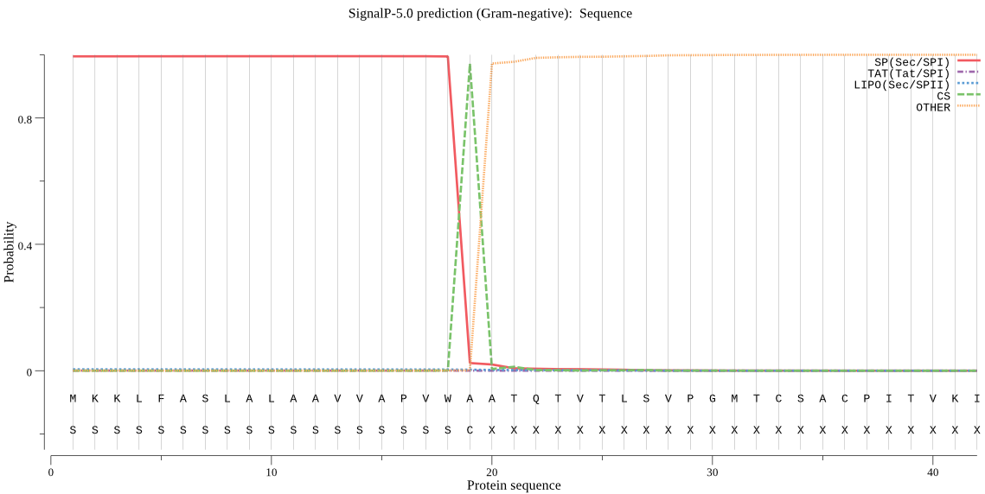
Fig. S2

Slide 4
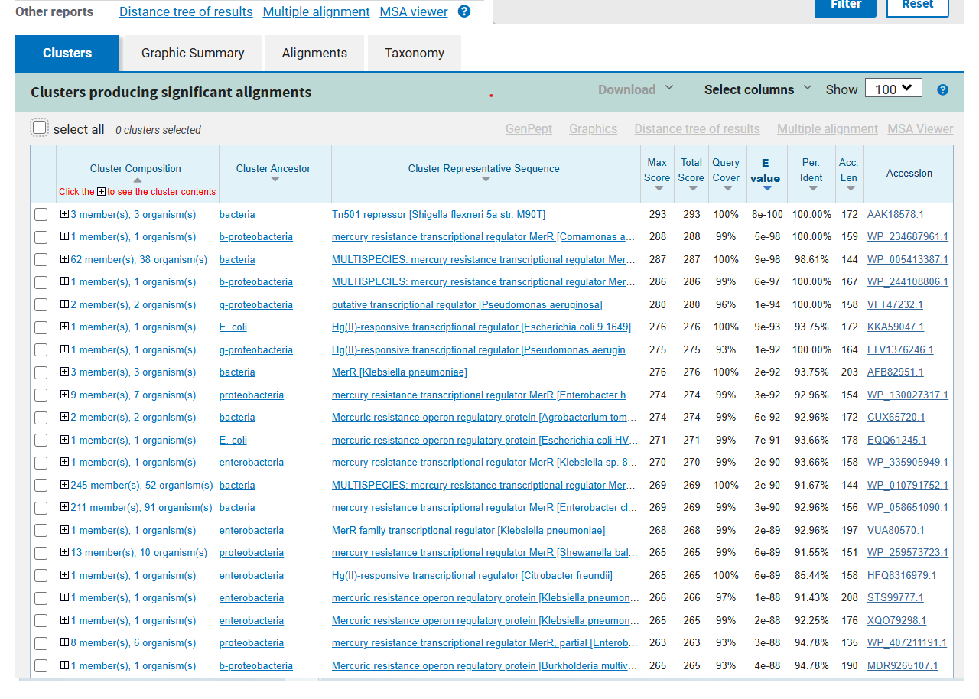
Fig. S3

Slide 5
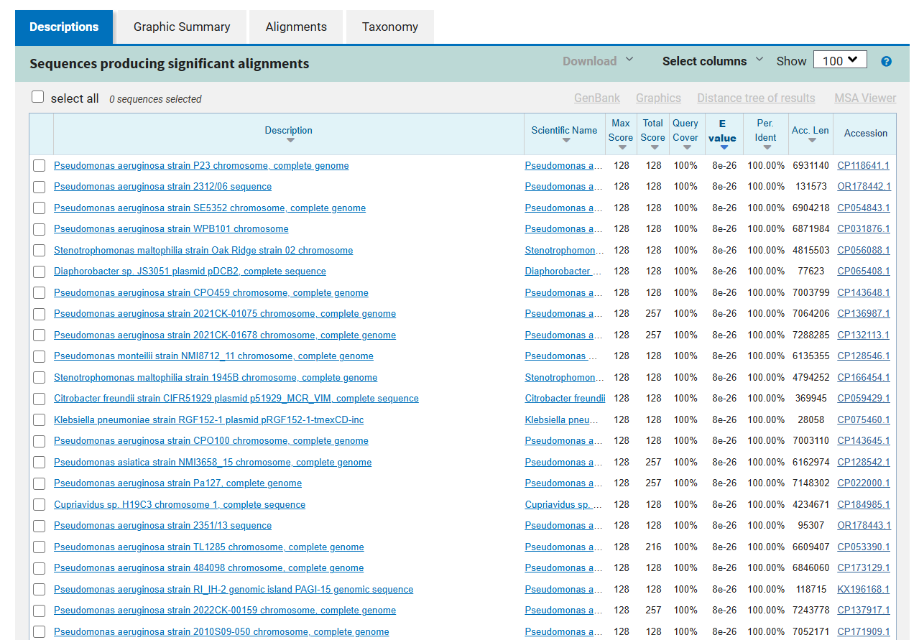
Fig. S4

Slide 6
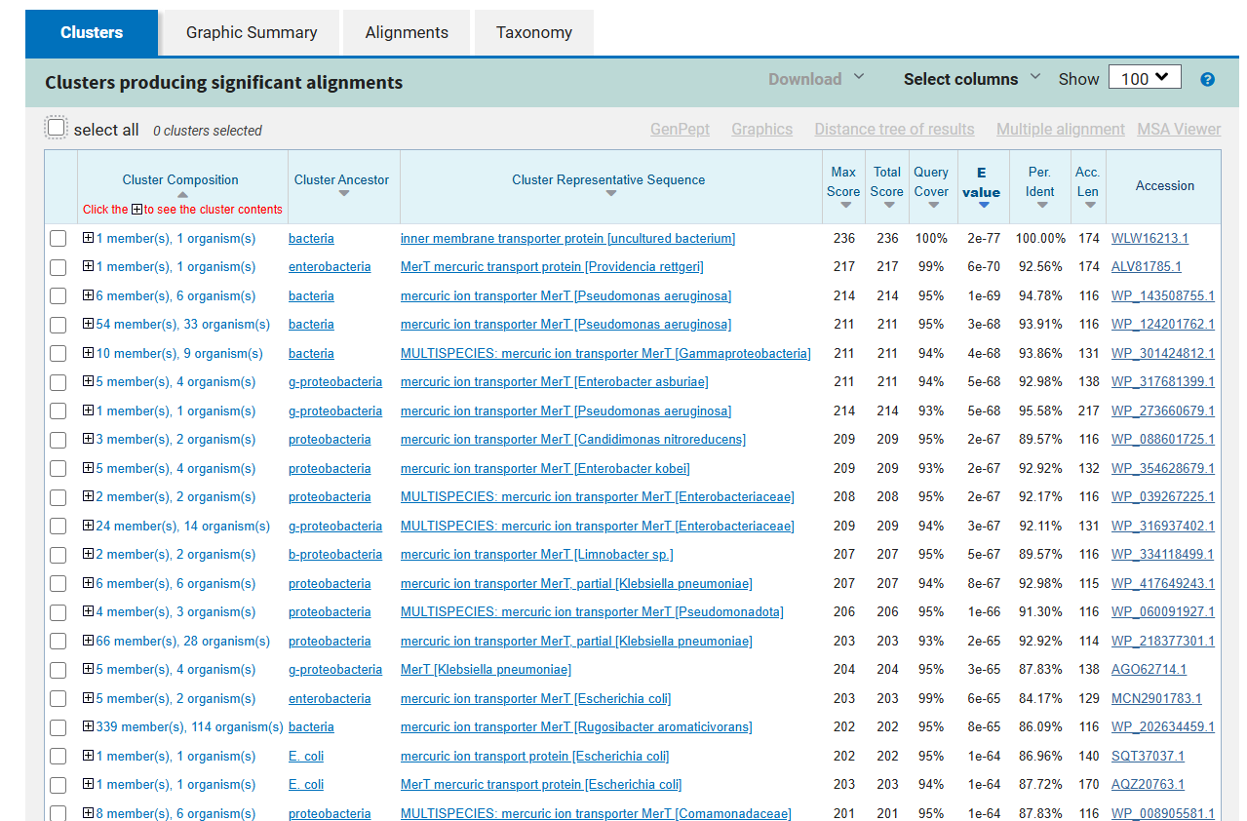
Fig. S5

Slide 7
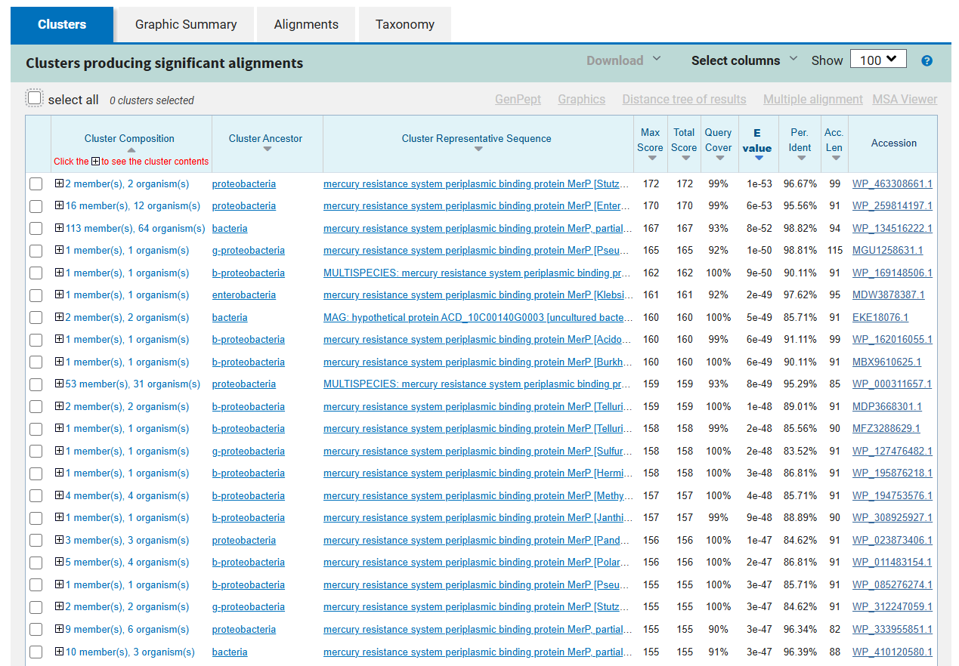
Fig. S6

Slide 8
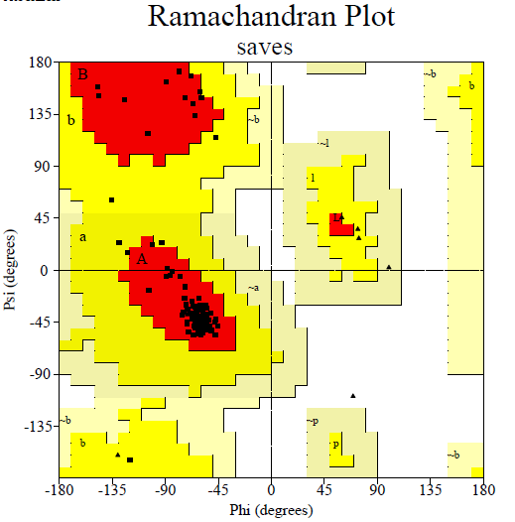
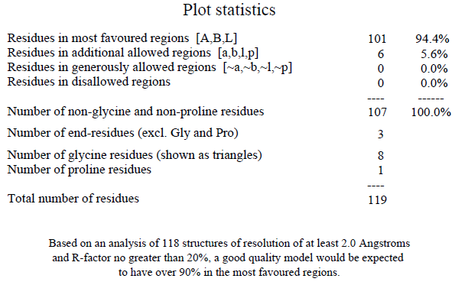
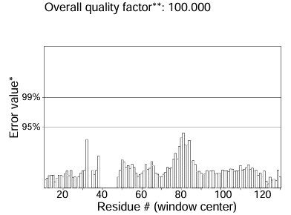
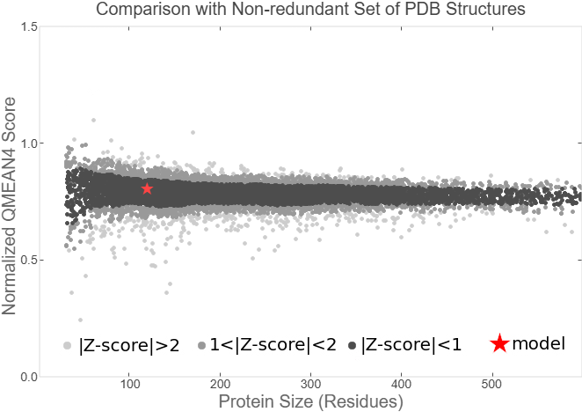
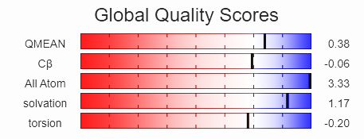
Fig. S7
a
b
c
d

Slide 9
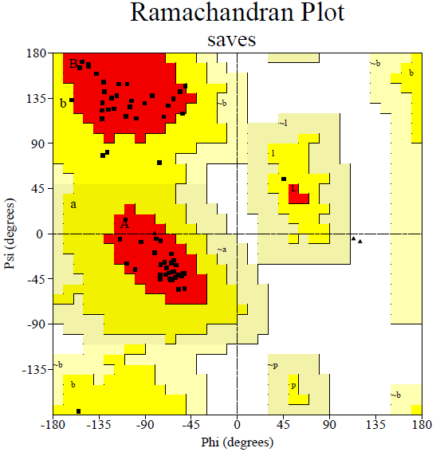
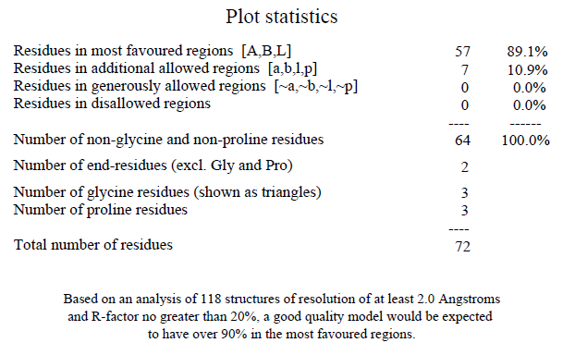
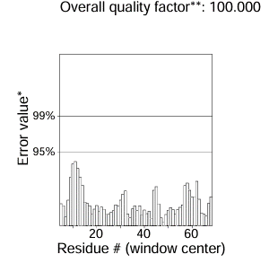
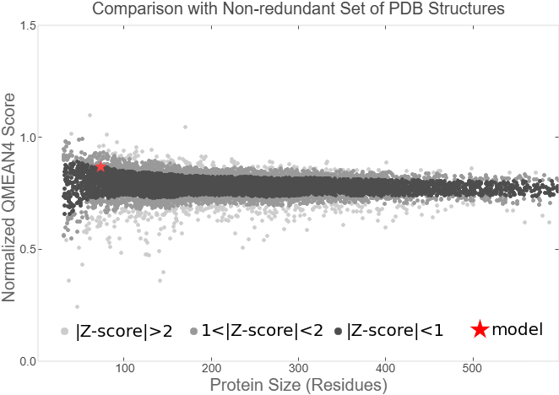
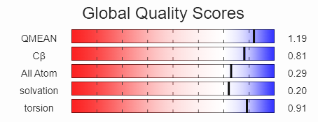
Fig. S8
a
b
c
d

