Slide 1
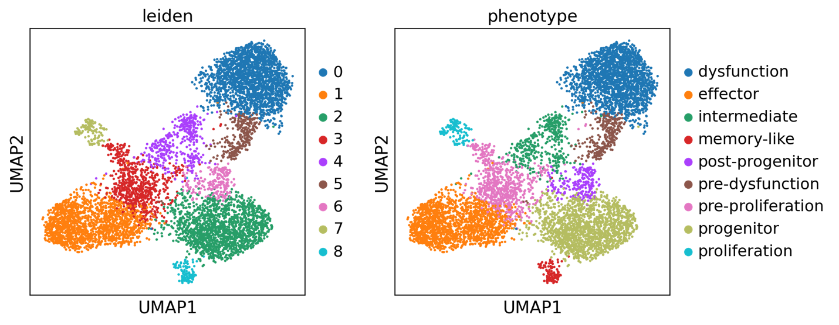
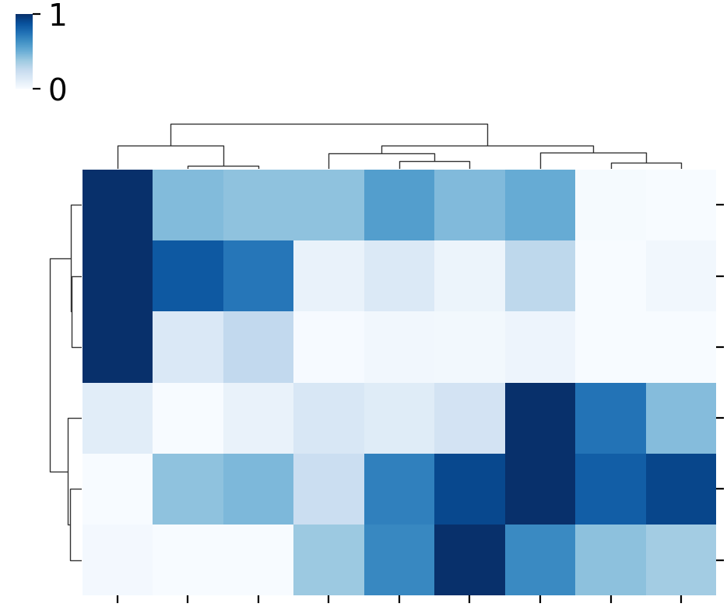
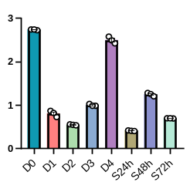
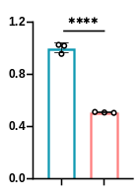
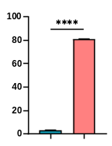
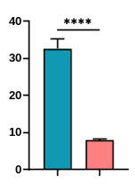
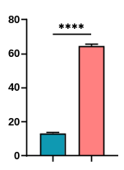
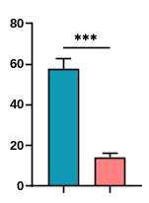


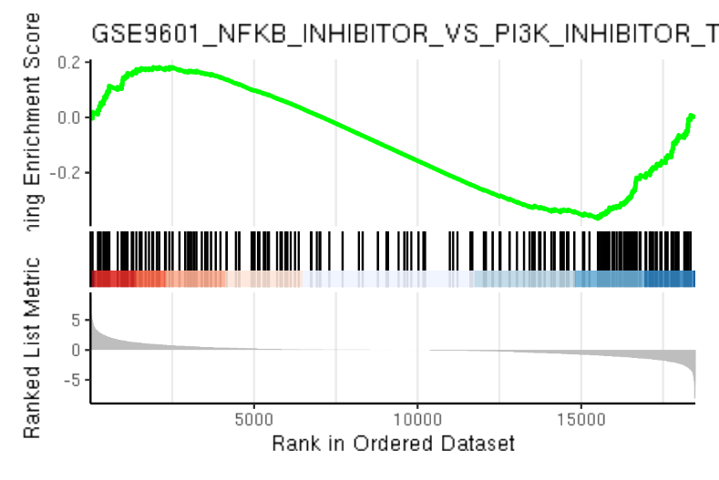
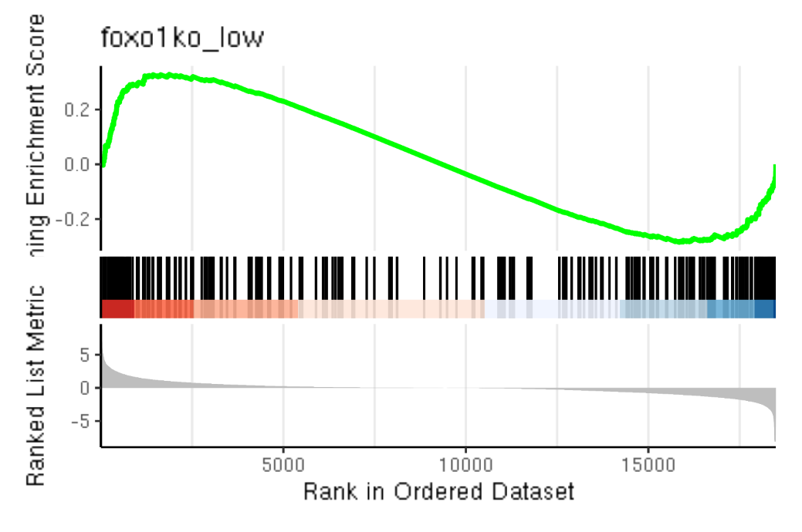
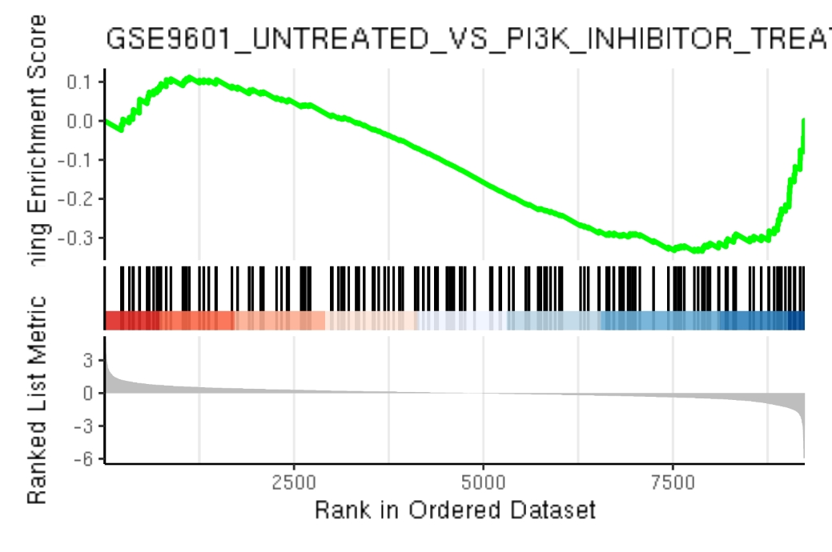
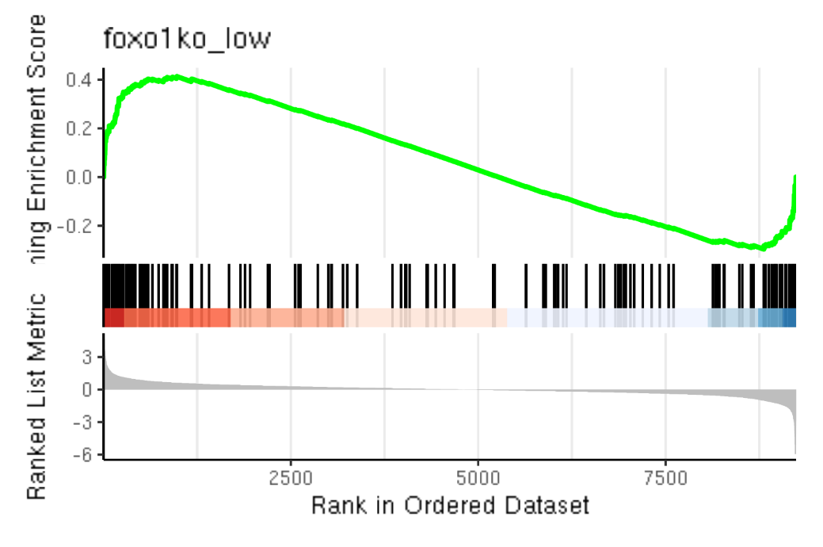
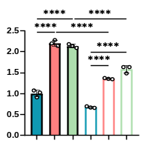
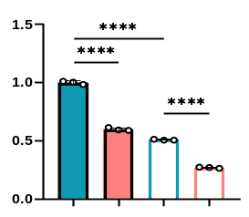
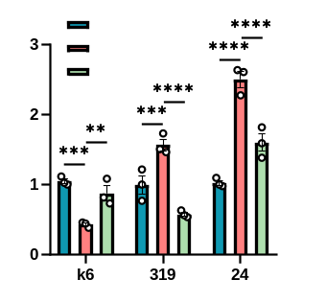
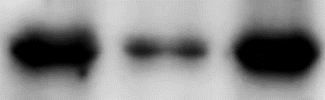




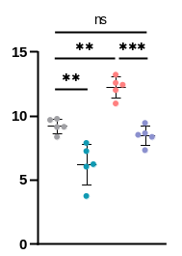
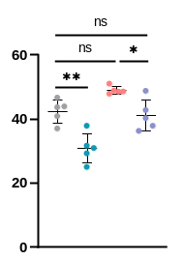
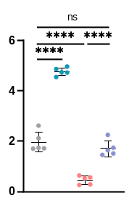
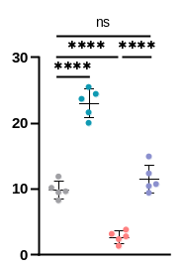
Supplementary Fig. 1 FOXO1 transcriptionally regulates KLHL6 expression in CD8⁺ T cells, related to Figure 1
a
Leiden
b
f
0
Cluster
0 Exhaustion
Klhl6
1 Effector
Tcf7
8
2
5
2 Intermediate
Klhl6 mRNA
Klhl6 mRNA
3 Memory-like
Sell
6
4
4 Post-progenitor
Cd244
1
5 Pre-exhaustion
Pdcd1
7
6 Pre-proliferation
UMAP2
7 Progenitor
Havcr2
D0
D1
D2
D3
D4
D5
D6
3
8 Proliferation
Activation
D7
No restim
UMAP1
8
2
6
1
3
7
4
0
5
Restimulation
Three restim
c
d
Mouse CD8⁺ T cells in vitro
e
Human CD8⁺ T cells in vitro
Restimulation
αCD3 (2μg/mL)
Spleen
Sorting
Activation
D4 D6 D8 D10
PD-1⁺TIM-3⁺ (%)
IFN-γ⁺TNF-α⁺ (%)
LAG-3⁺TIM-3⁺ (%)
IFN-γ⁺TNF-α⁺ (%)
OT-I mice
αCD3/αCD28/IL-2
Analysis
No restim
No restim
No restim
No restim
Three restim
Three restim
Three restim
Three restim
g
PI3K-AKT Pathway
FOXO1 Targets
h
0.1
PI3K-AKT Pathway
0.4
FOXO1 Targets
0.2
0.2
NES=1.23
P=0.0211
0.0
NES=-1.43
P=0.0152
0.2
NES=1.74
P=0.0000
0.0
NES=-1.38
P=0.0097
0.0
-0.1
0.0
-0.2
-0.2
-0.2
-0.2
-0.3
Naïve
Activation
Naïve
Activation
PD-1⁻TIM-3⁻
PD-1⁺TIM-3⁺
PD-1⁻TIM-3⁻
PD-1⁺TIM-3⁺
i
j
k
-
-
+
AKTi
No stim
(kDa)
-
+
+
αCD3 (48h)
αCD3
70
KLHL6
αCD3+AKTi
Relative Klhl6 mRNA level
Relative protein level
Relative KLHL6 mRNA level
70
p-FOXO1-S319
70
p-FOXO1-T24
FOXO1^{WT}
-
+
-
-
+
-
-
-
55
p-AKT-S473
FOXO1^{AAA}
-
-
+
-
-
+
shFOXO1
-
+
+
40
Actin
αCD3 (48h)
-
-
-
+
+
+
αCD3 (24h)
-
+
+
KLHL6
p-FOXO1-T24
l
m
dLN
Spleen
p-FOXO1-S319
shCtrl+Vec
shCtrl+Vec
shCtrl+Klhl6
shCtrl+Klhl6
shFoxo1+Vec
shFoxo1+Vec
shFoxo1+Klhl6
shFoxo1+Klhl6
TIM-3 MFI (×10²)
PD-1 MFI (×10²)
CD62L⁺CD44⁺
cell number (×10⁴)
CD62L⁺CD44⁺
cell number (×10⁴)

