Slide 1
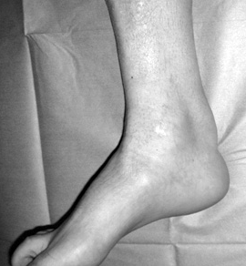
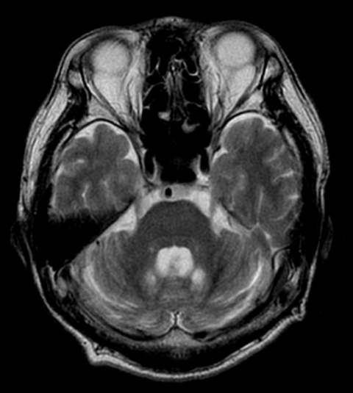
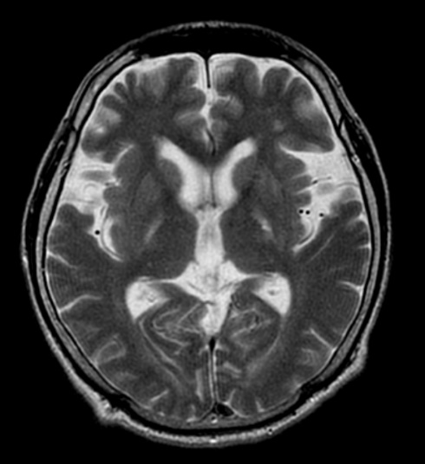
A
B
C
Supplemental figure 1 Achilles tendon xanthoma (A) and brain MRI (B, C, T2-weighted image, axial view) of a CTX patient. Diffuse brain atrophy and bilateral hyperintensitive signals on dentate nuclei (B), and corticospinal tract (internal capsule) (C) were observed.
Sekijima et al
Supplemental figure 1

