Slide 1
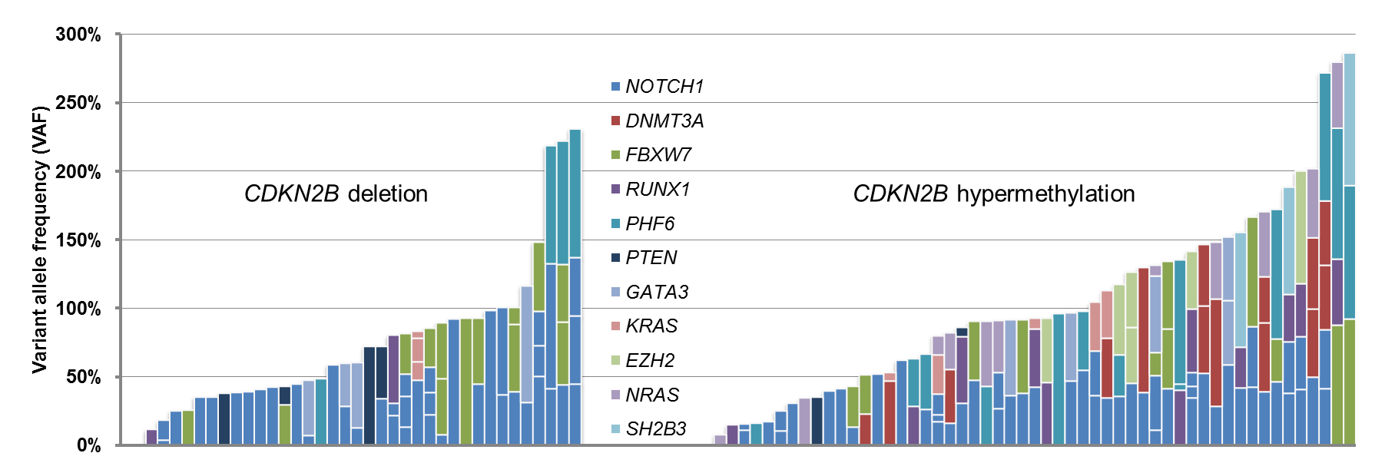
Supplementary Figure S4.
Differences in gene mutations according to the CDKN2B downregulation mechanism (deletion and hypermethylation). The y-axis represents the VAF (%) for each mutation for each sample on the x-axis. Each color defines genes associated with a given mutated gene.

