Slide 1
Supplementary Information
Highly efficient and safe genome editing by CRISPR-Cas12a using CRISPR RNA
with a ribosyl-2’-O-methylated uridinylate-rich 3’-overhang in mouse zygotes
Dae-In Ha^{1,2,4}, Jeong Mi Lee^{1,2, 4}, Nan-Ee Lee^{1,2}, Daesik Kim¹, Jeong-Heon Ko^{1,2}, Yong-Sam Kim^{1,2,3,}*
¹Genome Editing Research Center, KRIBB, Daejeon 34141, Republic of Korea.
²KRIBB School of Bioscience, Korea University of Science and Technology (UST) 34141, Daejeon, Republic of Korea
³GenKOre, Daejeon 34141, Republic of Korea.
⁴These authors contributed equally.
Figure S1-2
Table S1-S4

Slide 2
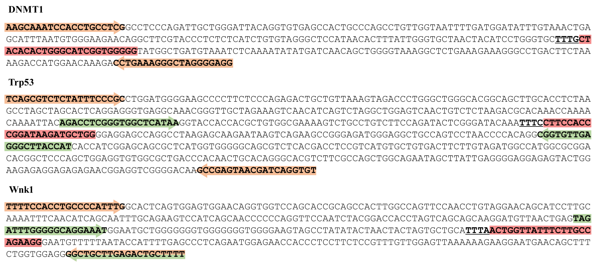
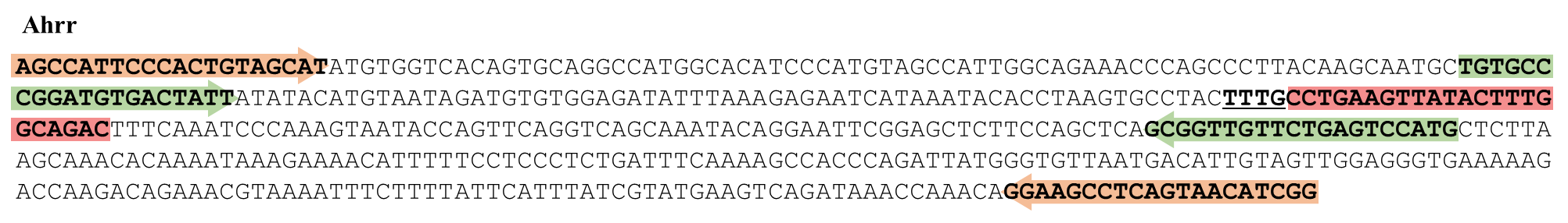
a
b
c
d
Figure S1. Sequence of the Target containing Template and Primers. Human DNMT1 (a) and mouse Trp53 (b), Wnk1 (c), and Ahrr (d) amplicon sequences were noted. Target sites (pink) and template amplicon primers (orange) were included. NGS amplicon primers (light green) are used to amplify templates within an analytical size range.

Slide 3
Canonical crRNA: 10 types of reads
OM U-rich crRNA: 27 types of reads
ATTTCCTTCCACCCGGATAAGATGCTGGGGAGGAGCCAGGCCTAAGAGCAA Indels
ATTTCCTTCCACCCGGATAAGCT----GGGAGGAGCCAGGCCTAAGAGCAA -4
ATTTCCTTCCACCCGGATA-----CTGGGGAGGAGCCAGGCCTAAGAGCAA -5
ATTTCCTTCCACCCGGATAA------GGGGAGGAGCCAGGCCTAAGAGCAA -6
ATTTCCTTCCACCCGGAT-------TGGGGAGGAGCCAGGCCTAAGAGCAA -7
ATTTCCTTCCACCCGGATA--------GGGAGGAGCCAGGCCTAAGAGCAA -8
ATTTCCTTCCACCCGGAT---------GGGAGGAGCCAGGCCTAAGAGCAA -9
ATTTCCTTCCACCC-------------GGGAGGAGCCAGGCCTAAGAGCAA -13
ATTTCCTTCCACCC--------------GGAGGAGCCAGGCCTAAGAGCAA -14
ATTTCCTTCCACCC-----------------GGAGCCAGGCCTAAGAGCAA -17
ATTTCCTTCCA------------------------CCAGGCCTAAGAGCAA -24
ATTTCCTTCCACCCGGATAAGATGCTGGGGAGGAGCCAGGCCTAAGAGCAA Indels
ATTTCCTTCCACCCGGATAA----CTGGGGAGGAGCCAGGCCTAAGAGCAA -4
ATTTCCTTCCACCCGGATAA------GGGGAGGAGCCAGGCCTAAGAGCAA -6
ATTTCCTTCCACCCGGATAAGAT--------GGAGCCAGGCCTAAGAGCAA -8
ATTTCCTTCCACCCGGATAA---------GAGGAGCCAGGCCTAAGAGCAA -9
ATTTCCTTCCACCCGGATAA------------GAGCCAGGCCTAAGAGCAA -12
ATTTCCTTCCACCCGGATA-----C----------CCAGGCCTAAGAGCAA -15
ATTTCCTTCCACCCGGATA------T---------CCAGGCCTAAGAGCAA -15
ATTTCCTTCCACCCGGATA-----CT----------CAGGCCTAAGAGCAA -15
ATTTCCTTCCACCCGGACAC---------------CCAGGCCTAAGAGCAA -15
ATTTCCTTCCACCCGGAT-----GC----------CCAGGCCTAAGAGCAA -15
ATTTCCTTCCACCCGGA----------------AGCCAGGCCTAAGAGCAA -16
ATTTCCTTCCACCCGGATA----------------CCAGGCCTAAGAGCAA -16
ATTTCCTTCCAC-----------------------CCAGGCCTAAGAGCAA -23
ATTTCCTTCCACC----T-------------------AGGCCTAAGAGCAA -23
ATTT------------------------GGAGGAGCCAGGCCTAAGAGCAA -24
ATTTCCTTCCACC------------------------AGGCCTAAGAGCAA -24
ATTT----------GG---------T-----GGAACCAGGCCTAAGAGCAA -24
ATT-C-----------------------GGAGGAGCCAGGCCTAAGAGCAA -24
ATTTCCTTCCACCCGGATAAGATGCTGGGGAGGAGCCAGGCCTAAGAGCAA Indels
ATTTCCTTCCACCCGGATAAGAT----GGGAGGAGCCAGGCCTAAGAGCAA -4
ATTTCCTTCCACCCGGATAA------GGGGAGGAGCCAGGCCTAAGAGCAA -6
ATTTCCTTCCACCCGGATAAG------GGGAGGAGCCAGGCCTAAGAGCAA -6
ATTTCCTTCCACCCGGAT-------TGGGGAGGAGCCAGGCCTAAGAGCAA -7
ATTTCCTTCCACCCGGATAA-------GGGAGGAGCCAGGCCTAAGAGCAA -7
ATTTCCTTCCACCCGGATAAGA-------GAGGAGCCAGGCCTAAGAGCAA -7
ATTTCCTTCCACCC-----------------GGAGCCAGGCCTAAGAGCAA -17
ATTTCCTTCCA------------------------CCAGGCCTAAGAGCAA -24
ATTTCCTTCCACC------------C------------GGCCTAAGAGCAA -24
ATTTCCTTCCACC--------G----------------GGCCTAAGAGCAA -24
ATTTCCTTCCACC------------------------AGGCCTAGGAGCAA -24
ATTTCCTTCCAC------------------------CAGGCCTAAGAGCAA -24
ATTTCCTTCCA------------------------CCAGGCCTAAGAGCAA -24
ATTTCCTTCCA------T------------------CAGGCCTAAGAGCAA -24
ATTTCCTTC---------AA---------------CCAGGCCTAAGAGCAA -24
ATTTCCTTCCAC-----A-------------------AGGCCTAAGAGCAA -24
ATTTCCTTCCACCC------------------------GGCCTAAGAGCAA -24
ATTTCCTTCC------------------------GCCAGGCCTAAGAGCAA -24
ATTTCCTTCCACCCGGAT--------------------------AGAGCAA -26
ATTTCCTTCCACCCGGATA--------------------------GAGCAA -26
ATTTCCTTCCACCC-----AGAT---------------------AGAGCAA -26
ATTTCCTTCCACCCG---AA--T---------------------AGAGCAA -26
ATTTCCTTCCACCCGGAT-------------------AGG-------GCAA -26
ATTTCCTTCCACCCGGAT----AT----------------------AGCAA -26
ATTTCCTTCCACCCGGAT-------TG-------------------AGCAA -26
ATTTCCTTCCACCCGGAT-------------GG-------------AGCAA -26
ATTTCCTTCCACCCGGATAA--------------------------AGCAA -26
U-rich crRNA: 18 types of reads
Figure S2. Alignments of mutation sequences with wild-type ones for indel mutation experiments (#4) for Trp53. All mutated sequences analyzed by deep sequencing were presented. Protospacer sequence was noted in red letters with an underlined PAM sequence.

Slide 4
Table S1. Comparison of post-transfection viability of embryos after transfection according to the modification types of crRNA
in the Trp53 target gene
Trp53
Type | #1 |  | #2 |  | #3 |  | #4 |  | #5
 | Total (n=50) |  | Total (n=66) |  | Total (n=62) |  | Total (n=22) |  | Total (n=24)
 | Morula (ea) | Viability (%) | Morula (ea) | Viability (%) | Morula (ea) | Viability (%) | Morula (ea) | Viability (%) | Morula (ea) | Viability (%)
Canonical crRNA | 15 | 30.00 | 3 | 4.54 | 11 | 17.74 | 16 | 72.73 | 15 | 62.50
U-rich crRNA | 18 | 36.00 | 8 | 12.12 | 13 | 20.97 | 14 | 63.64 | 17 | 70.83
OM U-rich crRNA | 16 | 32.00 | 16 | 24.24 | 18 | 29.03 | 18 | 81.82 | 22 | 91.67

Slide 5
Table S2. Comparison of post-transfection viability of embryos after transfection according to the modification types of crRNA in the Wnk1 target gene
Wnk1
Type | #1 |  | #2 |  | #3 |  | #4
 | Total (n=28) |  | Total (n=26) |  | Total (n=20) |  | Total (n=20)
 | Morula (ea) | Viability (%) | Morula (ea) | Viability (%) | Morula (ea) | Viability (%) | Morula (ea) | Viability (%)
Canonical crRNA | 10 | 35.71 | 15 | 57.69 | 8 | 40.00 | 6 | 30.00
U-rich crRNA | 10 | 35.71 | 16 | 61.54 | 7 | 35.00 | 5 | 25.00
OM U-rich crRNA | 12 | 42.86 | 15 | 57.69 | 9 | 45.00 | 10 | 50.00

Slide 6
Table S3. Comparison of post-transfection viability of embryos after transfection according to the modification types of crRNA in the Ahrr target gene
Ahrr
Type | #1 |  | #2 |  | #3 |  | #4
 | Total (n=28) |  | Total (n=26) |  | Total (n=20) |  | Total (n=20)
 | Morula (ea) | Viability (%) | Morula (ea) | Viability (%) | Morula (ea) | Viability (%) | Morula (ea) | Viability (%)
Canonical crRNA | 8 | 34.78 | 3 | 15.00 | 5 | 25.00 | 11 | 36.67
U-rich crRNA | 10 | 43.48 | 4 | 20.00 | 8 | 40.00 | 14 | 46.67
OM U-rich crRNA | 12 | 52.17 | 8 | 40.00 | 10 | 50.00 | 19 | 63.33

Slide 7
Table S4. Potential Off-Target Sites for Trp53 as an on-target
 | Chromosome | Bulge type | crRNA | DNA | Position | Direction | Mismatches | Bulge Size
OF1 | chr2 | RNA | CTTCCACCCGGATAAGATGCTGG | CTTCCAtgCaGATAAGATG--GG | 35249401 | + | 3 | 2
OF2 | chr4 | RNA | CTTCCACCCGGATAAGATGCTGG | tTTCCcCCCGGATAAGAT--TaG | 48002933 | - | 3 | 2
 |  | DNA | CTTCCACCCG--GATAAGATGCTGG | CTTCCACCCGTGGATgAGtTcCTGG | 135419816 | + | 3 | 2
 |  | DNA | CTTCCACCC--GGATAAGATGCTGG | CTTCCACCCGTGGATgAGtTcCTGG |  | + | 3 | 2
OF3 | chr8 | RNA | CTTCCACCCGGATAAGATGCTGG | CgTCCACCCtG-TgAGATGCTGG | 110004333 | + | 3 | 1
OF4 | chr17 | X | CTTCCACCCGGATAAGATGCTGG | CTTCCACCCtGATAAGATGCTGG | 54420228 | - | 1 | 0
OF5 | chr19 | RNA | CTTCCACCCGGATAAGATGCTGG | CTTCCACtC--ATAAGtTtCTGG | 31563938 | + | 3 | 2

