Slide 1

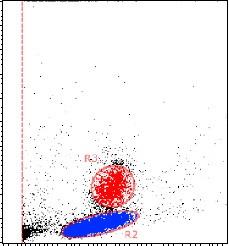
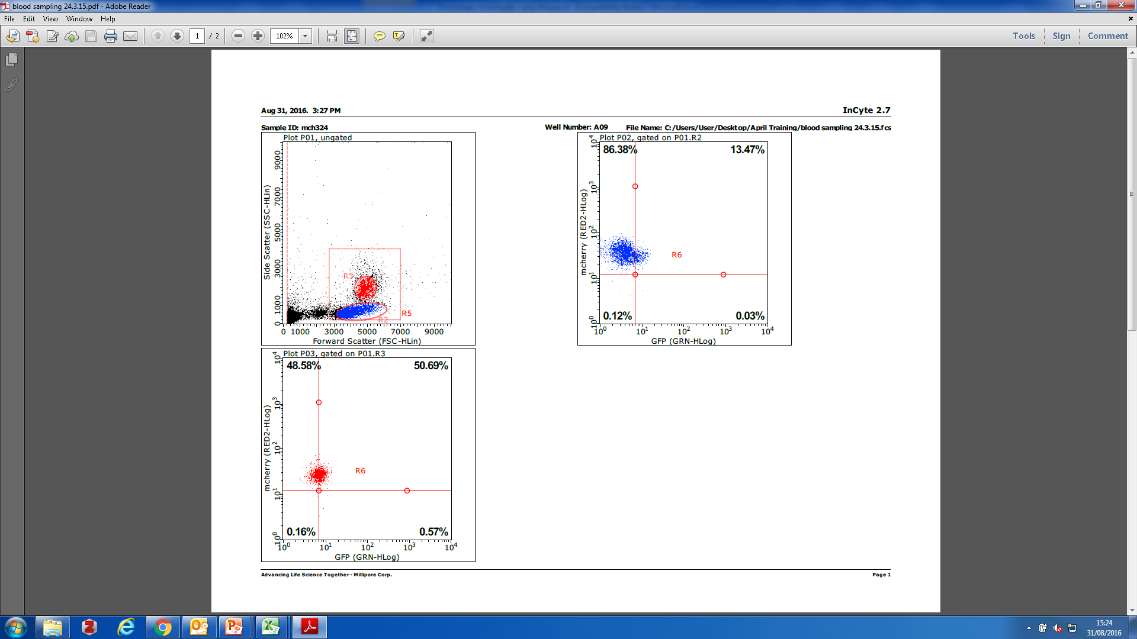
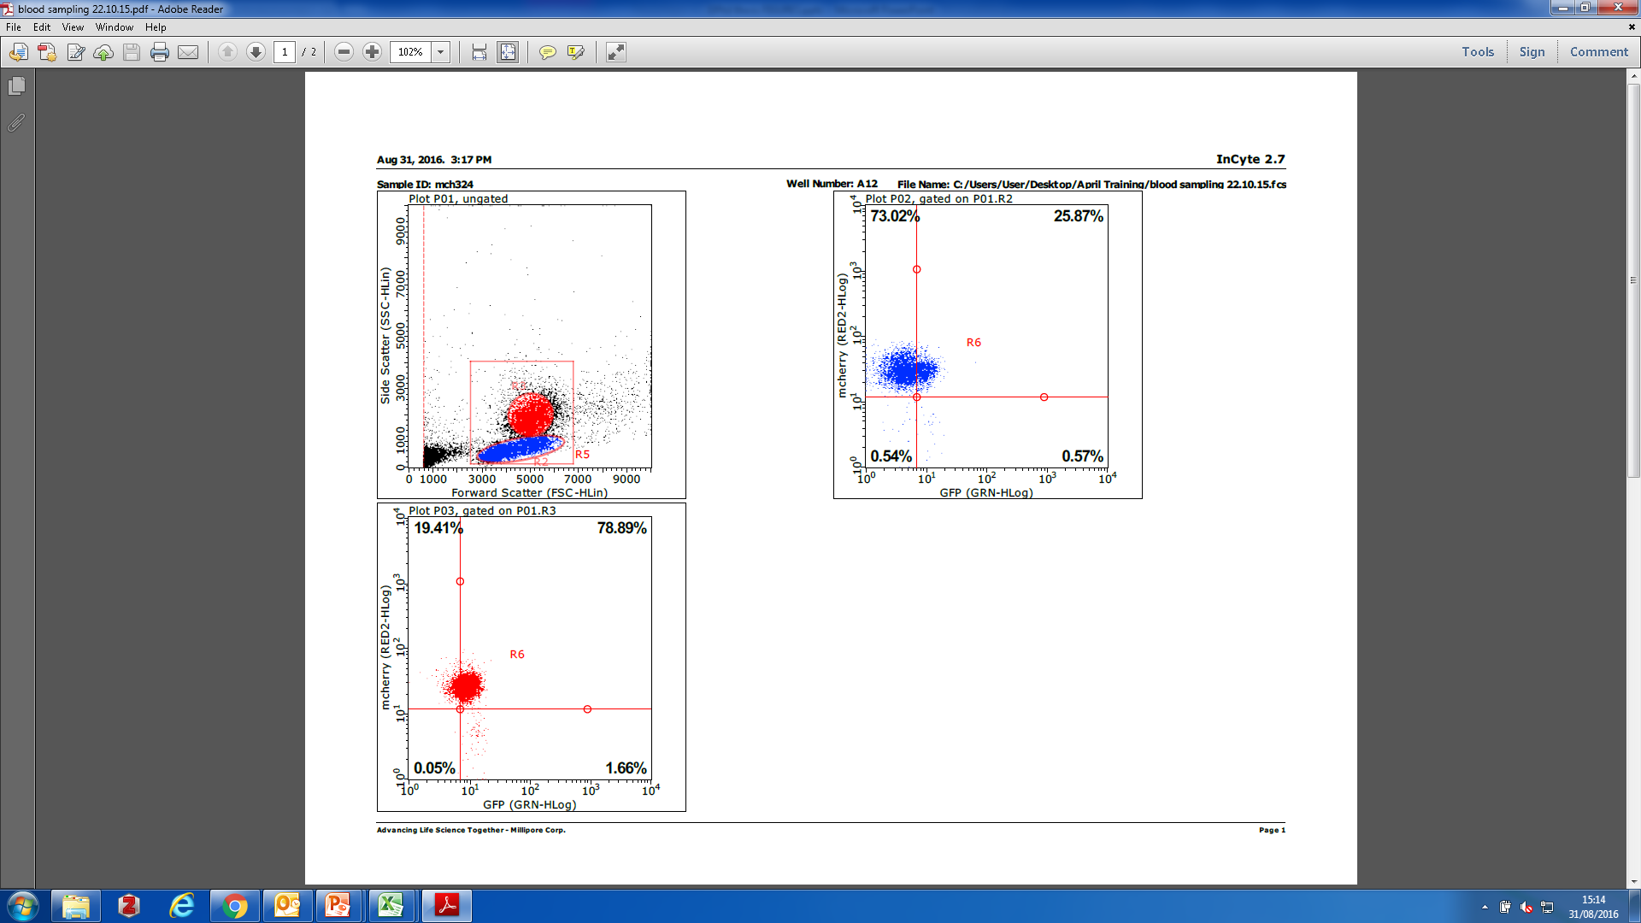
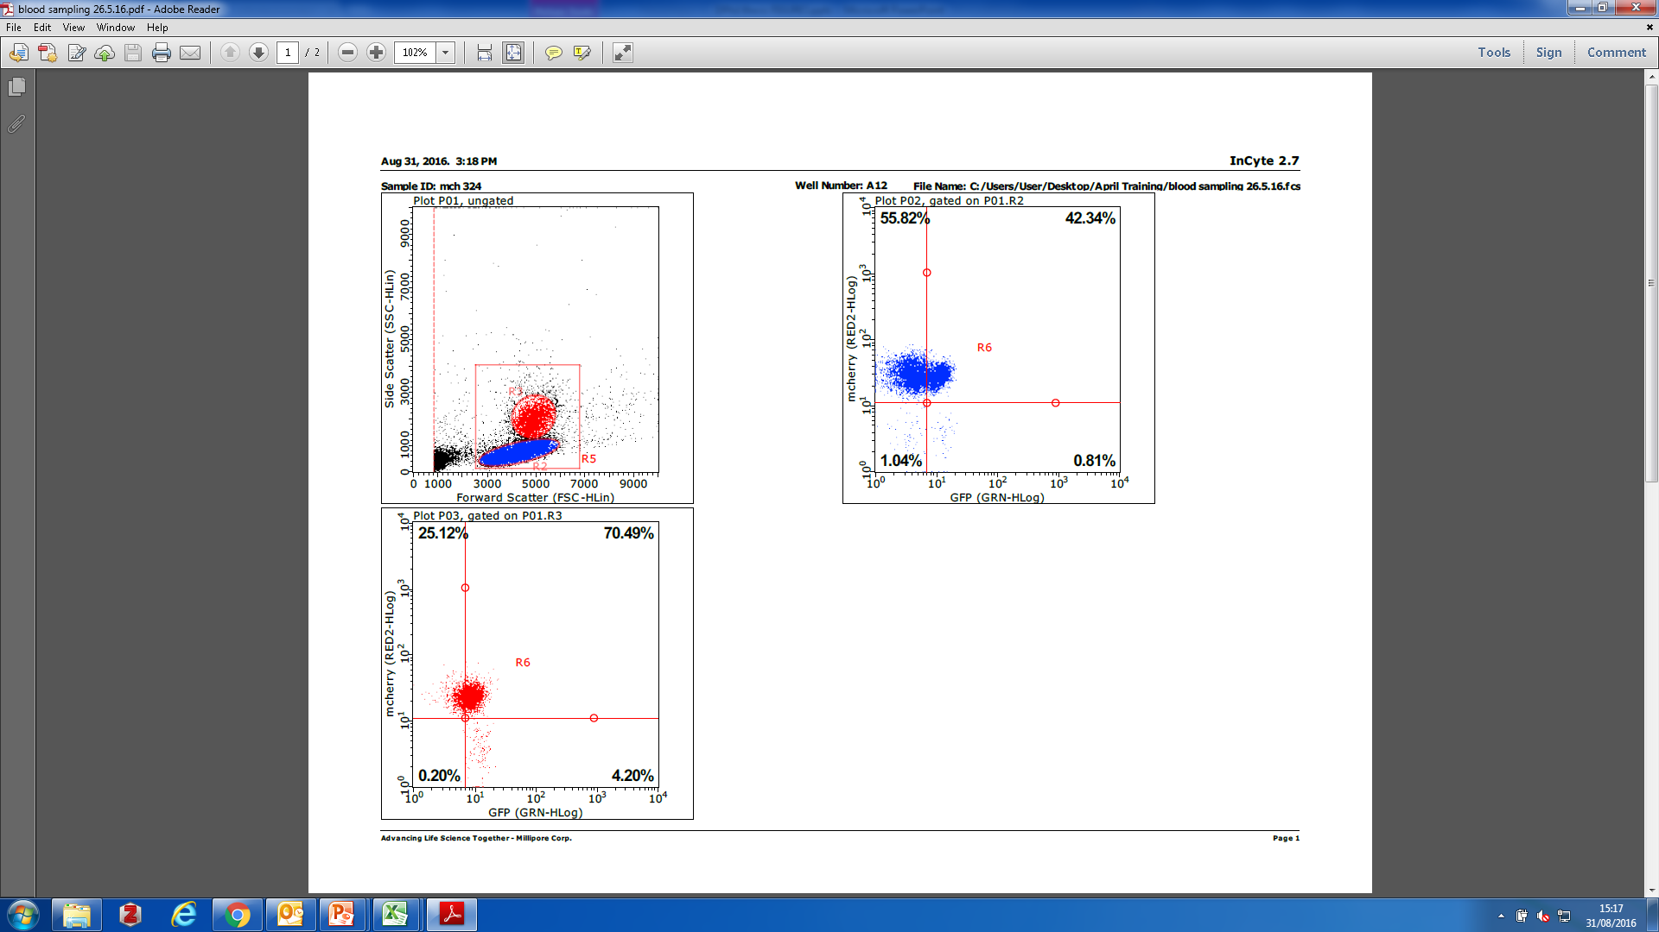
A
70 ♂ + 50 ♀
3 Gy
Blood sampling
SSC
1,2,3,…
Lym/Mon
Gr
Sfpi1^{mCh/GFP}
months
Sfpi1^{mCh/GFP}
FSC
t= 3 mo
t= 9 mo
t= 18 mo
mCh
Lym
Mon
Gr
GFP
GFP
GFP
B

