Slide 1
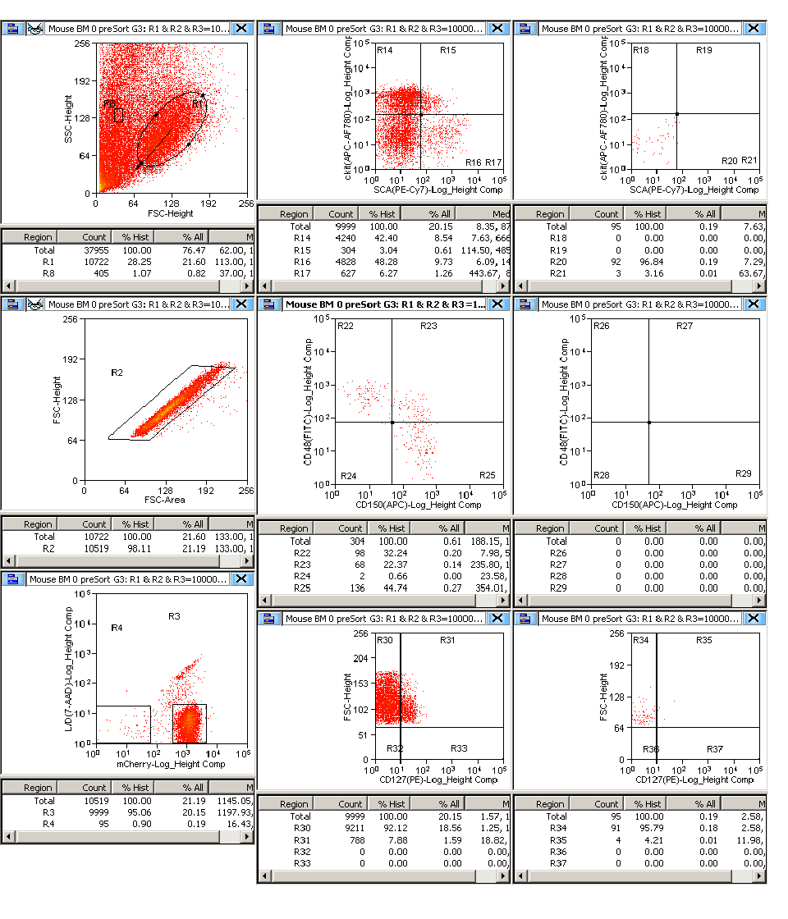
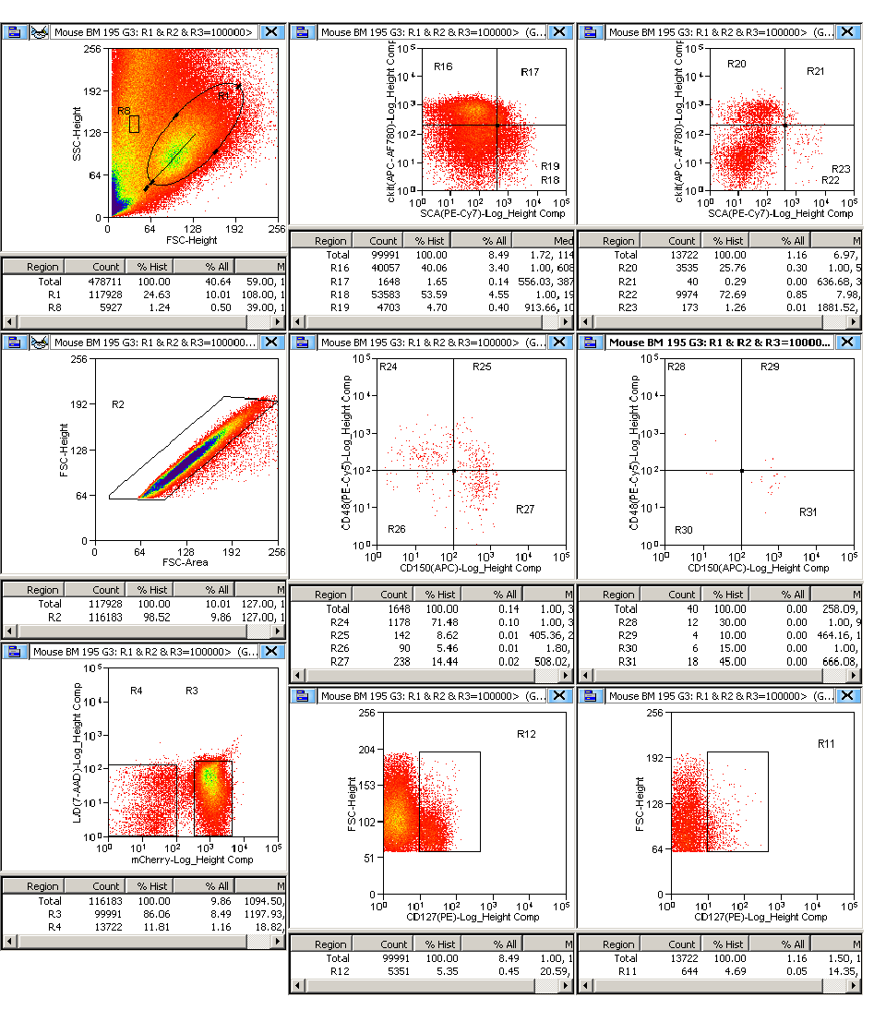
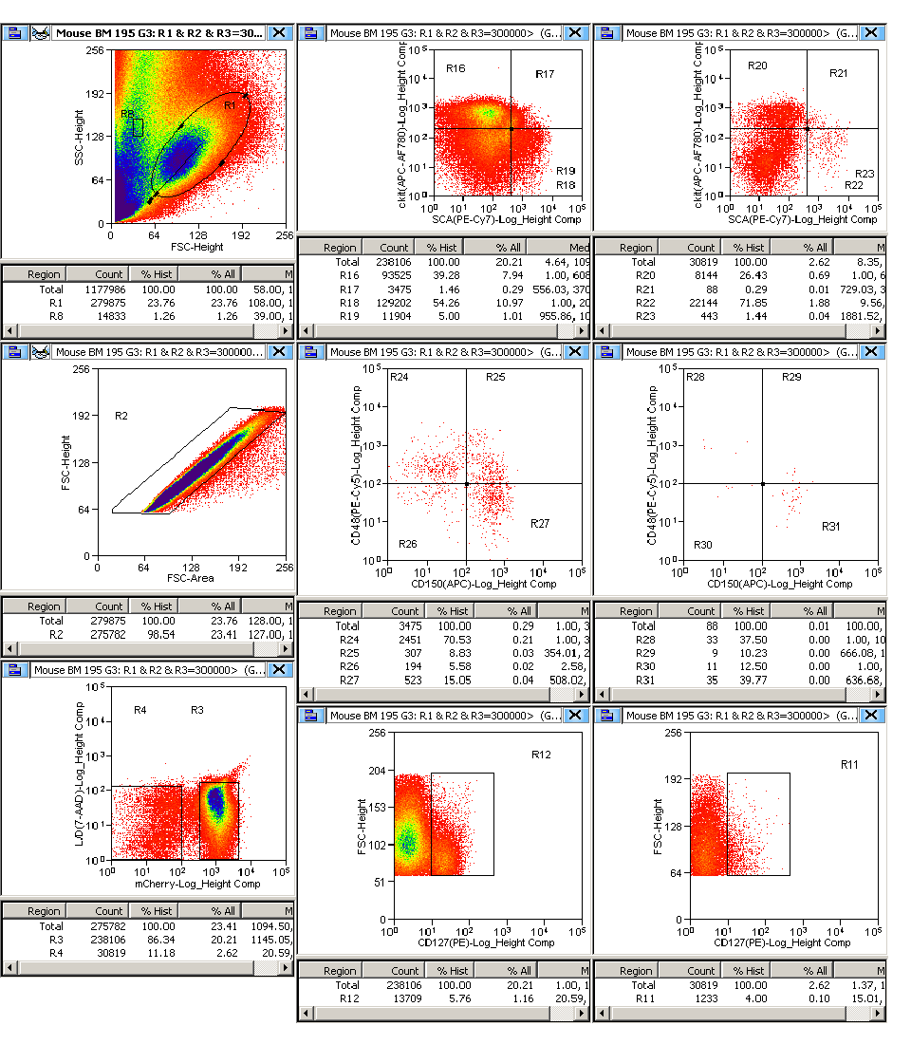
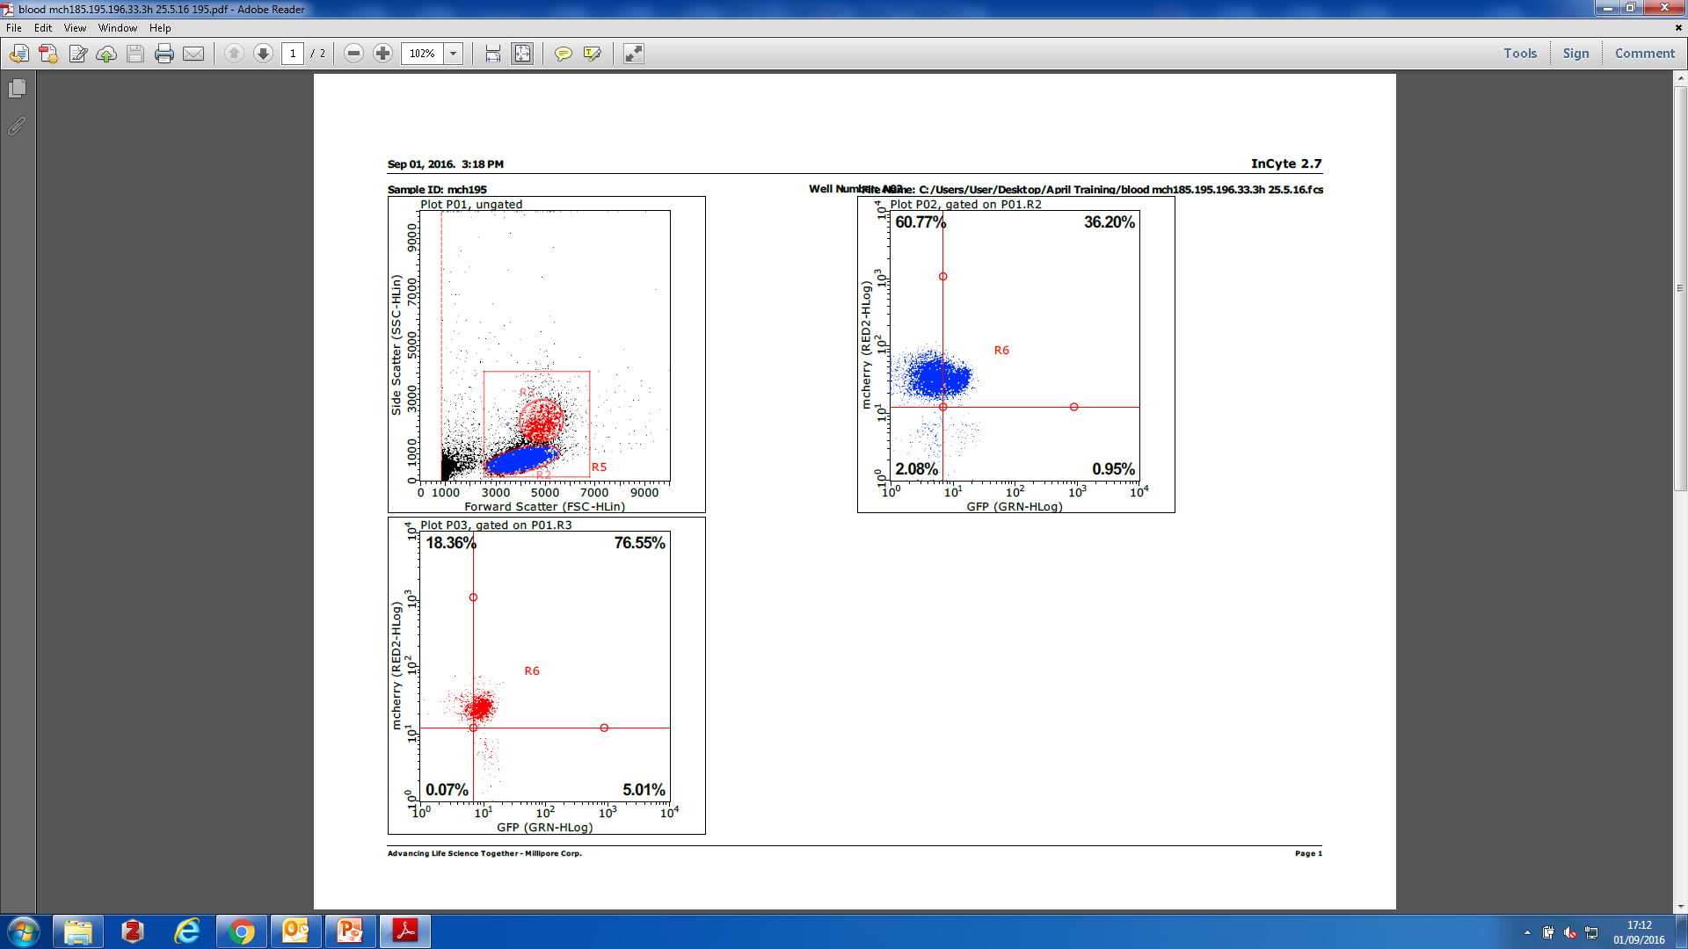
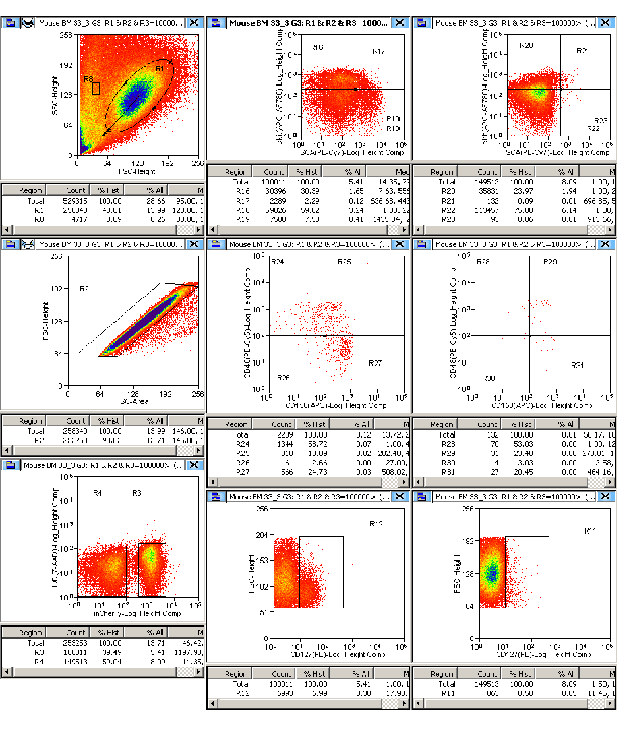
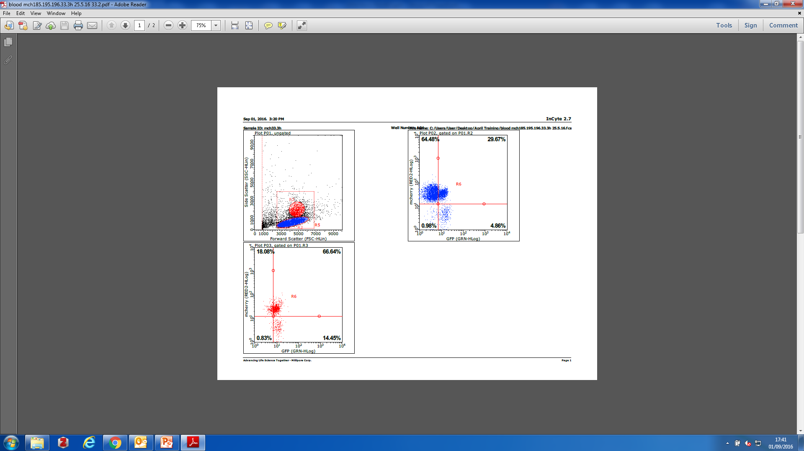
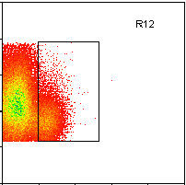
A
B
FSC
7-AAD
Lin- mCherry-
Lin- mCherry+
FSC
FSC
4%
6%
SSC
mCh
cKit
cKit
CD127
CD127
Sca1
Sca1
mCh
mCh
CD48
CD48
GFP
GFP
CD150
CD150
C
FSC
7-AAD
mCh
mCh
SSC
mCh
FSC
FSC
0.7%
8%
GFP
GFP
CD127
CD127

