Slide 1
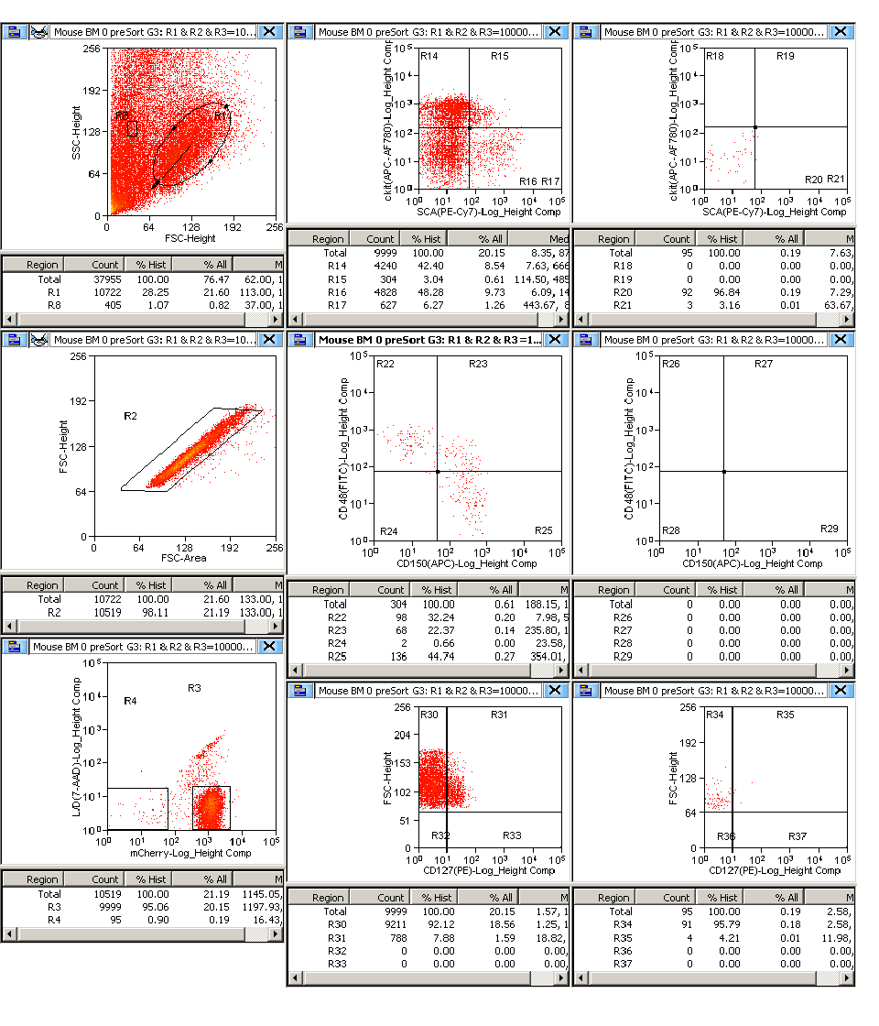
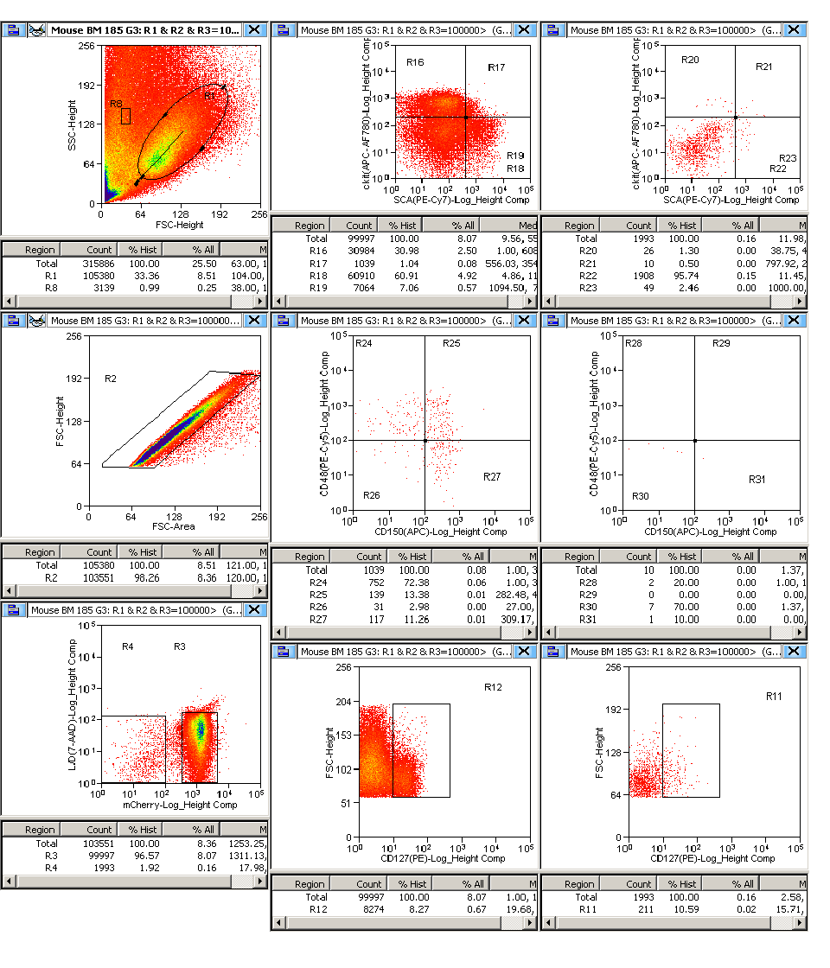
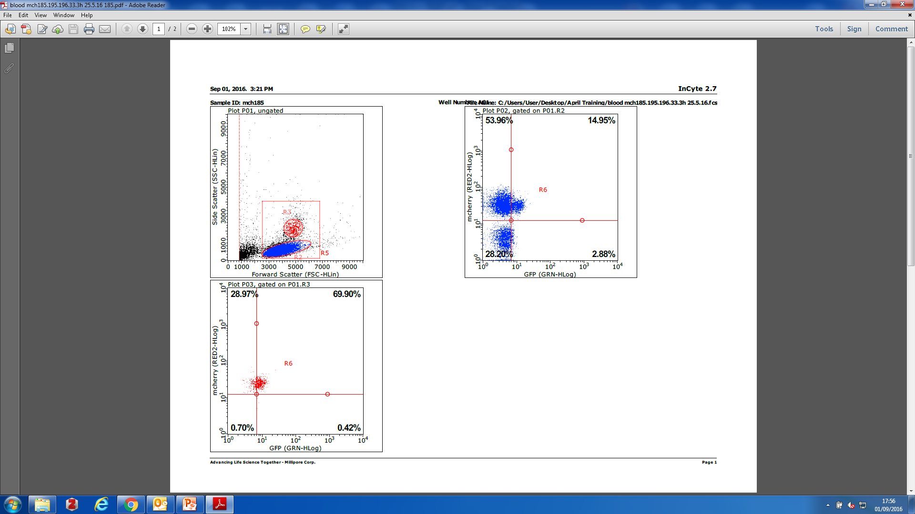
A
B
FSC
7-AAD
Lin- mCherry-
Lin- mCherry+
FSC
FSC
11%
8%
SSC
mCh
cKit
cKit
CD127
CD127
Sca1
Sca1
mCh
mCh
CD48
CD48
GFP
GFP
CD150
CD150

