Slide 1
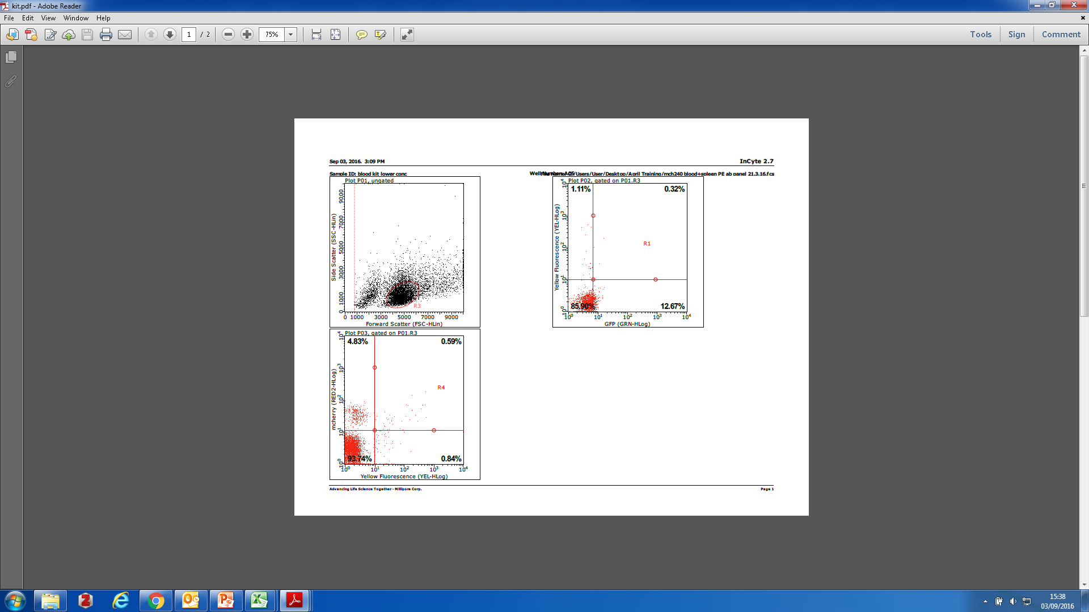


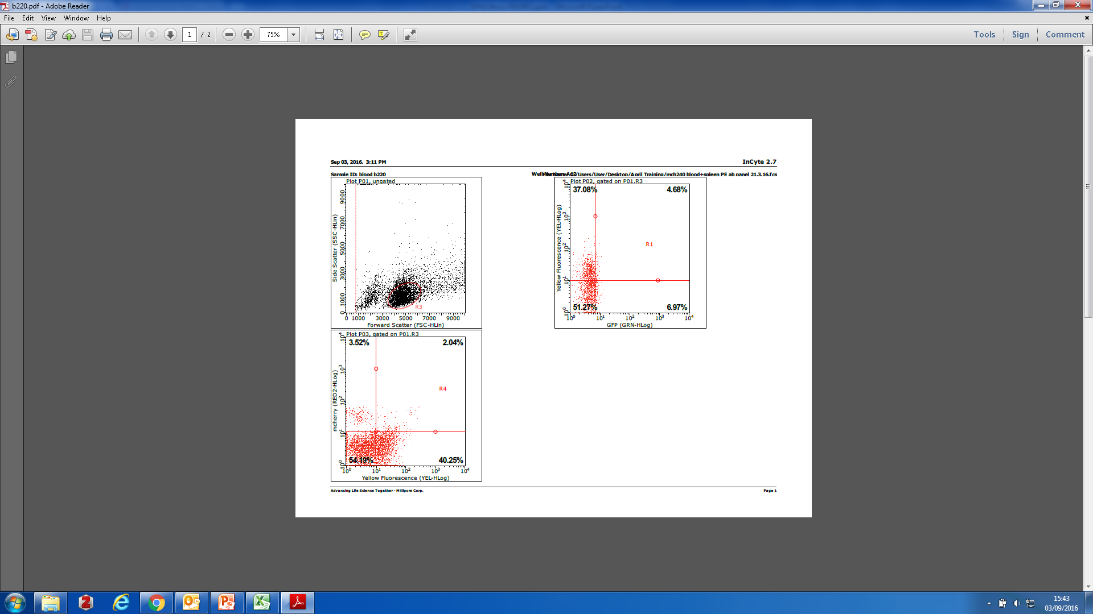
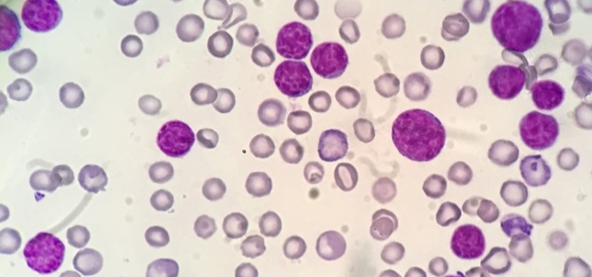
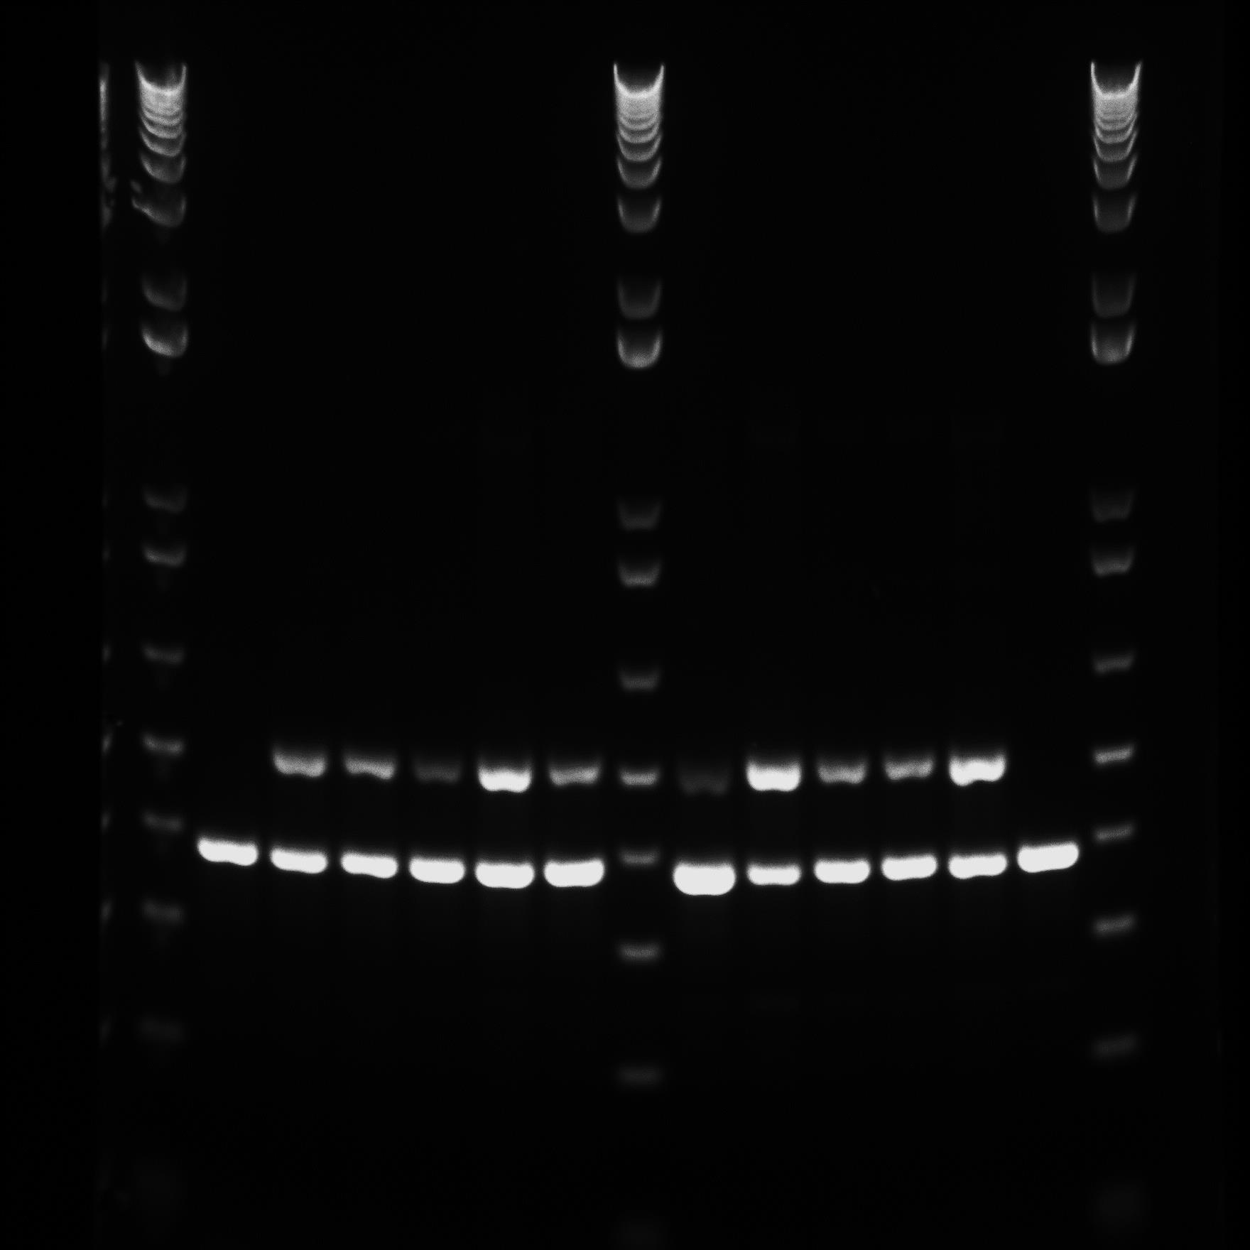
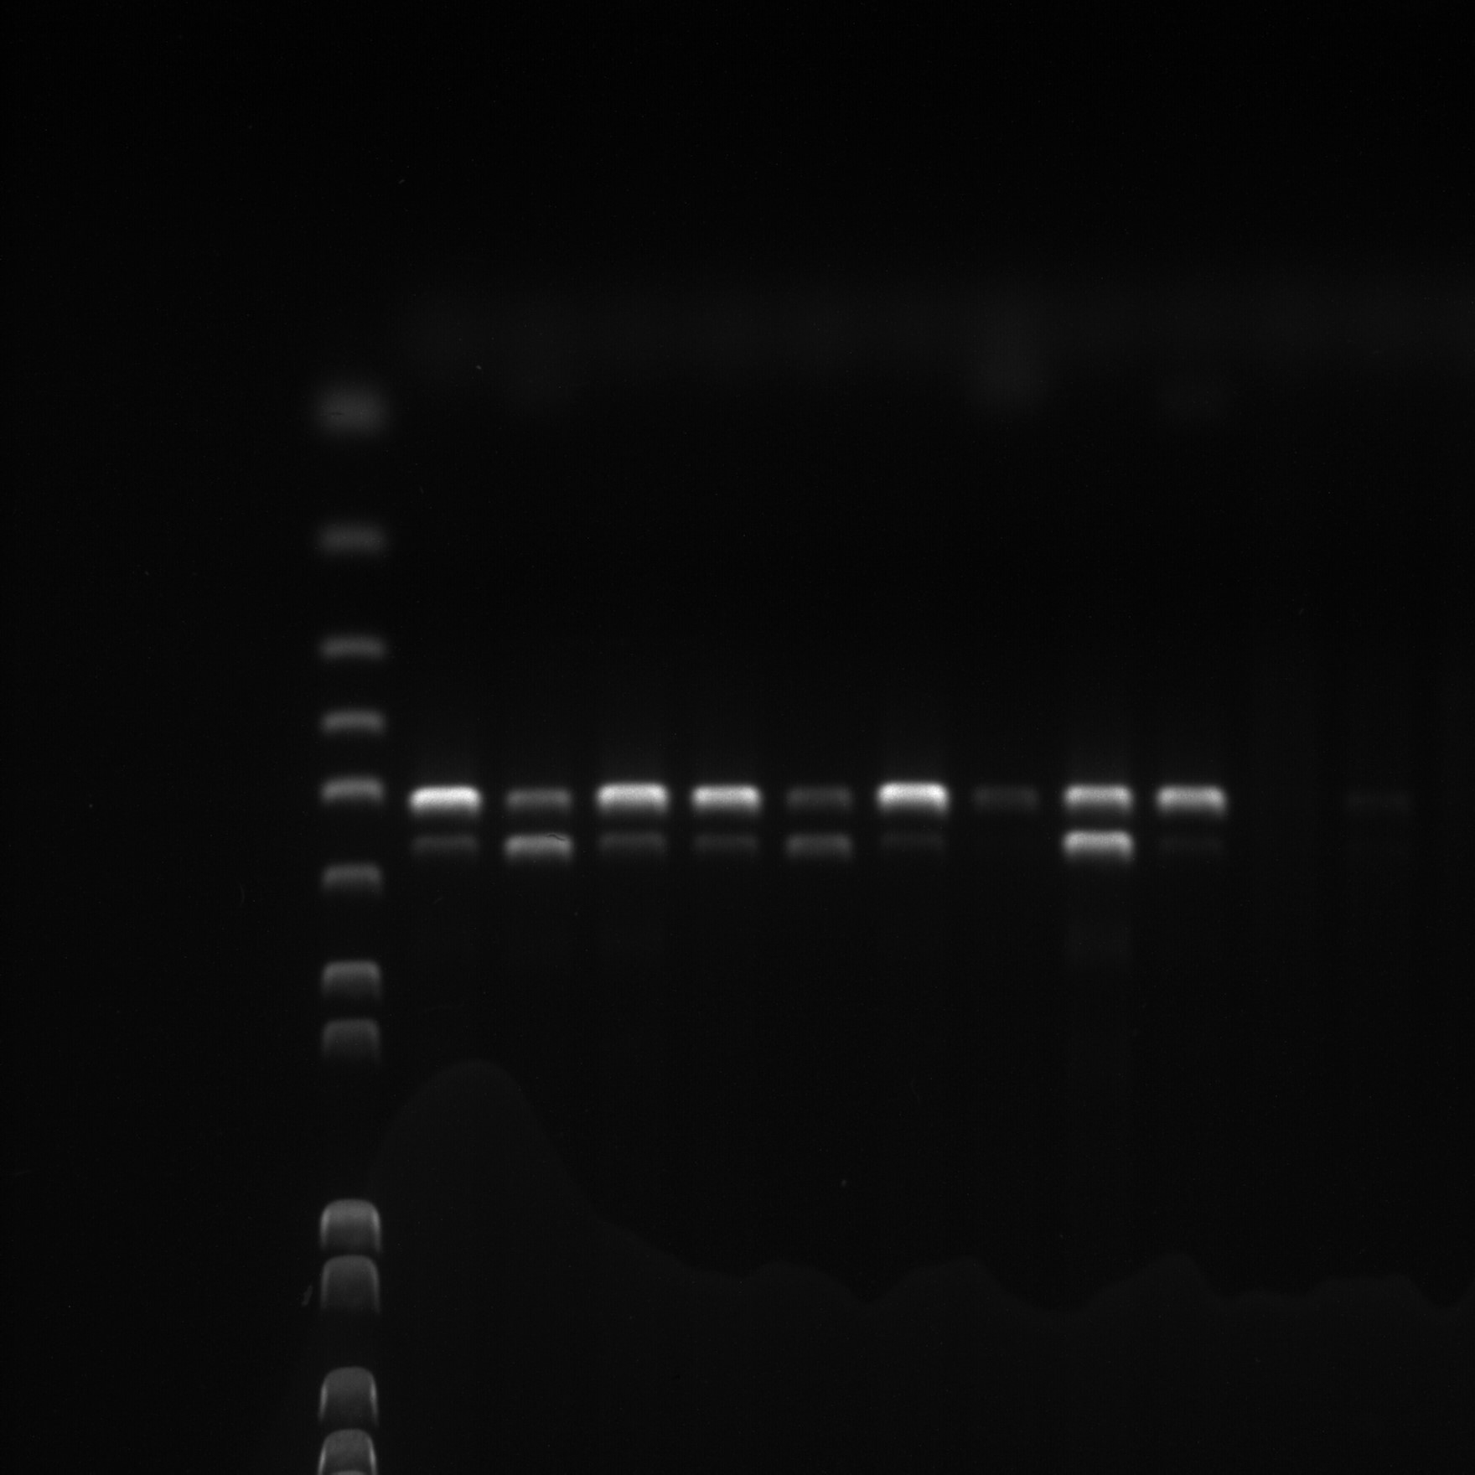
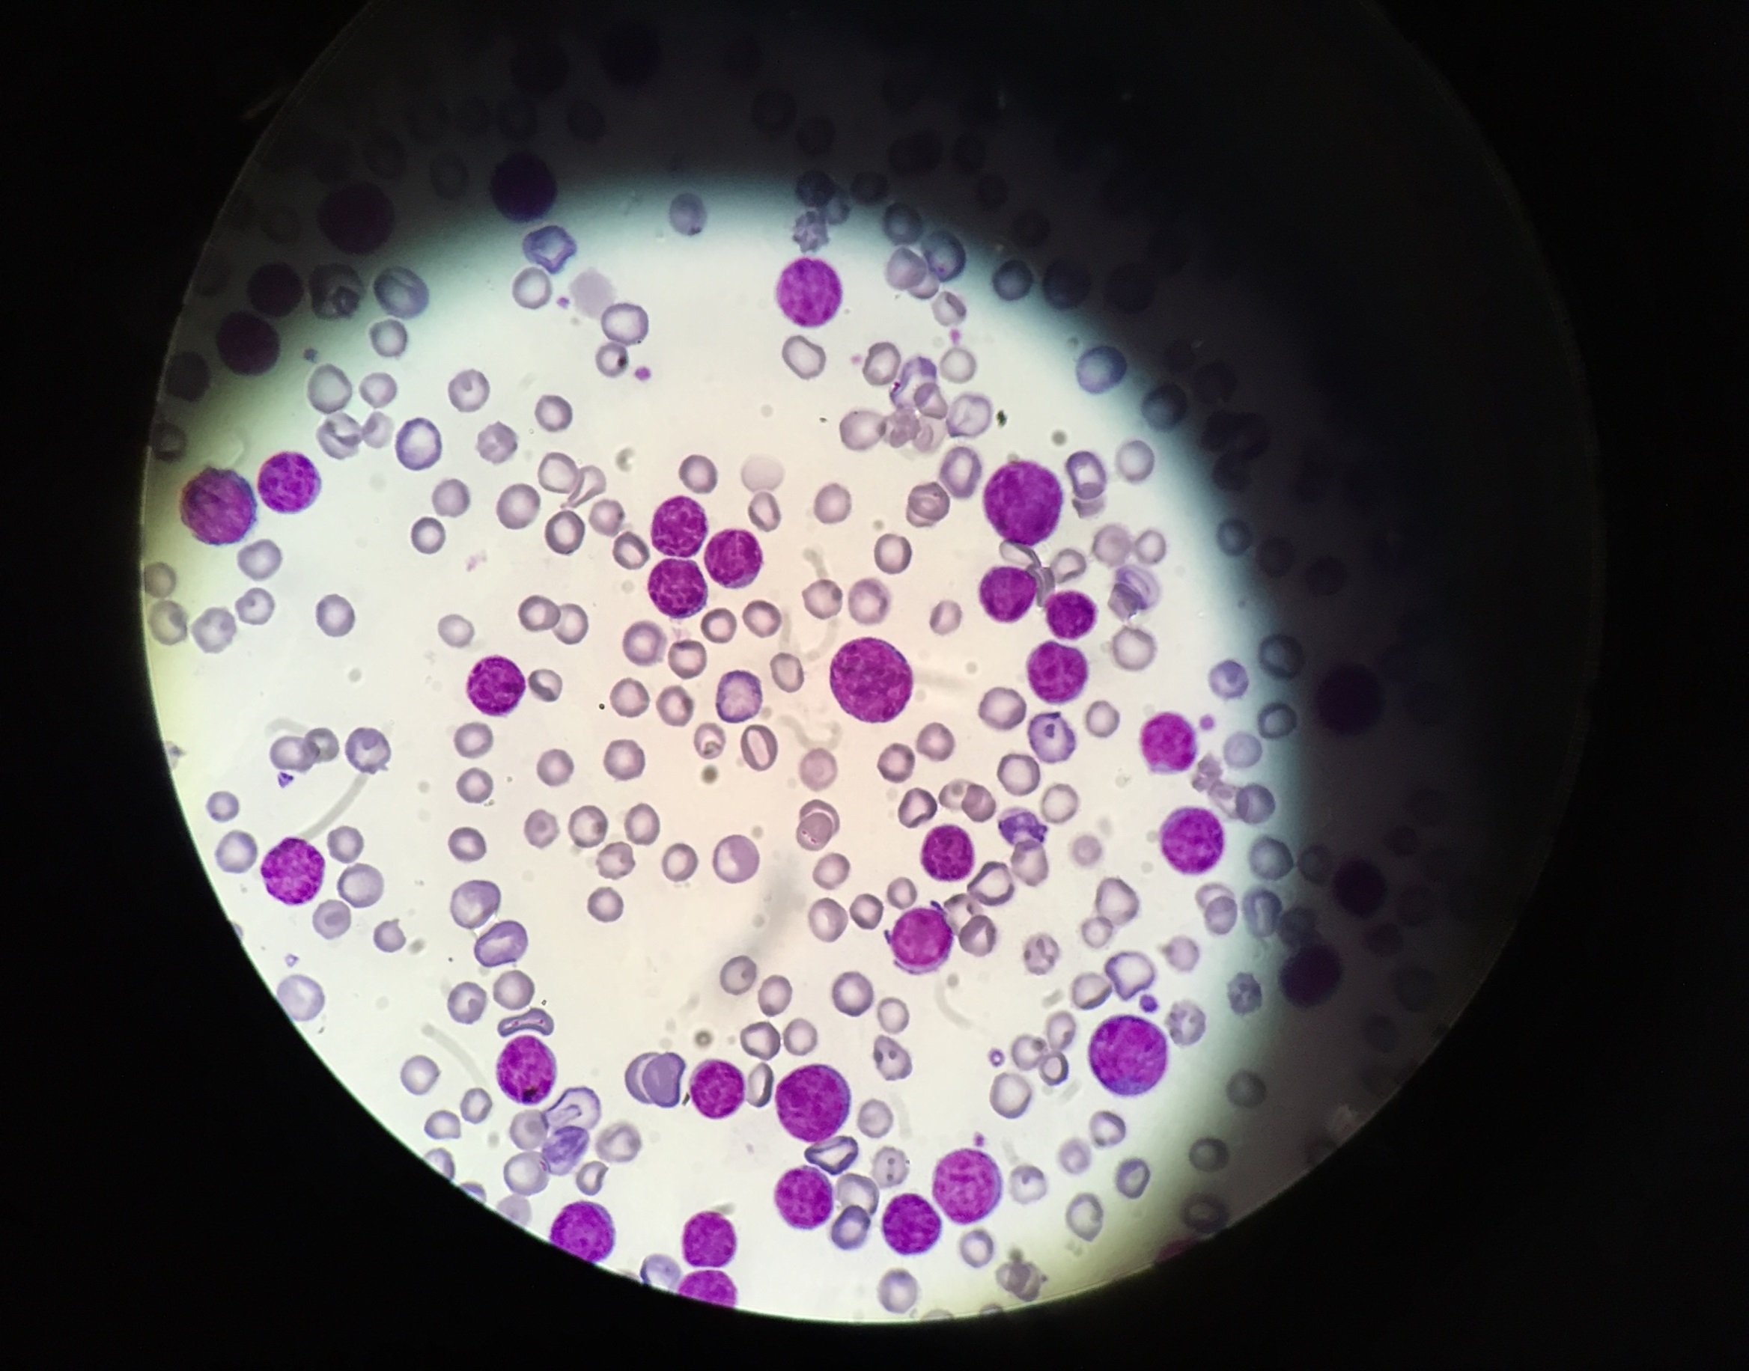
A
cKit
Ly6c
CD31
B220
GFP
mCh
cKit
Ly6c
CD31
B220
B
C
♀ rAML
Sfpi1^{mCh/GFP}
Sfpi1^{mCh/GFP}
Sfpi1^{mCh/GFP}
♀ rAML
Sfpi1^{wt/wt}
Sfpi1^{mCh/GFP}
500 bp
400 bp
850 bp
500 bp

