Slide 1
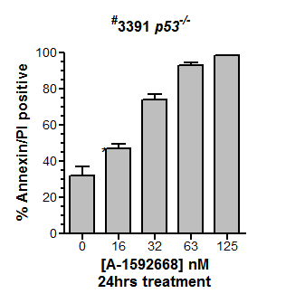
Supplemental Figure 1

Slide 2
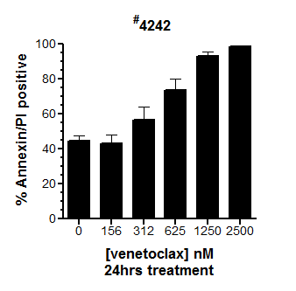
Supplemental Figure 2

Slide 3
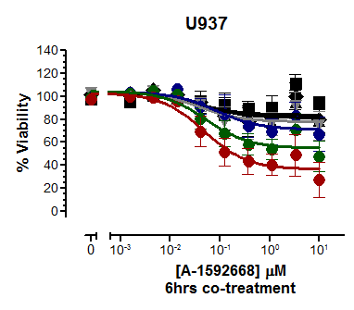
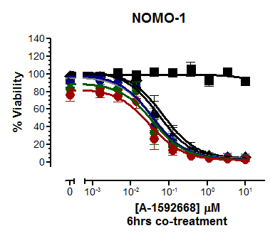
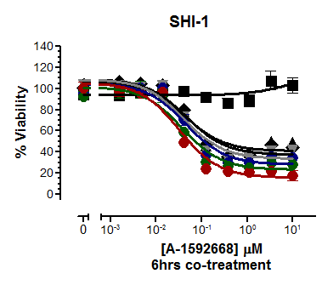
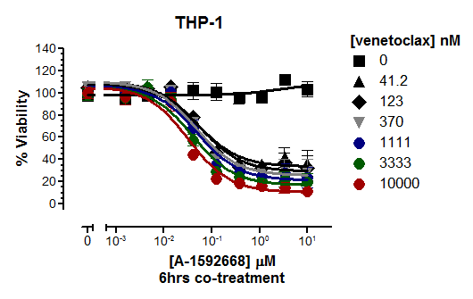
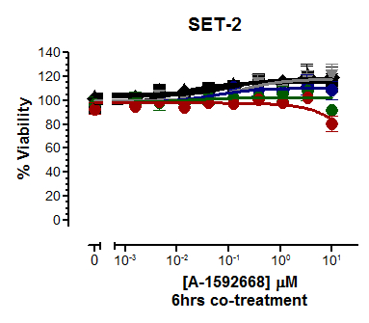
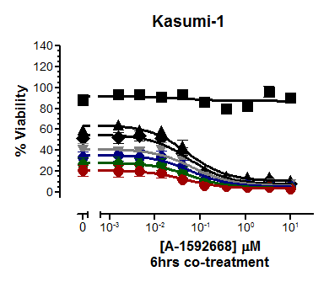
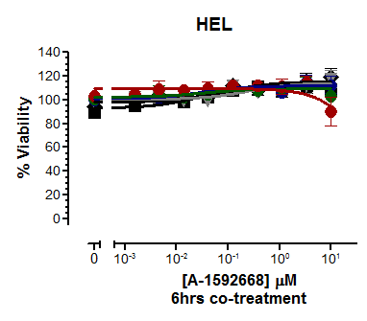
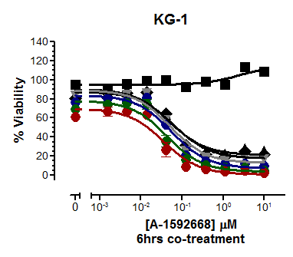
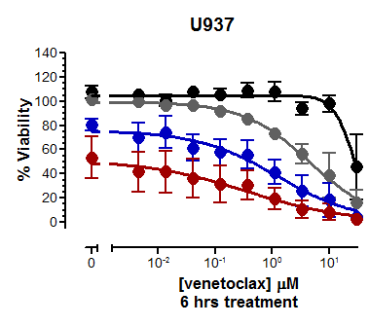
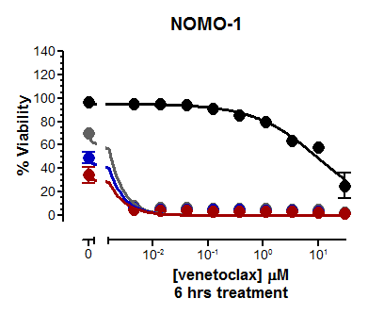
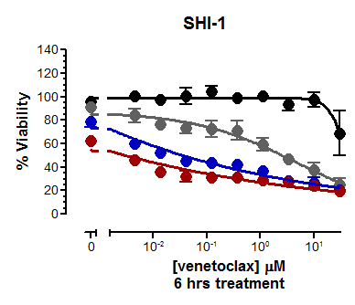
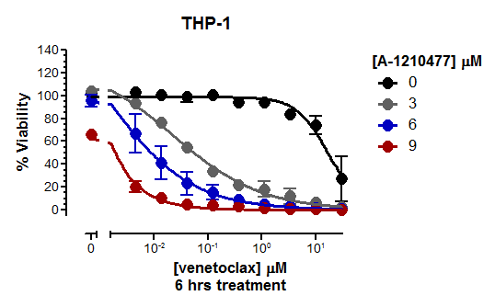
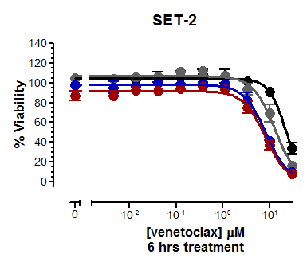
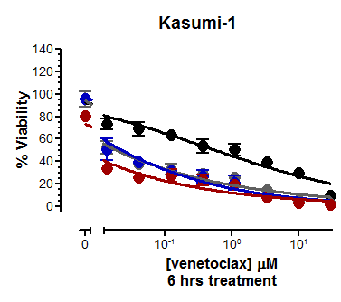
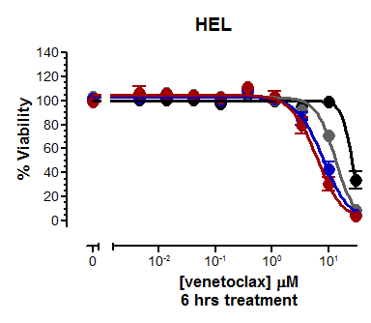
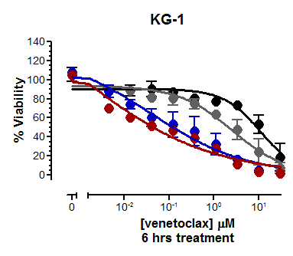
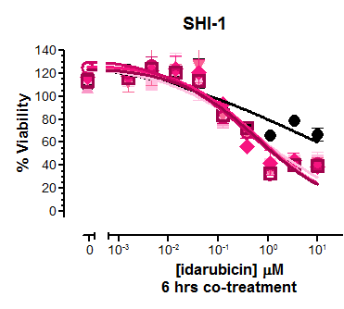
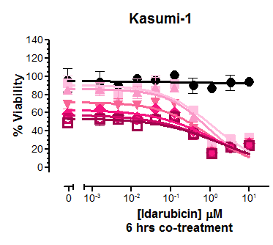
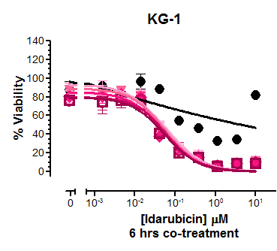
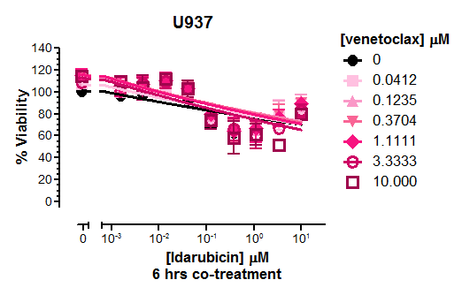
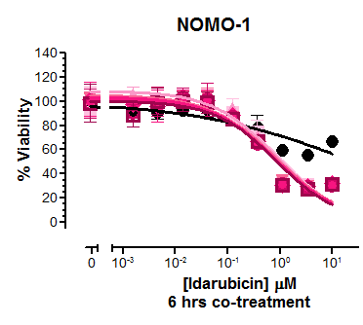
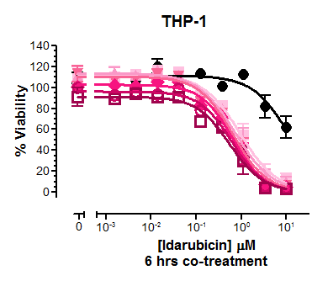
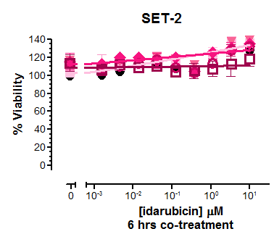
a
b
c
Supplemental Figure 3

Slide 4
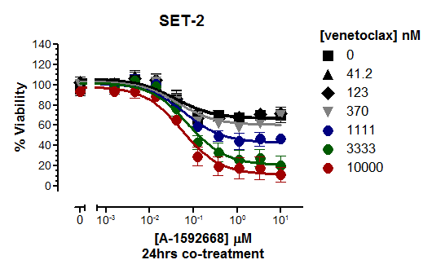
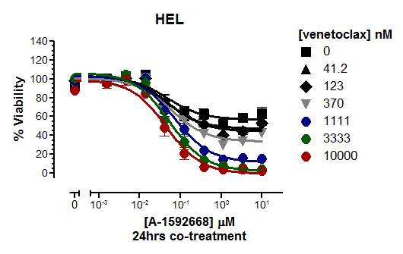
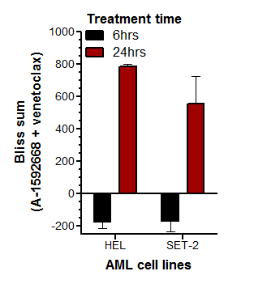
a
b
Supplemental Figure 4

Slide 5
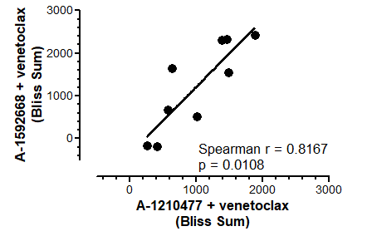
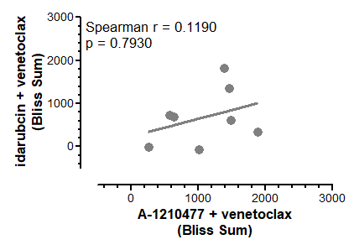
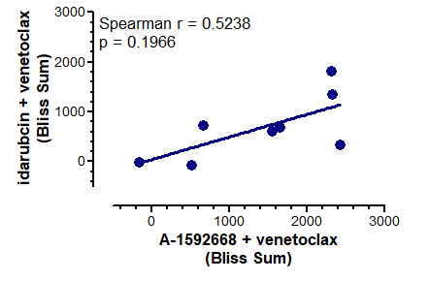
a
b
c
Supplemental Figure 5

Slide 6
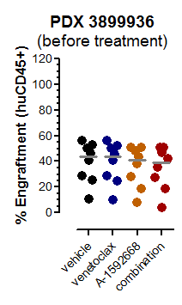
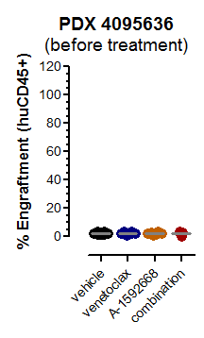
Supplemental Figure 6

Slide 7
AML cell line | TP53 status | A-1592668 IC₅₀ (nM)
HEL | M133K | >10,000
Kasumi-1 | R248Q | 54.1
KG-1 | E224 splice | 62.7
NOMO1 | C242 frame shift | 49.8
SET-2 | R248W, G187 splice | >10,000
SHI-1 | I195T | 26
SKM-1 | R248Q | 17.2
THP-1 | No coverage | 48.6
U937 | - | 28.9
Supplemental Table 1

Slide 8
a
Eµ-myc mouse model of lymphoma
Treatment | Median survival (Days)
vehicle | 17
A-1592668 | 30.5
venetoclax | 13
A-1592668 + venetoclax | 41
b
PDX 4095636
c
PDX 3899936
Treatment | Median survival (Days)
vehicle | 71
A-1592668 | 85
venetoclax | 70
A-1592668 + venetoclax | 99.5
Treatment | Median survival (Days)
vehicle | 67.5
A-1592668 | 74
venetoclax | 71
A-1592668 + venetoclax | 79.5
Supplemental Table 2

