Slide 1
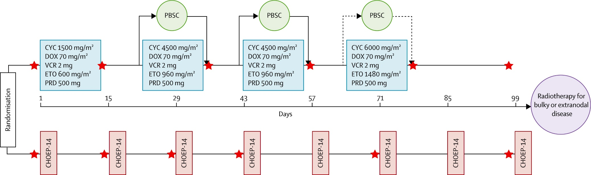
Suppl. Figure 1

