Slide 1
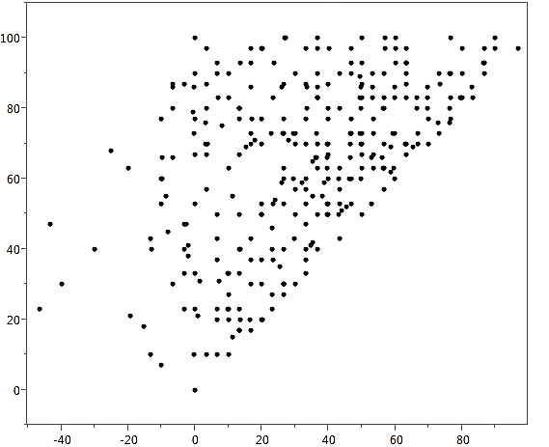
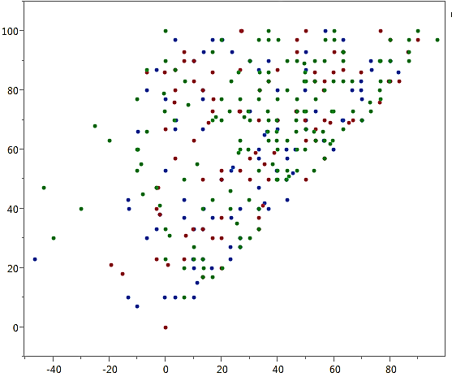
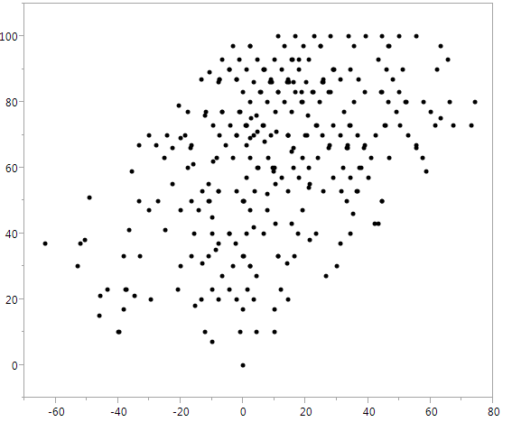
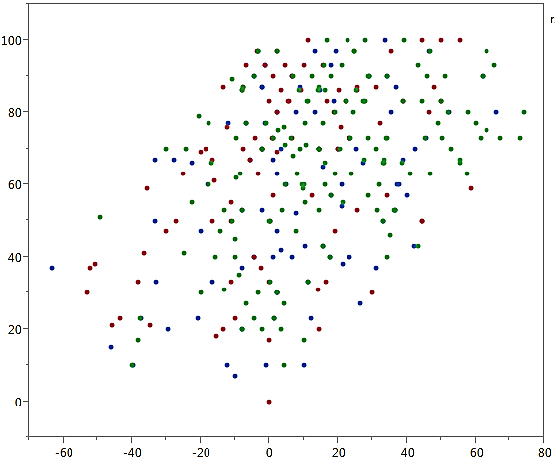
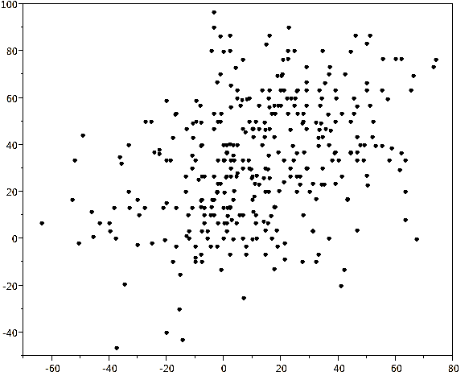
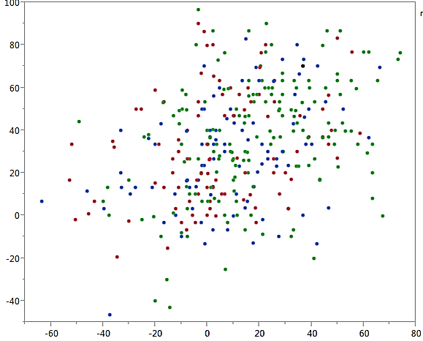
a
b
Figure S2
rs13477224 marker
S1 homozygote
B6 homozygote
Heterozygote
Fear retrieval score
Fear retrieval score
Extinction acquisition score
Extinction acquisition score
c
d
rs13477224 marker
S1 homozygote
B6 homozygote
Heterozygote
Fear retrieval score
Fear retrieval score
Extinction retrieval score
Extinction retrieval score
e
f
rs13477224 marker
S1 homozygote
B6 homozygote
Heterozygote
Extinction acquisition score
Extinction acquisition score
Extinction retrieval score
Extinction retrieval score

