Slide 1
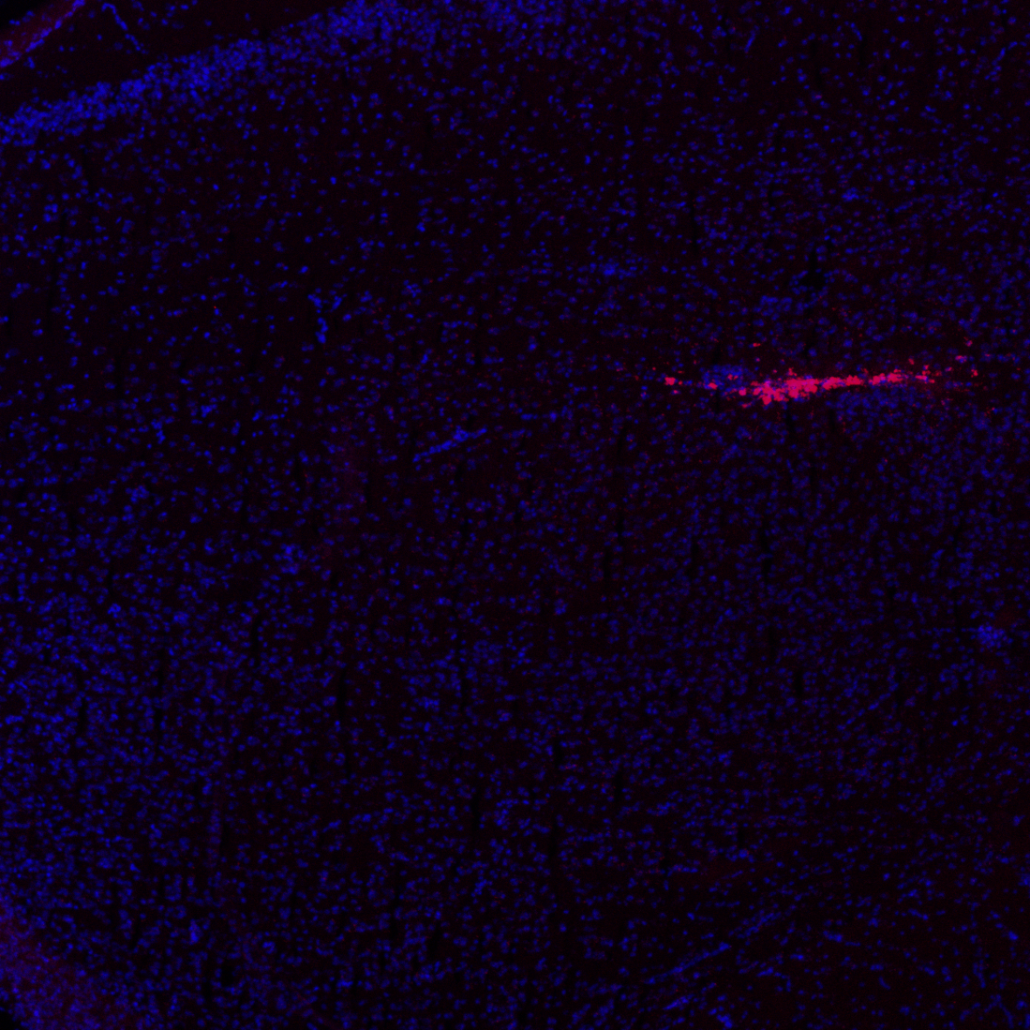
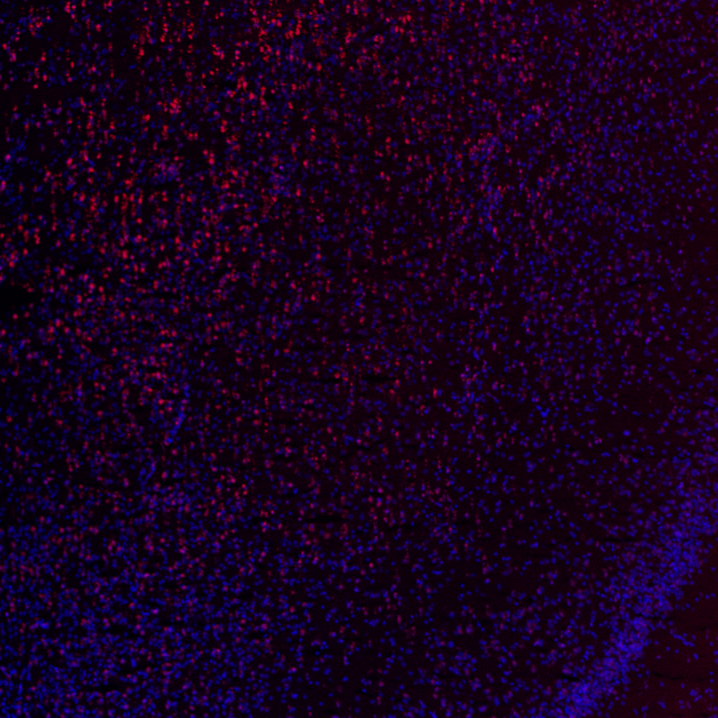
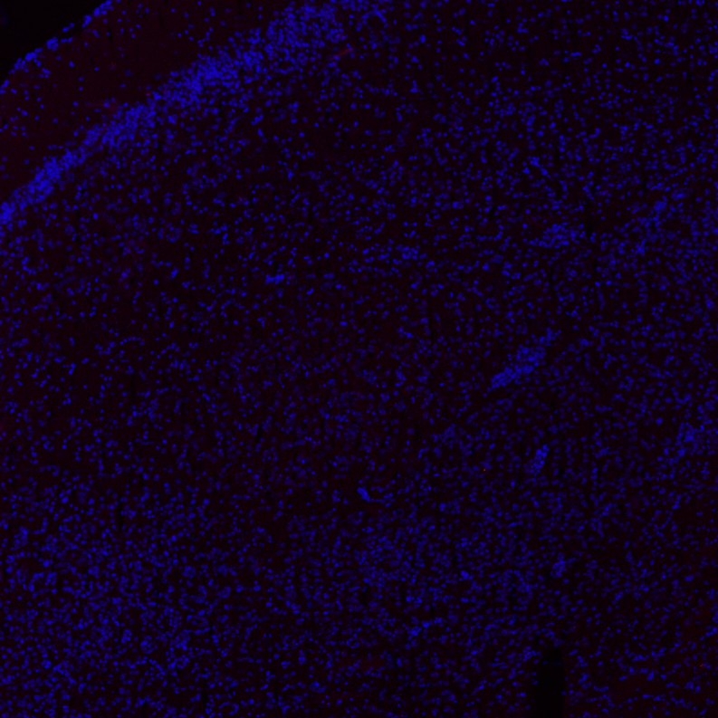
Figure S7
Injector tract
BLA
BLA
BLA
TUNEL
DAPI
TUNEL
DAPI
Positive reference
TUNEL
DAPI
Negative reference

