Slide 1
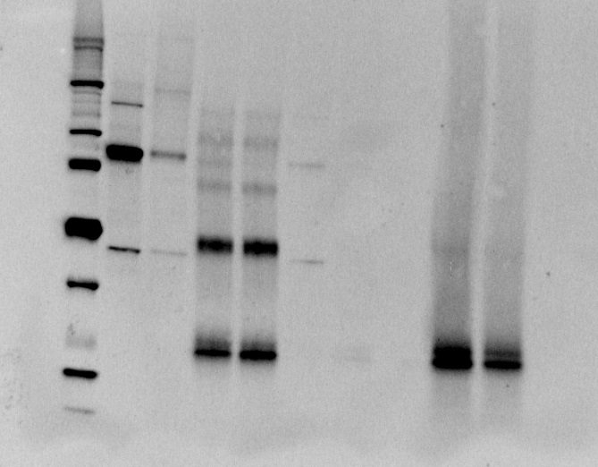
Figure S9
Beads with antibody flow through
Beads after denaturing
Unbound flow through
Input
IP
a
kDA
1 2 3 4 5 6 7 8 9 10
250
150
100
75
50
37
25
20
15
10
GR 95/90 kDA
GR 95/90 +PPID
IgG HC
IgG LC
b
250
150
100
75
50
37
25
20
15
10
1 2 3 4 5 6 7 8 9 10
GR 95/90 +PPID
PPID 40 kDA
IgG HC
IgG LC

