Slide 1
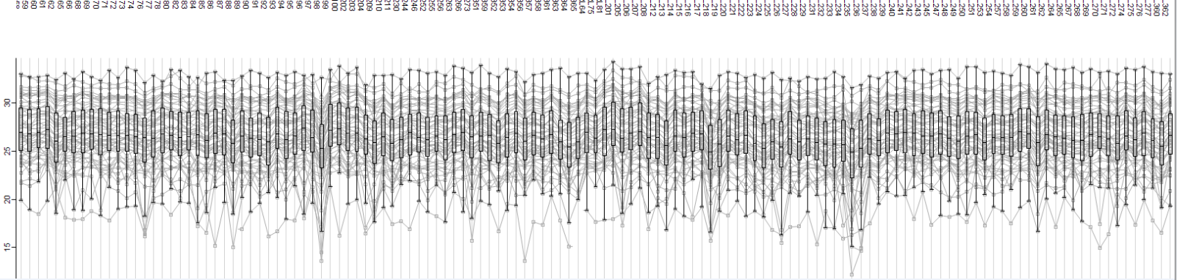
Supplementary Figure 1: Profile plots represent the log 2 transformed protein intensity levels (y-axis) for each protein quantified in each sample (x-axis). Overlaying box plots represent the overall distribution and median protein expression for each of the 64 cases and 67 controls profiled in the PE study.
Log2 protein intensity

