Slide 1
Supplementary Video1: 3D illustration of SNP heritability estimates for white matter tracts.

Slide 2
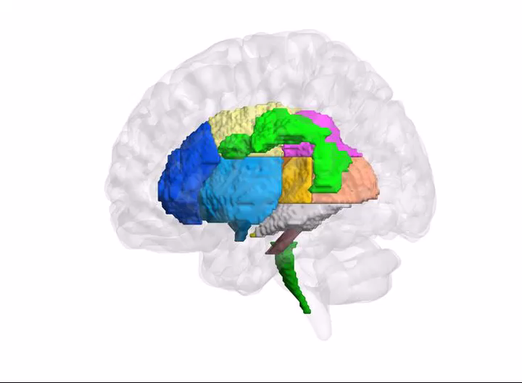

















ROI Annotation
ACR
ALIC
BCC
CGC
CGH
CST
EC
FX
FXST
GCC
IFO
PCR
PLIC
PTR
RLIC
SCC
SCR
SFO
SLF
SS
UNC
Anatomical while matter tracts

Slide 3
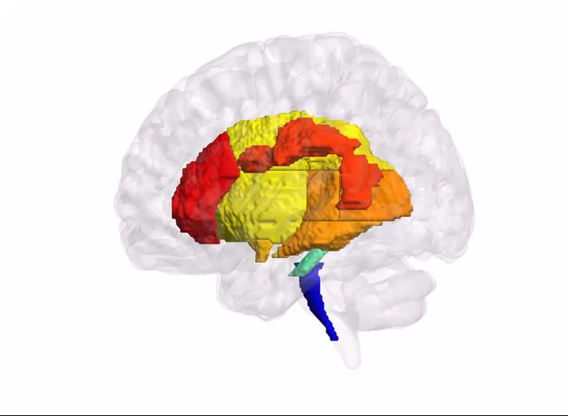
FA
SNP heritability estimates of FA for white matter tracts

Slide 4
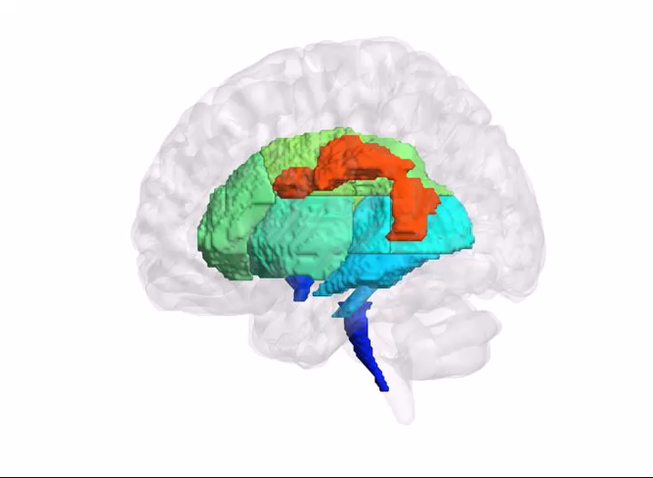
AD
SNP heritability estimates of AD for white matter tracts

Slide 5
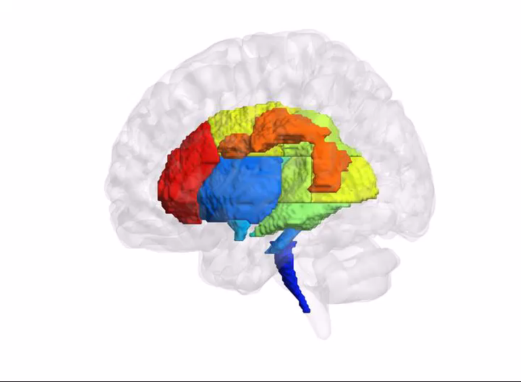
RD
SNP heritability estimates of RD for white matter tracts

Slide 6
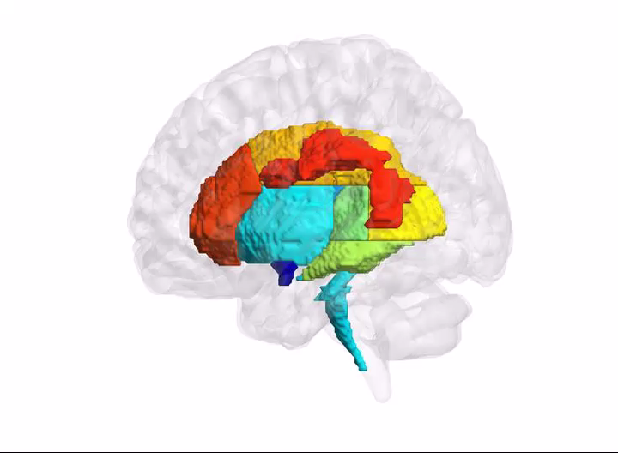
MD
SNP heritability estimates of MD for white matter tracts

Slide 7
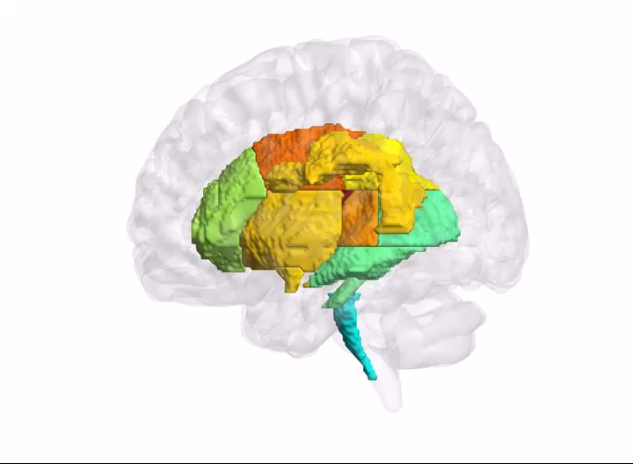
MO
SNP heritability estimates of MO for white matter tracts

