Slide 1
Supplemental Figure 2a: Randomized Clinical Trial Design with no placebo lead-in
MDD Historical Non-Responders on Antidepressant
Randomize
Adjunct Active Treatment
Adjunct Placebo

Slide 2
Supplemental Figure 2b: Randomized Clinical Trial Design with adjunct placebo lead-in
MDD Historical Non-Responders on Antidepressant
Adjunct Placebo
(OL, SB, DB)
No Response
Response
Randomize
Adjunct Active Treatment
Adjunct Placebo
Adjunct Placebo
OL: Open-label; SB: Single-blind; DB: Double-blind

Slide 3
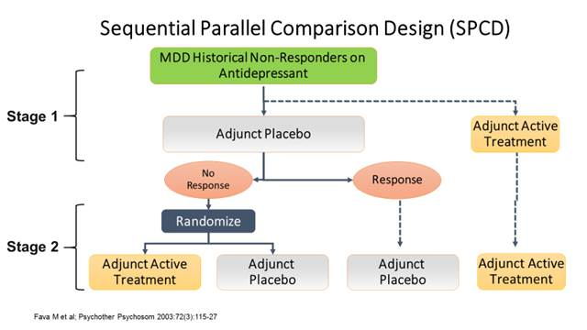
Supplemental Figure 2c: Sequential Parallel Comparison Design

