Slide 1
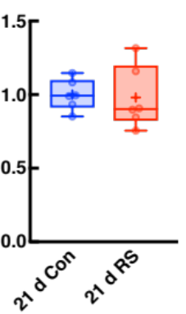
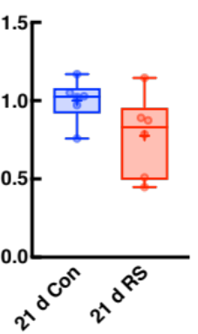
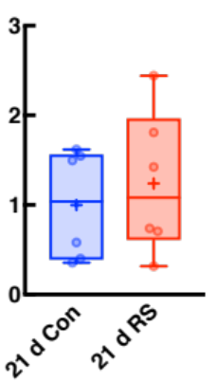
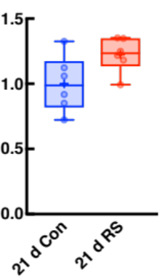



a
b
c
Lectin
OCLD
merge
  Relative CLDN5
  mRNA level
  Relative OCLD
  mRNA level
21 d Con
d
e
21 d RS
  Relative CLDN5
  protein level
  Relative OCLD
  protein level
f
21 d Con
21 d RS
CLDN5
OCLD
β-actin
Supplementary figure 2

