Slide 1
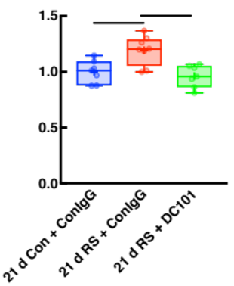
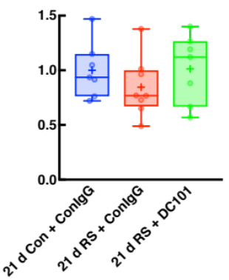
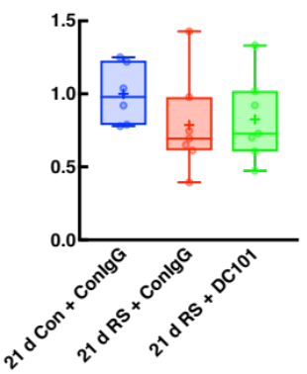
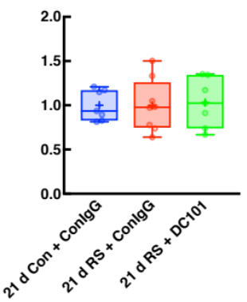
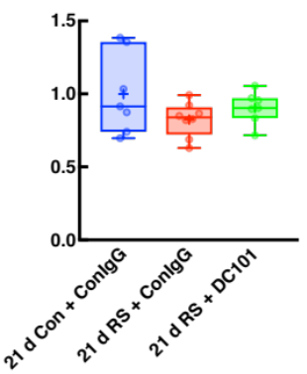




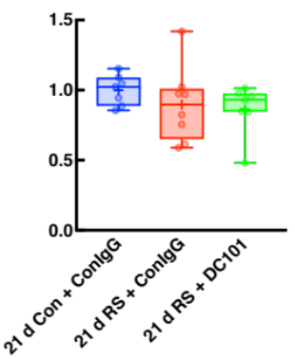
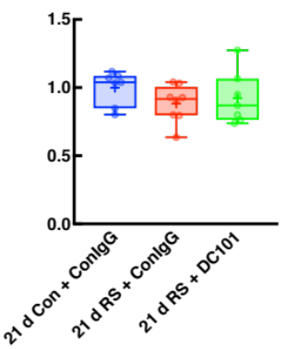




a
b
c
*
**
  Relative VEGFR2
  Protein level
  Relative p-VEGFR2 (Y951)/
  VEGFR2 ratio
  Relative p-VEGFR2 (Y1175)/
  VEGFR2 ratio
d
e
h
21 d Con + ConIgG
21 d Con + ConIgG
21 d Con + DC101
  Relative eNOS
  Protein level
  Relative p-eNOS (S1177)/
  eNOS ratio
VEGFR2
P-VEGFR2 (Y951)
P-VEGFR2 (Y1175)
f
g
eNOS
P-eNOS
(S1177)
  Relative Src
  Protein level
  Relative p-Src (Y416)/
  Src ratio
Src
P-Src
(Y416)
β-actin
Supplementary figure 6

