Slide 1
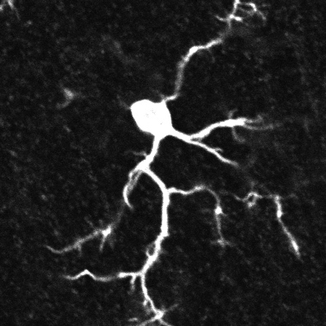
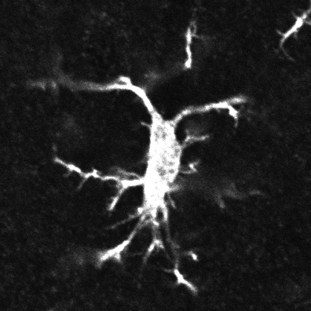
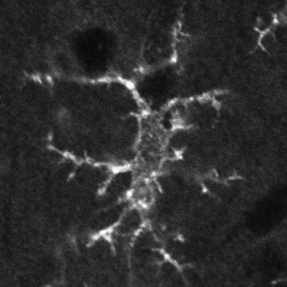
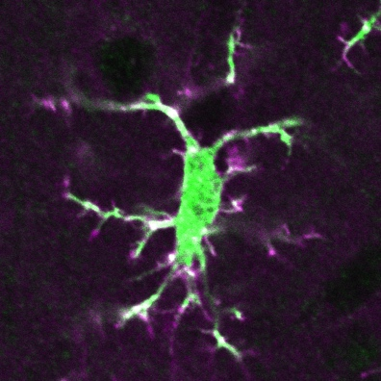
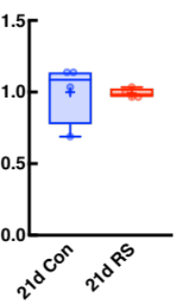
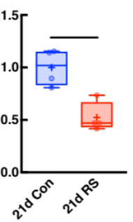
a
anti-Iba-1
anti-mIgG
merge
c
anti-Iba-1
21 d Con
21 d Con
21 d RS
21 d RS
  single optical section
  Z-projected image
b
anti-Iba-1
F(ab’2) fragment
of anti-mIgG
merge
d
21 d Con
Relative Iba-1
positive cell N
e
**
21 d RS
Relative Iba-1 positive area
  single optical section
Supplementary figure 7

