Slide 1
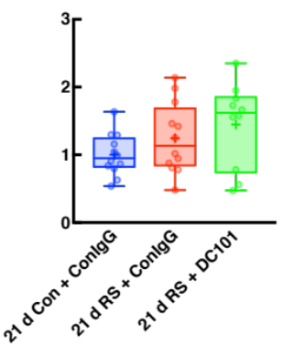
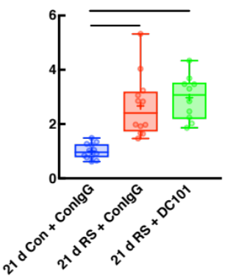
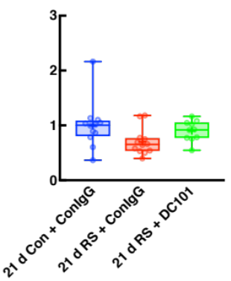
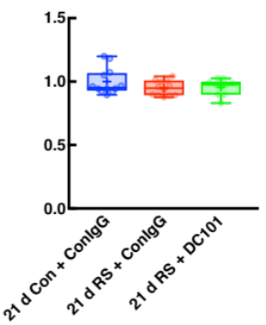
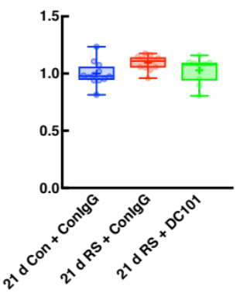
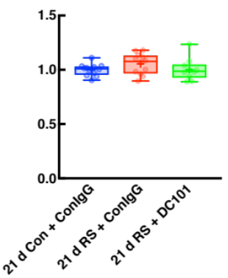
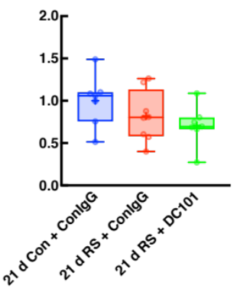
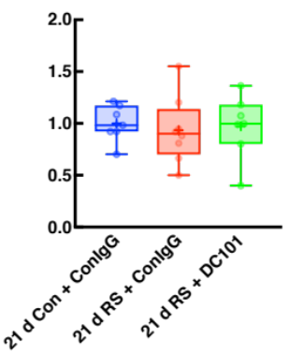
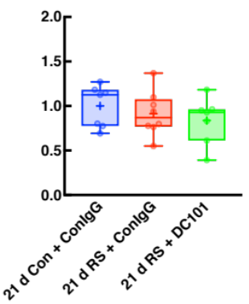
a
b
c
***
***
  Relative TNFα
  mRNA level
  Relative IL1β
  mRNA level
  Relative IL6
  mRNA level
d
e
f
  Relative Synaptophysin
  mRNA level
  Relative Iba-1
  mRNA level
  Relative CD68
  mRNA level
g
h
i
  Relative Synaptophysin
  Protein level
  Relative PSD-95
  protein level
  Relative Iba-1
  Protein level
Supplementary figure 9

