Slide 1
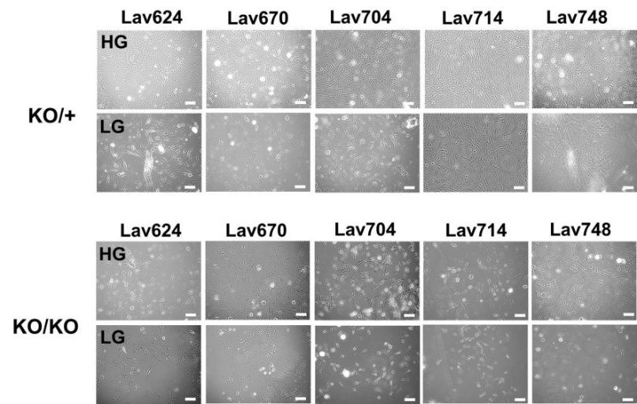
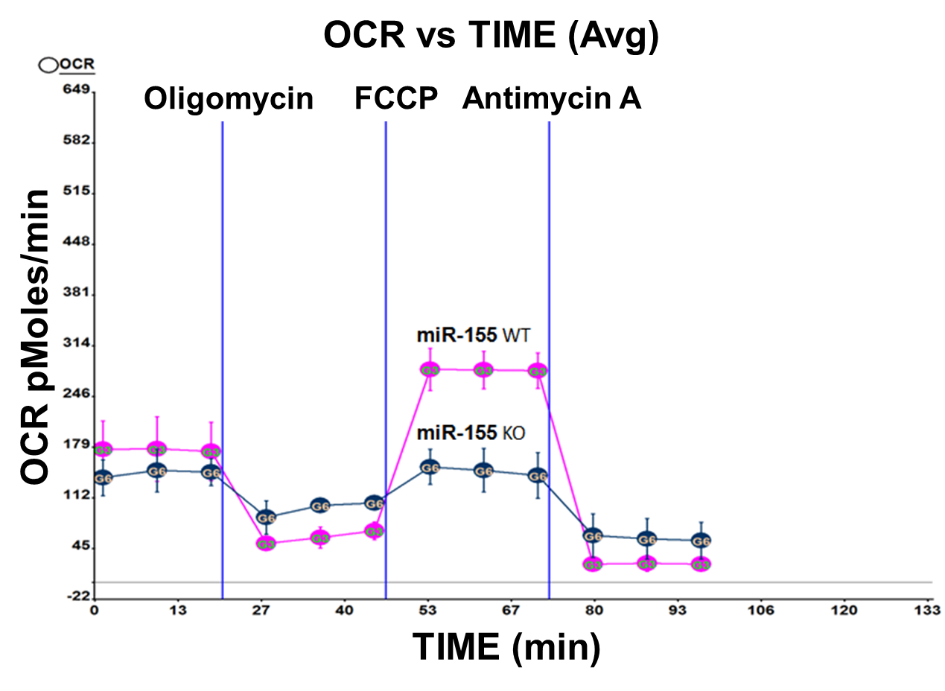
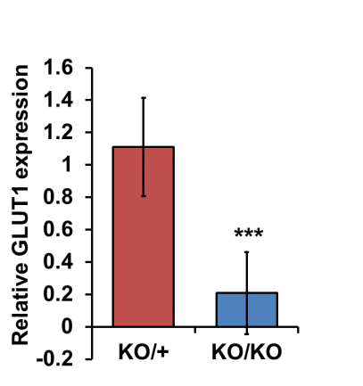
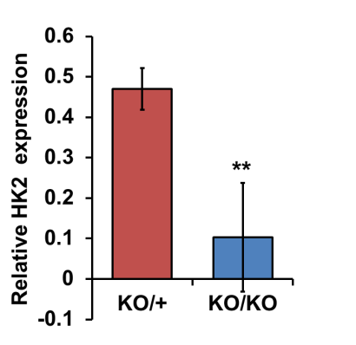
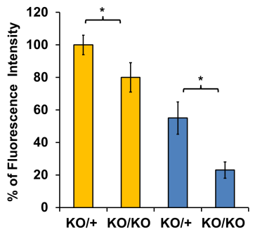

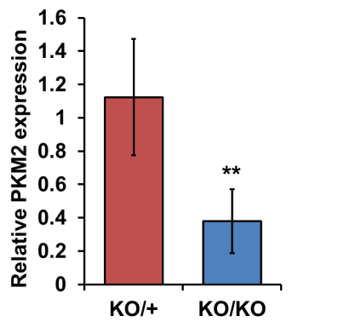
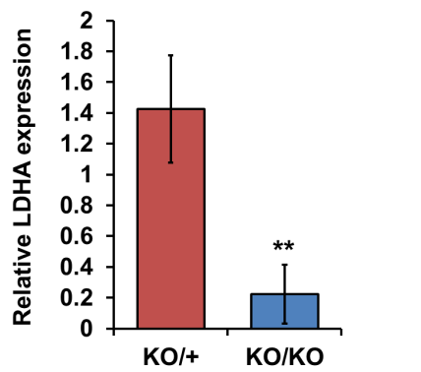
a
b
c
d
e
f
g
Supplementary Figure 1 Defects of miR-155 deficient cells in oxygen consumption and proliferation (a) Oxygen Consumption Rate (OCR) of miR-155 WT or KO breast cancer cells. miR-155^{+/KO} (in blue line) and miR-155^{KO/KO} (in red line) cells were plated on XF24 cell culture microplate and a Seahorse XF24 analyzer was used to measure the OCR. A bioenergetic profile of cells was generated by injecting electron transport chain (ETC) inhibitors (oligomycin, an ATP synthase inhibitor, FCCP, a mitochondrial uncoupler, and antimycin A, a complex III inhibitor) to probe mitochondria in different states of respiration (b) Phase contrast images of miR-155^{+/KO} and miR-155^{KO/KO} mammary tumor cells under normal glucose (NG) or low glucose (LG) media. (c) AlamarBlue assay results after culture in NG (in yellow) or LG (in blue) media. Cell proliferation was measured by a fluorescence spectrophotometer. *: p<0.05 (d-g) Graphs of protein level measured by densitometry (from Fig 1i). **: p<0.01, ***: p<0.001

Slide 2
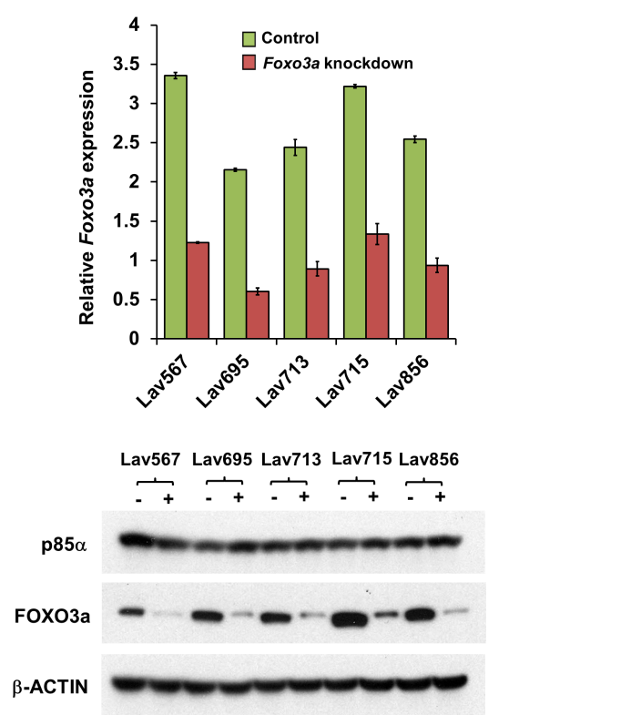
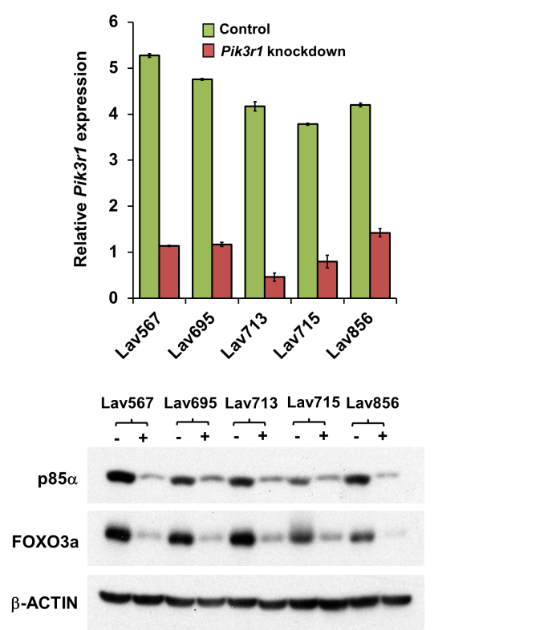
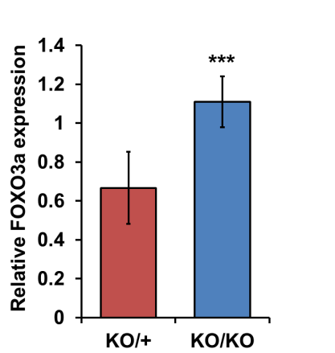
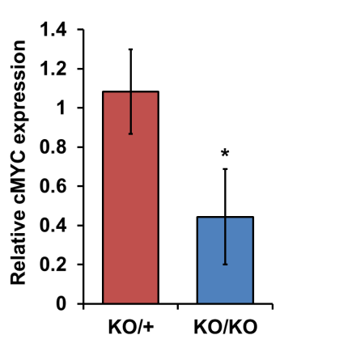
a
b
c
d
Supplementary Figure 2 Knockdown of Foxo3a or p85α or miR-155 in mouse mammary tumor cells (a and b) Knockdown of Foxo3a (a) or Pik3r1 (b) in miR-155^{+/KO} and miR-155^{KO/KO} breast cancer cells. The expression level of each gene was measured by real time PCR. Western blot analysis below indicates reduced FOXO3a and p85α protein level. Note that Pik3r1 knockdown caused decreased Foxo3a (b, lower panel). (c and d) Graphs of protein level measured by densitometry (from Fig 2c). *: p<0.05, ***: p<0.001

Slide 3
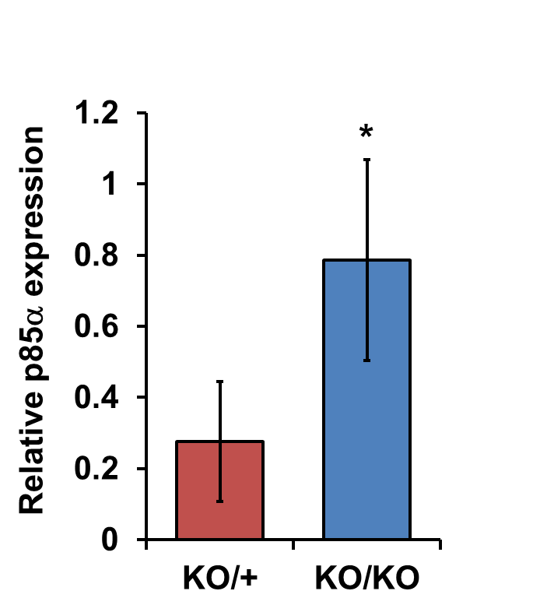
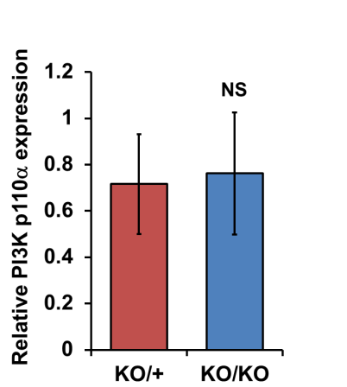
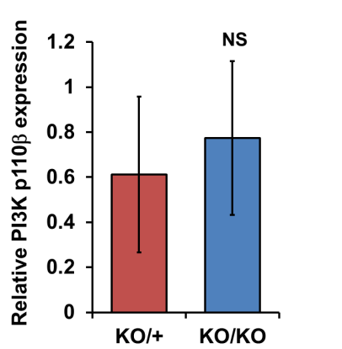
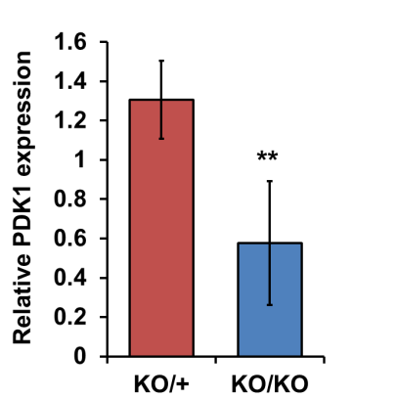
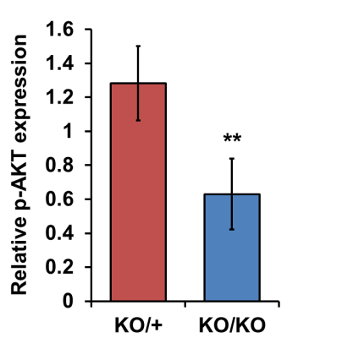
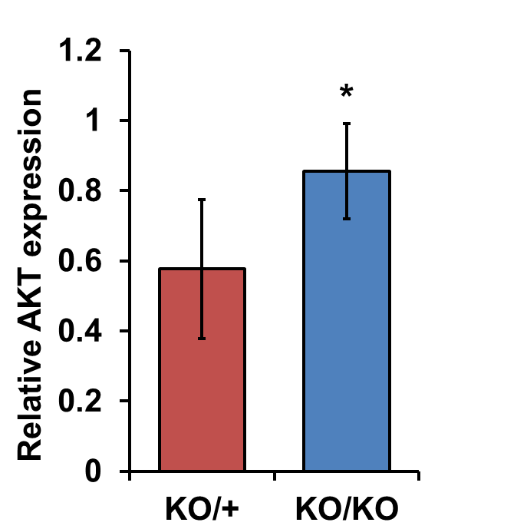
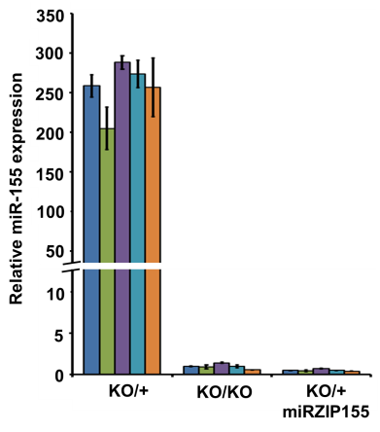
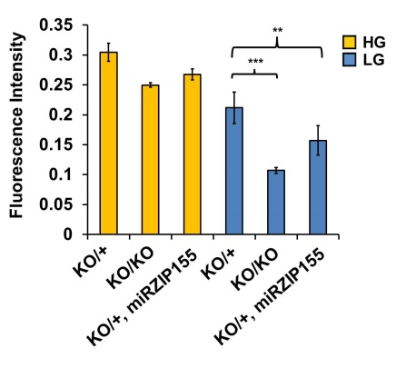
e
f
g
h
i
j
k
l
Supplementary Figure 2 (conti.) (e-j) Graphs showing protein level measured by densitometry (from Fig 2l). *: p<0.05, **: p<0.01 NS: non-significant (k) Stable knockdown of miR-155 using lentivirus (miRZIP155). Real time PCR measurement of miR-155 in five independent cancer cells with high miR-155 and its paired miRZIP155 clones. miR-155^{KO/KO} cells were used as controls. (l) Comparative analysis of the effect of a stable miR-155 knock-down and genetic inactivation of miR-155 on the growth of the cancer cells. miR-155^{+/KO} cells were knock-downed for miR-155 (miRZIP155) and its growth was compared with miR-155^{KO/KO} cells, by alamarBlue assay under normal media (NG) or in low-glucose media (LG) condition.

Slide 4
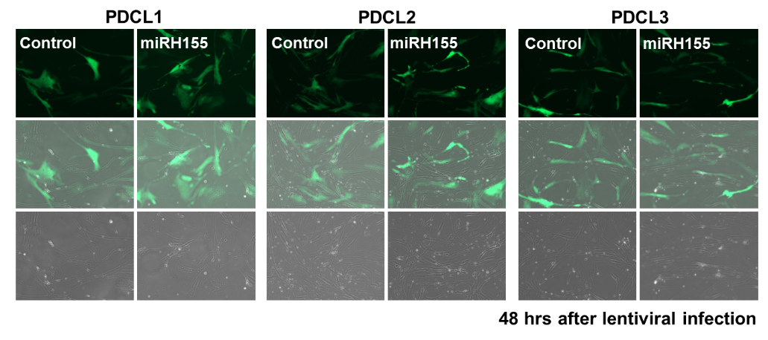
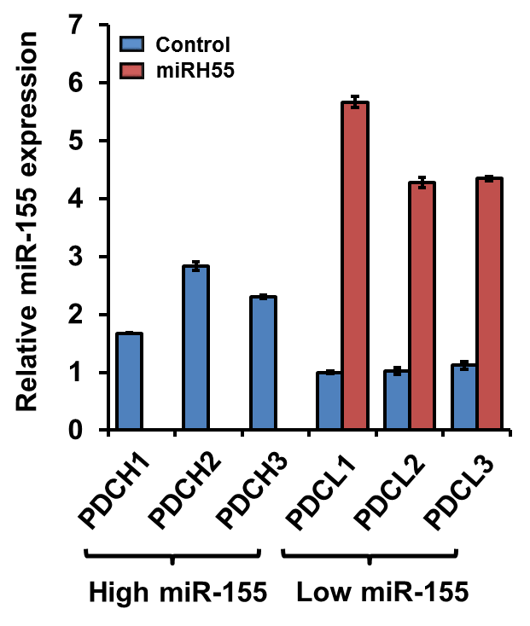
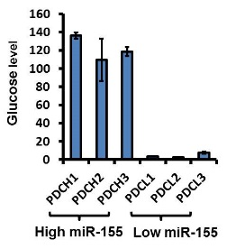
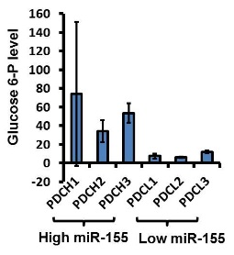
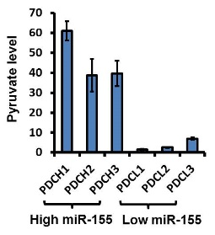
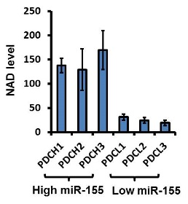
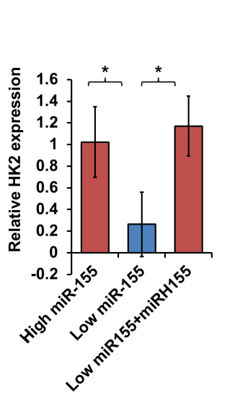
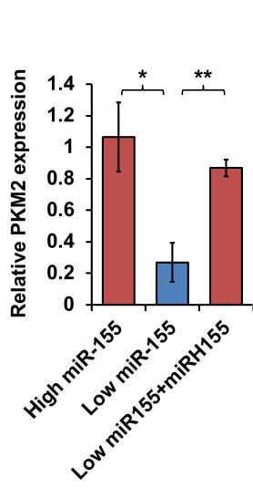
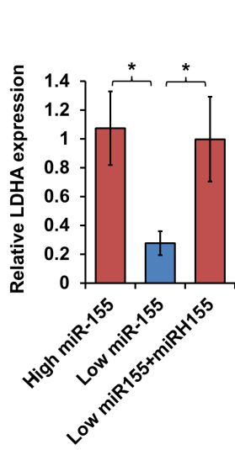
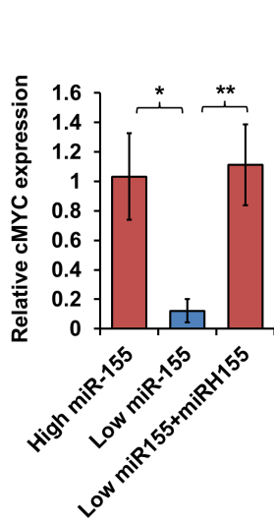
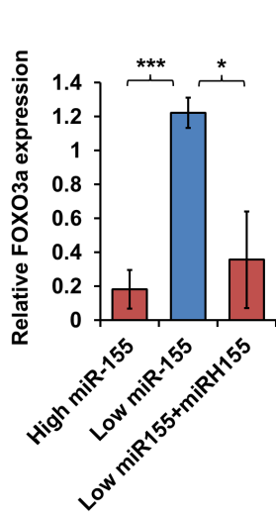
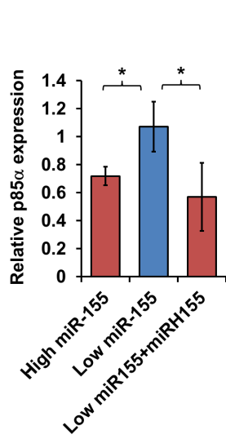
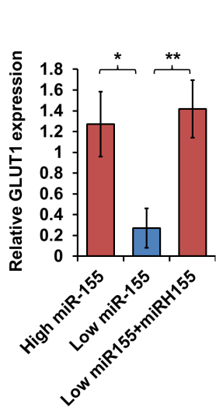
a
b
c
d
e
f
g
h
i
j
k
l
m
Supplementary Figure 3 Lentiviral infection of patient derived primary breast cancer cells for stable miR-155 over-expression. (a) Lentivirus expressing GFP only (Control) and GFP with miR-155 (miRH155) was infected to three independent primary breast cancer cells and the infection was monitored by fluorescence microscopy. (b) The relative revel of miR-155 in patient derived primary breast cancer cell lines (PDCL). Among 6 lines, those with higher miR-155 were labeled as PDCH1~3, and the lower miR-155 were labeled as PDCL1~3. Blue bar indicates basal level and the red bar indicates after miR-155 overexpression. (c-f) The level of metabolites in glycolysis and NAD in miR-155 high (PDCH) and miR-155 low (PDCL) primary breast cancer cells. Relative level of glucose (c), glucose-6-phosphate (d), pyruvate (e), NAD (f) are shown. (g-m) Graphs showing protein level measured by densitometry (from Fig 3f).

Slide 5
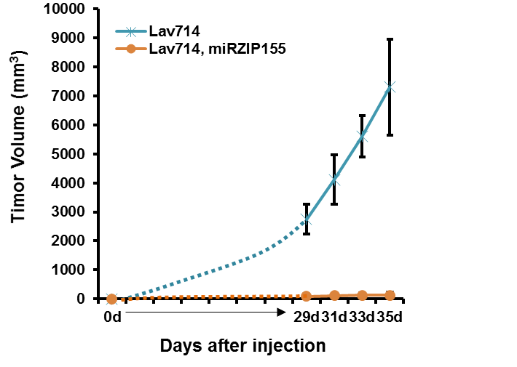
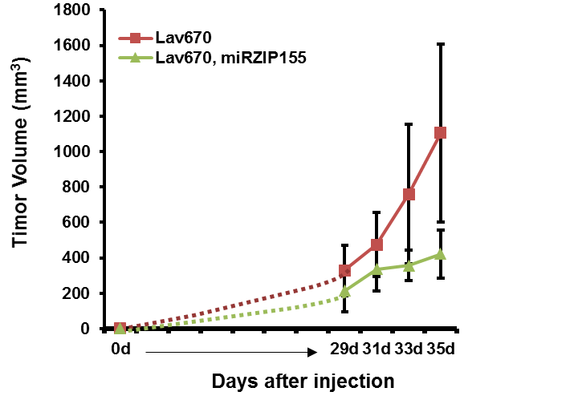
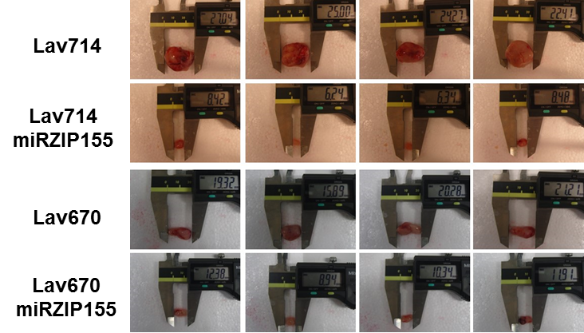
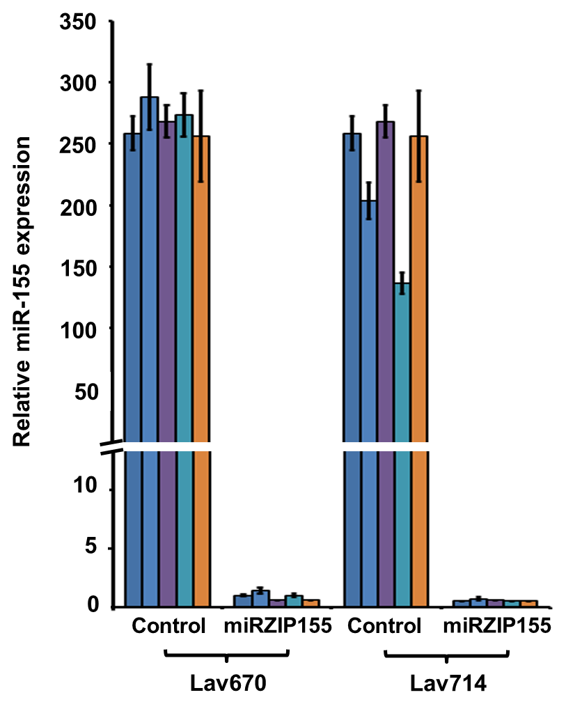
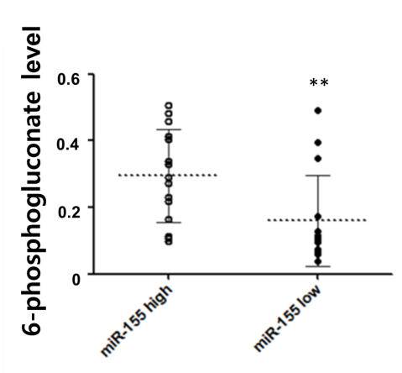
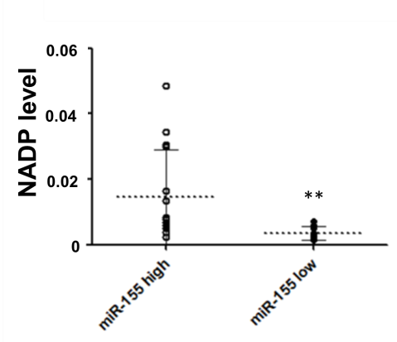
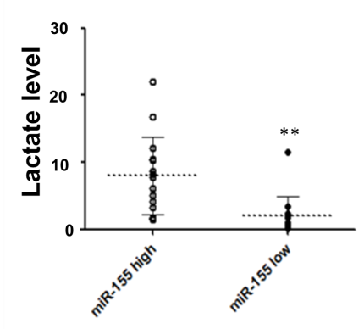
a
b
c
d
e
f
g
*
Supplementary Figure 4 In vivo effect of miR-155 knockdown on tumor growth. (a-c) Two pairs of control and miRZIP155 cells were allografted and the tumor growth was monitored (a for Lav714, B for Lav670) by measuring it with calipers (Shown in c). Tumor volume was calculated by length X (width)2/2. (d) Measurement of miR-155 in xenograft tumors (n=5 for each group) that were generated by control or miR-155 knockdown cells by lentivirus (miRZIP155). (e-g) Graphs showing relative Lactate (e), 6-phosphogluconate (f) and NADP (g) levels measured by LC-MS/MS in miR-155 high and low TNBC samples. . **: p<0.01 P=0.010221 (e), 0.001927 (f), and 0.012304 (g)

Slide 6
Sample Name |  | NAD | G6P/F6P | CIT/ISO CIT | AKG | FUM | MAL | FBP | ADP | NADH | 3PG | PYR | ATP | LAC | GLU | SUC | R5P_r5P | S7P | 6PG | NADPH | NADP
NG_KO/+ | Lav624 | 8.52 | 64.85 | 27.91 | 1.31 | 12.97 | 100.94 | 2.10 | 4.30 | 0.15 | 10.91 | 3.02 | 0.00 | 66.95 | 3.67 | 23.92 | 17.73 | 19.90 | 5.29 | 0.03 | 1.32
 | Lav670 | 2.93 | 64.43 | 21.48 | 3.04 | 7.73 | 48.72 | 1.66 | 3.00 | 0.03 | 10.83 | 1.21 | 0.00 | 26.52 | 2.39 | 8.52 | 11.14 | 10.12 | 2.71 | 0.03 | 0.46
 | Lav704 | 6.13 | 239.93 | 31.35 | 5.53 | 8.74 | 66.37 | 8.06 | 6.81 | 0.98 | 25.39 | 3.03 | 0.01 | 83.71 | 7.32 | 17.51 | 46.06 | 30.12 | 2.66 | 0.04 | 1.87
 | Lav714 | 5.20 | 158.20 | 18.17 | 3.17 | 8.68 | 37.83 | 2.83 | 1.51 | 0.06 | 16.93 | 1.52 | 0.00 | 34.08 | 2.89 | 10.83 | 16.51 | 11.15 | 3.65 | 0.02 | 0.79
 | Lav748 | 3.30 | 66.67 | 20.65 | 2.60 | 6.83 | 37.89 | 1.69 | 1.58 | 0.02 | 9.27 | 1.34 | 0.00 | 26.02 | 2.80 | 7.41 | 12.73 | 8.44 | 3.35 | 0.02 | 0.49
NG_KO/KO | Lav567 | 2.25 | 75.94 | 12.62 | 3.07 | 4.53 | 33.53 | 2.65 | 2.13 | 0.16 | 10.09 | 1.35 | 0.00 | 28.98 | 2.34 | 8.47 | 16.44 | 9.44 | 2.73 | 0.02 | 0.65
 | Lav695 | 3.33 | 43.77 | 11.58 | 1.15 | 3.49 | 24.66 | 1.52 | 2.38 | 0.05 | 2.94 | 1.17 | 0.00 | 25.51 | 2.12 | 6.38 | 5.75 | 7.72 | 1.80 | 0.02 | 0.65
 | Lav713 | 3.81 | 61.87 | 10.59 | 1.04 | 5.02 | 36.80 | 1.58 | 1.83 | 0.06 | 5.62 | 1.58 | 0.00 | 32.61 | 2.40 | 11.89 | 6.58 | 8.00 | 1.44 | 0.02 | 0.58
 | Lav715 | 4.10 | 60.00 | 29.00 | 3.02 | 8.58 | 60.58 | 2.63 | 1.87 | 0.06 | 7.70 | 2.05 | 0.01 | 40.54 | 3.98 | 13.80 | 21.86 | 8.79 | 7.04 | 0.01 | 0.84
 | Lav856 | 2.25 | 40.85 | 12.23 | 1.32 | 4.58 | 33.46 | 1.45 | 1.32 | 0.02 | 6.21 | 1.33 | 0.01 | 28.15 | 1.84 | 6.48 | 8.46 | 5.25 | 1.92 | 0.01 | 0.37
LG_KO/+ | Lav624 | 0.72 | 9.58 | 7.89 | 0.41 | 3.79 | 19.38 | 0.34 | 0.34 | 0.01 | 4.40 | 0.58 | 0.00 | 5.27 | 0.64 | 4.00 | 2.99 | 1.74 | 0.85 | 0.00 | 0.13
 | Lav670 | 1.28 | 20.79 | 6.72 | 0.44 | 2.47 | 10.40 | 0.31 | 0.56 | 0.01 | 3.65 | 0.35 | 0.00 | 6.45 | 0.74 | 3.21 | 3.44 | 4.32 | 0.51 | 0.01 | 0.19
 | Lav704 | 6.61 | 71.76 | 21.71 | 1.17 | 9.46 | 56.30 | 2.45 | 3.92 | 0.07 | 7.42 | 1.86 | 0.01 | 37.17 | 2.08 | 18.40 | 10.40 | 18.23 | 2.28 | 0.05 | 1.32
 | Lav714 | 8.47 | 114.94 | 11.86 | 1.05 | 14.72 | 112.82 | 2.80 | 3.77 | 0.22 | 7.22 | 2.01 | 0.01 | 39.21 | 2.76 | 33.83 | 12.13 | 20.53 | 2.38 | 0.06 | 2.10
 | Lav748 | 3.68 | 29.61 | 9.62 | 0.78 | 5.26 | 24.39 | 0.87 | 1.71 | 0.03 | 3.49 | 0.93 | 0.00 | 13.97 | 0.95 | 7.65 | 5.20 | 9.78 | 1.00 | 0.02 | 0.52
LG_KO/KO | Lav567 | 1.42 | 8.52 | 7.85 | 0.70 | 2.96 | 14.43 | 0.27 | 0.61 | 0.01 | 1.69 | 0.56 | 0.00 | 6.61 | 0.58 | 4.37 | 2.35 | 3.07 | 0.35 | 0.01 | 0.15
 | Lav695 | 1.08 | 28.14 | 10.08 | 0.67 | 5.79 | 38.68 | 1.10 | 1.72 | 0.03 | 2.05 | 1.10 | 0.00 | 18.33 | 1.01 | 10.82 | 5.21 | 13.75 | 1.16 | 0.02 | 0.75
 | Lav713 | 1.61 | 30.59 | 6.88 | 0.76 | 6.44 | 44.57 | 0.83 | 1.32 | 0.02 | 2.49 | 1.00 | 0.01 | 17.05 | 1.07 | 11.64 | 3.58 | 8.24 | 0.81 | 0.02 | 0.42
 | Lav715 | 0.63 | 38.24 | 10.33 | 1.18 | 5.36 | 34.26 | 1.57 | 2.74 | 0.11 | 2.14 | 1.48 | 0.01 | 29.23 | 1.89 | 14.88 | 4.48 | 11.21 | 1.17 | 0.02 | 0.70
 | Lav856 | 0.12 | 7.89 | 5.62 | 0.69 | 3.17 | 16.64 | 0.35 | 0.83 | 0.01 | 1.34 | 0.58 | 0.00 | 9.60 | 0.51 | 4.30 | 1.72 | 3.00 | 0.42 | 0.01 | 0.18
Supplementary Table 1 Raw data of the metabolite profiling of ten mouse breast cancer cell lines with miR-155^{+/KO} or miR-155^{KO/KO} genotype, under normal glucose media (NG) or low-glucose media (LG).

Slide 7
Sample Name |  | NAD | G6P/F6P | CIT/ISO CIT | AKG | FUM | MAL | FBP | ADP | NADH | 3PG | PYR | ATP | LAC | GLU | SUC | R5P | R15BP | S7P | 6PG | NADPH | NADP
KO/+ | Lav624 | 38.76 | 144.52 | 59.83 | 13.82 | 8.36 | 33.08 | 8.97 | 28.23 | 1.15 | 6.03 | 1.37 | 85.11 | 11.04 | 4.30 | 7.42 | 121.35 | 2.55 | 44.24 | 8.36 | 0.07 | 8.47
 | Lav670 | 27.58 | 238.55 | 110.08 | 1.49 | 6.68 | 17.03 | 28.67 | 6.74 | 1.04 | 15.23 | 3.46 | 24.51 | 24.73 | 10.99 | 6.87 | 202.66 | 3.74 | 200.25 | 22.54 | 0.07 | 10.81
 | Lav704 | 33.96 | 80.57 | 70.75 | 7.19 | 10.45 | 65.47 | 8.58 | 10.94 | 0.38 | 6.96 | 1.47 | 35.66 | 11.89 | 5.09 | 9.02 | 158.11 | 1.82 | 39.62 | 7.85 | 0.04 | 9.36
 | Lav714 | 44.76 | 55.76 | 54.81 | 7.28 | 6.49 | 30.34 | 4.04 | 10.34 | 0.46 | 2.29 | 1.10 | 42.29 | 7.34 | 3.58 | 6.54 | 86.29 | 1.38 | 14.36 | 3.55 | 0.06 | 5.82
 | Lav748 | 43.50 | 95.01 | 83.70 | 2.19 | 6.11 | 31.15 | 9.21 | 12.48 | 0.39 | 7.53 | 1.09 | 35.50 | 10.56 | 1.91 | 7.24 | 172.27 | 2.35 | 84.22 | 11.28 | 0.05 | 11.52
KO/KO | Lav567 | 1.97 | 8.06 | 20.78 | 0.19 | 1.04 | 6.82 | 0.60 | 0.14 | 0.01 | 1.29 | 0.28 | 0.07 | 4.59 | 1.70 | 1.06 | 13.80 | 0.15 | 8.00 | 1.13 | 0.00 | 0.61
 | Lav695 | 20.14 | 18.81 | 32.75 | 4.70 | 3.07 | 15.76 | 1.28 | 8.02 | 0.29 | 0.92 | 0.40 | 30.00 | 4.18 | 2.60 | 2.33 | 15.36 | 0.49 | 2.59 | 1.57 | 0.02 | 2.19
 | Lav713 | 27.50 | 86.56 | 133.44 | 2.96 | 8.65 | 67.26 | 4.05 | 18.57 | 0.43 | 3.10 | 1.13 | 67.53 | 7.12 | 2.96 | 5.82 | 44.54 | 0.88 | 11.72 | 2.79 | 0.03 | 6.18
 | Lav715 | 15.43 | 16.18 | 22.01 | 2.89 | 1.93 | 10.63 | 1.40 | 13.23 | 0.13 | 0.84 | 0.23 | 29.62 | 2.13 | 1.49 | 1.80 | 7.41 | 0.32 | 3.63 | 0.76 | 0.01 | 2.36
 | Lav856 | 2.28 | 22.06 | 44.05 | 1.42 | 2.59 | 19.47 | 6.07 | 0.31 | 0.01 | 5.90 | 0.88 | 0.95 | 16.94 | 2.56 | 4.23 | 22.34 | 0.32 | 39.08 | 4.01 | 0.01 | 1.57
KO/+ | Lav624 | 2.90 | 25.40 | 16.86 | 0.28 | 0.96 | 2.50 | 4.98 | 0.58 | 0.02 | 3.75 | 0.43 | 3.17 | 7.12 | 1.08 | 1.17 | 28.51 | 0.53 | 58.72 | 6.18 | 0.01 | 1.61
miRZIP155 | Lav670 | 15.68 | 40.44 | 23.02 | 2.95 | 2.42 | 12.53 | 2.33 | 5.83 | 0.28 | 1.70 | 0.37 | 25.52 | 3.37 | 7.75 | 2.26 | 45.22 | 0.68 | 12.24 | 3.54 | 0.02 | 4.27
 | Lav704 | 27.30 | 59.87 | 60.91 | 6.18 | 4.88 | 29.94 | 4.74 | 14.87 | 0.49 | 2.14 | 0.65 | 53.57 | 4.42 | 3.28 | 4.91 | 31.63 | 0.84 | 14.50 | 3.46 | 0.02 | 4.40
 | Lav714 | 26.19 | 27.32 | 25.46 | 4.30 | 2.81 | 14.59 | 4.05 | 15.41 | 0.14 | 1.47 | 0.36 | 53.11 | 3.07 | 1.26 | 4.25 | 13.95 | 0.68 | 10.22 | 2.32 | 0.03 | 6.71
 | Lav748 | 22.67 | 64.83 | 151.48 | 6.46 | 7.24 | 55.30 | 6.12 | 6.65 | 0.68 | 7.94 | 2.38 | 18.01 | 15.36 | 1.75 | 10.34 | 59.96 | 1.08 | 39.51 | 11.12 | 0.04 | 12.18
Supplementary Table 2 Raw data of the metabolite profiling of five miR-155^{+/KO}, miR-155^{KO/KO} or miR-155^{+/KO} cells with stable knockdown of miR-155 (miRZIP155).

Slide 8
Sample Name | NAD | G6P/F6P | CIT/ISO CIT | AKG | FUM | MAL | FBP | ADP | NADH | 3PG | PYR | ATP | LAC | GLU | SUC | PEP | R5P | R15BP | S7P | 6PG | NADPH | NADP
PDCH1 | 149.85 | 28.46 | 1095.56 | 74.30 | 64.85 | 418.07 | 16.12 | 119.63 | 1.64 | 5.84 | 64.22 | 80.59 | 768.15 | 138.52 | 35.76 | 20.21 | 3.70 | 2.02 | 4.02 | 11.27 | 0.01 | 6.42
PDCH2 | 172.97 | 27.70 | 1040.63 | 53.23 | 50.13 | 319.92 | 19.97 | 132.19 | 0.85 | 4.94 | 47.81 | 90.00 | 661.64 | 123.75 | 47.88 | 21.02 | 2.43 | 0.89 | 4.84 | 6.32 | 0.02 | 3.16
PDCH3 | 192.99 | 43.32 | 207.40 | 28.67 | 47.01 | 234.63 | 30.75 | 102.50 | 1.38 | 6.01 | 43.20 | 133.73 | 21.22 | 116.58 | 25.95 | 12.01 | 3.08 | 1.03 | 3.46 | 19.70 | 0.01 | 3.47
PDCL1 | 32.78 | 5.55 | 109.94 | 5.89 | 8.24 | 60.24 | 2.65 | 43.91 | 0.22 | 1.04 | 1.31 | 56.50 | 10.07 | 3.60 | 8.71 | 1.62 | 1.06 | 0.21 | 1.06 | 1.75 | 0.00 | 1.77
PDCL1 miRH155 | 109.08 | 22.25 | 216.00 | 15.98 | 29.38 | 194.40 | 16.96 | 114.48 | 0.34 | 4.95 | 4.32 | 142.56 | 28.51 | 7.38 | 30.56 | 7.21 | 3.33 | 1.03 | 4.81 | 7.10 | 0.15 | 4.57
PDCL2 | 21.17 | 5.29 | 23.26 | 3.90 | 5.66 | 28.93 | 2.97 | 12.61 | 0.12 | 0.65 | 2.40 | 17.70 | 2.77 | 2.12 | 3.48 | 0.96 | 0.36 | 0.11 | 0.46 | 2.14 | 0.00 | 0.43
PDCL2 miRH155 | 143.58 | 34.27 | 675.05 | 18.53 | 25.36 | 170.21 | 19.92 | 147.05 | 0.77 | 5.19 | 16.90 | 149.37 | 43.65 | 13.37 | 19.45 | 15.17 | 6.21 | 1.31 | 3.90 | 64.03 | 0.01 | 5.05
PDCL3 | 15.38 | 11.57 | 23.62 | 1.98 | 4.11 | 27.29 | 0.99 | 17.84 | 0.07 | 0.37 | 6.47 | 26.41 | 2.89 | 8.25 | 3.90 | 0.79 | 0.42 | 0.11 | 0.47 | 0.70 | 0.00 | 0.70
PDCL3 miRH155 | 63.39 | 27.81 | 263.32 | 18.18 | 15.17 | 91.38 | 3.42 | 32.60 | 0.27 | 1.22 | 24.34 | 21.00 | 154.08 | 27.59 | 9.15 | 5.75 | 1.00 | 0.49 | 1.18 | 2.96 | 0.00 | 1.63
Sample Name | NAD | G6P/F6P | CIT/ISO CIT | AKG | FUM | MAL | FBP | ADP | NADH | 3PG | PYR | ATP | LAC | GLU | SUC | PEP | R5P | R15BP | S7P | 6PG | NADPH | NADP
PDCH1 | 121.46 | 31.23 | 1080.22 | 67.72 | 63.25 | 390.11 | 17.80 | 94.59 | 0.97 | 5.56 | 55.52 | 64.93 | 654.85 | 137.69 | 40.47 | 23.51 | 4.06 | 2.07 | 4.32 | 14.16 | 0.12 | 4.89
PDCH2 | 87.65 | 27.70 | 691.94 | 35.85 | 32.58 | 197.52 | 16.44 | 86.39 | 0.63 | 3.81 | 32.12 | 49.06 | 444.52 | 83.03 | 36.53 | 12.87 | 1.48 | 0.57 | 2.99 | 4.78 | 0.10 | 4.57
PDCH3 | 191.95 | 53.36 | 258.75 | 30.44 | 52.76 | 267.21 | 33.15 | 91.32 | 1.25 | 6.00 | 43.25 | 141.21 | 22.07 | 124.18 | 32.30 | 13.95 | 3.26 | 1.30 | 5.07 | 22.83 | 0.12 | 3.49
PDCL1 | 36.03 | 6.59 | 127.17 | 5.53 | 7.51 | 50.46 | 2.83 | 26.49 | 0.15 | 0.78 | 1.43 | 68.48 | 8.15 | 3.84 | 5.91 | 2.20 | 1.57 | 0.32 | 0.90 | 7.61 | 0.04 | 1.99
PDCL1 miRH155 | 155.34 | 27.78 | 771.62 | 21.34 | 28.54 | 210.90 | 16.67 | 155.34 | 0.59 | 4.10 | 7.75 | 154.07 | 42.56 | 7.23 | 22.10 | 13.51 | 6.48 | 1.46 | 4.75 | 58.35 | 0.16 | 4.80
PDCL2 | 19.50 | 5.90 | 20.19 | 3.13 | 4.82 | 24.69 | 2.60 | 8.13 | 0.10 | 0.50 | 2.34 | 15.58 | 2.42 | 2.00 | 3.17 | 0.86 | 0.35 | 0.11 | 0.51 | 1.93 | 0.01 | 0.34
PDCL2 miRH155 | 150.93 | 30.19 | 697.23 | 17.12 | 31.99 | 205.00 | 20.05 | 136.29 | 0.70 | 4.75 | 17.28 | 136.29 | 37.40 | 13.82 | 20.39 | 14.76 | 6.16 | 1.48 | 4.30 | 48.88 | 0.16 | 4.43
PDCL3 | 25.08 | 13.77 | 40.73 | 3.33 | 6.71 | 42.96 | 2.48 | 26.57 | 0.10 | 0.79 | 6.68 | 36.75 | 5.14 | 8.51 | 6.16 | 1.69 | 0.78 | 0.21 | 0.83 | 1.27 | 0.03 | 0.99
PDCL3 miRH155 | 55.61 | 24.59 | 448.78 | 30.00 | 25.37 | 162.68 | 6.66 | 42.20 | 0.21 | 2.10 | 21.00 | 27.32 | 253.66 | 33.17 | 16.22 | 9.41 | 1.83 | 0.93 | 2.34 | 6.66 | 0.06 | 2.21
Sample Name | NAD | G6P/F6P | CIT/ISO CIT | AKG | FUM | MAL | FBP | ADP | NADH | 3PG | PYR | ATP | LAC | GLU | SUC | PEP | R5P | R15BP | S7P | 6PG | NADPH | NADP
PDCH1 | 142.12 | 163.35 | 520.73 | 10.39 | 33.83 | 313.43 | 491.71 | 8.52 | 1.44 | 1371.48 | 63.52 | 4.98 | 1359.04 | 132.26 | 123.55 | 113.60 | 320.07 | 4.21 | 92.12 | 1252.07 | 0.17 | 0.36
PDCH2 | 127.27 | 47.88 | 607.58 | 12.27 | 30.30 | 284.85 | 41.06 | 81.21 | 0.69 | 91.82 | 36.06 | 189.39 | 422.73 | 122.12 | 141.21 | 30.15 | 41.36 | 4.03 | 12.89 | 17.73 | 0.44 | 2.94
PDCH3 | 123.25 | 64.35 | 1002.21 | 12.66 | 29.82 | 250.92 | 60.96 | 79.56 | 0.83 | 118.38 | 32.18 | 163.84 | 309.96 | 115.06 | 214.02 | 33.80 | 50.33 | 3.91 | 40.44 | 31.88 | 0.31 | 3.22
PDCL1 | 23.56 | 10.46 | 193.10 | 3.34 | 5.72 | 48.45 | 5.32 | 21.15 | 0.18 | 8.91 | 1.91 | 40.46 | 28.51 | 3.52 | 45.40 | 6.09 | 11.72 | 0.98 | 4.26 | 3.39 | 0.12 | 0.96
PDCL1 miRH155 | 112.44 | 22.41 | 425.79 | 7.14 | 15.96 | 150.47 | 12.07 | 40.43 | 0.38 | 12.32 | 3.62 | 90.12 | 52.58 | 6.42 | 82.68 | 10.25 | 15.79 | 1.60 | 7.49 | 5.13 | 0.21 | 1.91
PDCL2 | 30.59 | 6.99 | 100.17 | 1.64 | 1.48 | 12.71 | 3.43 | 11.16 | 0.11 | 6.32 | 2.82 | 31.26 | 26.08 | 3.12 | 20.00 | 2.82 | 5.55 | 0.56 | 2.99 | 2.64 | 0.08 | 0.62
PDCL2 miRH155 | 219.65 | 30.36 | 437.87 | 8.83 | 14.46 | 99.36 | 31.76 | 64.96 | 0.85 | 36.33 | 16.94 | 159.75 | 107.06 | 15.76 | 76.51 | 13.62 | 29.11 | 4.11 | 23.87 | 19.01 | 0.22 | 3.83
PDCL3 | 16.22 | 10.97 | 127.84 | 3.37 | 3.83 | 32.56 | 9.35 | 24.17 | 0.18 | 16.88 | 7.71 | 79.40 | 31.46 | 6.10 | 27.17 | 5.55 | 11.59 | 1.41 | 5.66 | 11.09 | 0.17 | 1.44
PDCL3 miRH155 | 93.95 | 29.79 | 205.34 | 12.94 | 8.79 | 63.73 | 24.41 | 78.65 | 0.34 | 32.74 | 18.21 | 308.01 | 53.08 | 27.59 | 42.81 | 12.05 | 30.80 | 3.87 | 17.40 | 23.63 | 0.33 | 5.54
Supplementary Table 3 Raw data of the metabolite profiling for Patient derived cell line samples (PDCH1~3 and PDCL1~3) and miR-155 low-clones with miR-155 overexpression (miRH155).

Slide 9
Sample Name |  | NAD | G6P/F6P | CIT/ISO CIT | AKG | FUM | MAL | FBP | ADP | NADH | 3PG | PYR | ATP | LAC | GLU | SUC | PEP | R5P | R15BP | S7P | 6PG | NADPH | NADP
Lav670 | 1 | 0.45 | 0.75 | 15.66 | 0.15 | 2.15 | 14.12 | 1.29 | 0.38 | 0.03 | 0.52 | 2.56 | 0.06 | 41.64 | 6.68 | 11.98 | 0.07 | 0.61 | 0.07 | 0.95 | 0.17 | 0.00 | 0.02
Control | 2 | 0.38 | 1.00 | 14.66 | 0.24 | 2.44 | 15.07 | 1.41 | 0.38 | 0.02 | 0.54 | 1.81 | 0.07 | 28.75 | 2.57 | 9.98 | 0.07 | 0.48 | 0.06 | 0.99 | 0.20 | 0.00 | 0.02
 | 3 | 0.14 | 0.72 | 12.96 | 0.11 | 2.37 | 14.79 | 1.98 | 0.40 | 0.01 | 0.66 | 2.01 | 0.05 | 29.69 | 4.51 | 11.12 | 0.05 | 0.57 | 0.05 | 1.04 | 0.16 | 0.00 | 0.01
Lav670 | 1 | 0.08 | 0.50 | 8.59 | 0.09 | 1.57 | 9.83 | 1.14 | 0.27 | 0.01 | 0.47 | 1.30 | 0.04 | 18.63 | 2.46 | 7.20 | 0.04 | 0.42 | 0.03 | 0.66 | 0.10 | 0.00 | 0.01
miRZIP155 | 2 | 0.09 | 0.48 | 6.32 | 0.08 | 1.38 | 8.34 | 0.96 | 0.19 | 0.01 | 0.37 | 1.15 | 0.02 | 17.27 | 2.42 | 6.14 | 0.03 | 0.36 | 0.02 | 0.55 | 0.09 | 0.00 | 0.01
 | 3 | 0.03 | 0.39 | 9.48 | 0.10 | 1.28 | 8.02 | 0.22 | 0.05 | 0.00 | 0.20 | 1.26 | 0.00 | 17.08 | 1.97 | 3.93 | 0.04 | 0.26 | 0.02 | 0.59 | 0.08 | 0.00 | 0.00
Lav714 | 1 | 0.12 | 1.61 | 13.05 | 0.11 | 3.02 | 19.34 | 2.55 | 0.50 | 0.01 | 0.84 | 3.55 | 0.06 | 47.52 | 9.13 | 10.84 | 0.08 | 1.43 | 0.05 | 1.50 | 0.24 | 0.00 | 0.01
Control | 2 | 0.11 | 1.27 | 18.40 | 0.09 | 2.87 | 17.91 | 2.82 | 0.52 | 0.01 | 0.94 | 2.72 | 0.09 | 38.18 | 6.11 | 10.23 | 0.07 | 1.34 | 0.05 | 1.33 | 0.20 | 0.00 | 0.01
 | 3 | 0.05 | 1.85 | 14.38 | 0.11 | 3.39 | 20.03 | 4.44 | 0.35 | 0.01 | 1.70 | 2.29 | 0.06 | 29.40 | 4.64 | 7.02 | 0.08 | 1.24 | 0.04 | 1.18 | 0.17 | 0.00 | 0.01
Lav714 | 1 | 0.02 | 1.02 | 6.21 | 0.04 | 1.41 | 8.71 | 1.66 | 0.18 | 0.00 | 0.57 | 1.25 | 0.02 | 17.22 | 3.12 | 5.06 | 0.04 | 0.87 | 0.02 | 0.82 | 0.11 | 0.00 | 0.00
miRZIP155 | 2 | 0.01 | 0.81 | 5.02 | 0.05 | 1.11 | 6.71 | 0.84 | 0.06 | 0.00 | 0.31 | 0.82 | 0.01 | 10.47 | 1.34 | 2.90 | 0.02 | 0.39 | 0.01 | 0.48 | 0.07 | 0.00 | 0.00
 | 3 | 0.02 | 0.69 | 8.55 | 0.05 | 1.27 | 7.61 | 0.91 | 0.09 | 0.00 | 0.42 | 1.56 | 0.01 | 19.58 | 3.30 | 4.31 | 0.03 | 0.51 | 0.02 | 0.65 | 0.09 | 0.00 | 0.00
Supplementary Table 4 Raw data of the metabolite profiling for allograft tumors generated from two mouse mammary tumor cells (Lav670 and Lav714) and its paired clones with stable miR-155 knockdown (miRZIP155).

Slide 10
Sample Name | NAD | G6P/F6P | CIT/ISO CIT | AKG | FUM | MAL | FBP | ADP | NADH | 3PG | PYR | ATP | LAC | GLU | SUC | PEP | R5P_r5P | R15BP | S7P | 6PG | NADPH | NADP
1_T | 0.01 | 1.16 | 4.04 | 0.14 | 0.61 | 4.18 | 0.19 | 0.03 | 0.00 | 0.19 | 0.21 | 0.01 | 5.57 | 0.87 | 1.16 | 0.06 | 0.43 | 0.01 | 0.28 | 0.12 | 0.0002 | 0.00
2_T | 0.08 | 5.47 | 7.39 | 0.17 | 2.40 | 15.57 | 1.89 | 0.46 | 0.01 | 0.55 | 0.71 | 0.08 | 19.65 | 5.02 | 7.73 | 0.04 | 0.98 | 0.01 | 0.95 | 0.68 | 0.0003 | 0.01
3_T | 0.04 | 0.16 | 1.22 | 0.16 | 0.66 | 4.78 | 0.04 | 0.09 | 0.01 | 0.04 | 0.69 | 0.04 | 18.66 | 3.71 | 0.74 | 0.01 | 0.20 | 0.00 | 0.05 | 0.01 | 0.0001 | 0.00
4_T | 0.05 | 1.33 | 3.26 | 0.15 | 1.10 | 7.50 | 0.73 | 0.36 | 0.01 | 0.27 | 0.70 | 0.06 | 21.01 | 4.75 | 5.08 | 0.03 | 0.58 | 0.01 | 0.40 | 0.06 | 0.0003 | 0.01
5_T | 0.01 | 0.16 | 2.61 | 0.08 | 0.31 | 1.82 | 0.02 | 0.01 | 0.00 | 0.07 | 0.10 | 0.01 | 1.89 | 0.40 | 0.23 | 0.07 | 0.06 | 0.00 | 0.04 | 0.03 | 0.0001 | 0.00
6_T | 0.02 | 4.31 | 4.48 | 0.12 | 1.07 | 7.60 | 1.43 | 0.21 | 0.01 | 0.59 | 0.62 | 0.03 | 15.93 | 3.48 | 2.99 | 0.03 | 1.15 | 0.01 | 0.39 | 0.47 | 0.0002 | 0.00
7_T | 0.01 | 0.25 | 2.60 | 0.11 | 0.54 | 3.93 | 0.03 | 0.03 | 0.00 | 0.07 | 0.31 | 0.01 | 7.60 | 1.24 | 1.14 | 0.01 | 0.21 | 0.00 | 0.13 | 0.02 | 0.0001 | 0.00
8_T | 0.02 | 1.29 | 3.50 | 0.20 | 1.64 | 11.17 | 0.94 | 0.80 | 0.01 | 0.48 | 0.57 | 0.11 | 28.40 | 6.37 | 2.02 | 0.05 | 1.36 | 0.02 | 0.57 | 0.04 | 0.0008 | 0.02
9_T | 0.32 | 0.53 | 3.38 | 0.12 | 0.92 | 6.65 | 0.65 | 0.36 | 0.02 | 0.15 | 0.61 | 0.05 | 18.57 | 5.74 | 8.67 | 0.03 | 0.68 | 0.01 | 0.32 | 0.07 | 0.0002 | 0.01
11_T | 0.14 | 0.70 | 5.81 | 0.14 | 1.18 | 8.13 | 1.18 | 0.37 | 0.01 | 0.27 | 0.62 | 0.05 | 18.30 | 5.77 | 9.11 | 0.03 | 0.72 | 0.01 | 0.38 | 0.09 | 0.0002 | 0.01
12_T | 0.06 | 0.40 | 14.87 | 0.13 | 1.17 | 7.43 | 0.19 | 0.12 | 0.01 | 0.09 | 0.44 | 0.02 | 12.95 | 2.20 | 4.56 | 0.02 | 0.44 | 0.01 | 0.32 | 0.04 | 0.0002 | 0.00
13_T | 0.14 | 0.80 | 5.94 | 0.08 | 1.49 | 9.24 | 0.58 | 0.23 | 0.01 | 0.23 | 0.56 | 0.05 | 15.88 | 3.14 | 4.76 | 0.03 | 0.69 | 0.01 | 0.36 | 0.09 | 0.0003 | 0.01
14_T | 0.21 | 0.77 | 8.07 | 0.13 | 1.93 | 13.02 | 0.81 | 0.47 | 0.01 | 0.20 | 0.80 | 0.07 | 21.28 | 6.05 | 7.78 | 0.02 | 0.46 | 0.01 | 0.45 | 0.06 | 0.0003 | 0.02
16_T | 0.07 | 0.30 | 2.52 | 0.15 | 0.68 | 4.65 | 0.12 | 0.18 | 0.01 | 0.06 | 0.37 | 0.08 | 11.25 | 1.88 | 2.88 | 0.01 | 0.26 | 0.01 | 0.12 | 0.03 | 0.0003 | 0.01
17_T | 0.02 | 1.01 | 2.64 | 0.07 | 0.84 | 5.86 | 0.60 | 0.21 | 0.00 | 0.29 | 0.50 | 0.03 | 14.10 | 2.95 | 3.50 | 0.02 | 0.39 | 0.01 | 0.23 | 0.07 | 0.0001 | 0.00
18_T | 0.10 | 0.21 | 1.49 | 0.08 | 0.70 | 4.59 | 0.13 | 0.34 | 0.01 | 0.04 | 0.50 | 0.08 | 13.72 | 3.13 | 2.31 | 0.01 | 0.19 | 0.00 | 0.09 | 0.02 | 0.0001 | 0.01
20_T | 0.05 | 0.17 | 0.47 | 0.05 | 0.16 | 1.18 | 0.01 | 0.02 | 0.00 | 0.02 | 0.10 | 0.01 | 2.60 | 0.37 | 0.28 | 0.00 | 0.04 | 0.00 | 0.04 | 0.01 | 0.0000 | 0.00
21_T | 0.04 | 0.16 | 5.03 | 0.09 | 0.31 | 2.27 | 0.04 | 0.04 | 0.00 | 0.06 | 0.21 | 0.03 | 4.31 | 0.77 | 0.99 | 0.04 | 0.15 | 0.00 | 0.09 | 0.03 | 0.0002 | 0.01
22_T | 0.27 | 1.47 | 1.77 | 0.17 | 0.56 | 3.89 | 0.39 | 0.33 | 0.01 | 0.08 | 0.62 | 0.11 | 13.64 | 4.49 | 2.51 | 0.01 | 0.15 | 0.01 | 0.34 | 0.40 | 0.0003 | 0.02
24_T | 0.22 | 1.13 | 5.93 | 0.17 | 1.10 | 7.05 | 0.38 | 0.49 | 0.03 | 0.13 | 0.49 | 0.15 | 17.06 | 2.87 | 1.03 | 0.04 | 0.35 | 0.00 | 0.40 | 0.38 | 0.0006 | 0.03
25_T | 0.48 | 4.84 | 2.44 | 0.37 | 2.33 | 15.31 | 6.51 | 1.10 | 0.04 | 1.63 | 1.02 | 0.81 | 28.02 | 9.48 | 4.55 | 0.03 | 1.77 | 0.01 | 0.66 | 0.25 | 0.0005 | 0.03
26_T | 0.13 | 0.92 | 11.14 | 0.14 | 2.16 | 13.38 | 0.61 | 0.37 | 0.01 | 0.16 | 0.67 | 0.04 | 18.90 | 4.20 | 6.17 | 0.03 | 0.79 | 0.01 | 0.43 | 0.08 | 0.0003 | 0.01
27_T | 0.70 | 2.36 | 6.61 | 0.38 | 1.65 | 10.04 | 0.52 | 0.47 | 0.01 | 0.12 | 0.62 | 0.06 | 17.87 | 4.00 | 5.22 | 0.02 | 0.44 | 0.01 | 0.33 | 0.11 | 0.0014 | 0.04
28_T | 0.00 | 0.10 | 9.07 | 0.08 | 0.26 | 1.66 | 0.01 | 0.00 | 0.00 | 0.04 | 0.15 | 0.00 | 2.99 | 0.77 | 0.30 | 0.06 | 0.07 | 0.00 | 0.08 | 0.01 | 0.0001 | 0.00
29_T | 0.02 | 0.79 | 6.71 | 0.15 | 1.01 | 7.01 | 0.13 | 0.13 | 0.01 | 0.10 | 0.37 | 0.04 | 10.43 | 1.56 | 1.89 | 0.03 | 0.40 | 0.00 | 0.43 | 0.03 | 0.0001 | 0.00
30_T | 0.04 | 0.86 | 11.11 | 0.15 | 1.17 | 7.52 | 0.27 | 0.15 | 0.01 | 0.25 | 0.52 | 0.03 | 14.25 | 2.77 | 3.07 | 0.03 | 0.79 | 0.01 | 0.42 | 0.27 | 0.0005 | 0.02
Supplementary Table 5 Raw data of the metabolite profiling obtained from frozen TNBC specimen. These tumors are selected based on the miR-155 expression (Figure 5a).

Slide 11
Number | pT | pN | M | Recur | Age | SUV | Cancer type
1 | T2 | N0 | M0 | 1 | 54 | 2.7 | invasive ductal carcinoma
2 | T1 | N1 | M0 | 0 | 67 | 5.2 | invasive ductal carcinoma
3 | T2 | N0 | M0 | 0 | 44 | 50.5 | invasive ductal carcinoma
4 | T2 | N0 | M0 | 0 | 48 | 6 | invasive ductal carcinoma
5 | T2 | N1 | M1 | 0 | 57 | 4.7 | invasive ductal carcinoma
6 | T3 | N2 | M1 | 1 | 42 | 5.3 | invasive ductal carcinoma
7 | T2 | N0 | M0 | 0 | 46 | 13.2 | invasive ductal carcinoma
8 | T3 | N2 | M1 | 1 | 52 | 11.7 | invasive ductal carcinoma
9 | T2 | N0 | M0 | 0 | 61 | 8.9 | invasive ductal carcinoma
10 | T1 | N0 | M0 | 1 | 46 | 6.6 | invasive ductal carcinoma
11 | T1 | N0 | M0 | 0 | 31 | 6.4 | invasive ductal carcinoma
12 | T2 | N0 | M0 | 0 | 35 | 2.4 | invasive ductal carcinoma
13 | T2 | N1 | M0 | 0 | 46 | 22.7 | invasive ductal carcinoma
14 | T1 | N0 | M0 | 0 | 57 | 3.25 | invasive ductal carcinoma
15 | T2 | N0 | M0 | 0 | 63 | 4 | invasive ductal carcinoma
16 | T2 | N0 | M0 | 0 | 38 | 7.3 | invasive ductal carcinoma
17 | T2 | N1 | M0 | 0 | 71 | 10.1 | invasive ductal carcinoma
18 | T1 | N0 | M0 | 0 | 40 | 2.2 | invasive ductal carcinoma
19 | T1 | N0 | M0 | 0 | 44 | 12.0 | invasive ductal carcinoma
20 | T2 | N0 | M0 | 0 | 48 | 6.1 | invasive ductal carcinoma
21 | T1 | N0 | M0 | 0 | 56 | 3 | invasive ductal carcinoma
22 | T2 | N1 | M0 | 0 | 48 | 6.1 | invasive ductal carcinoma
23 | T1 | N0 | M0 | 0 | 37 | 5.7 | invasive ductal carcinoma
24 | T2 | N0 | M0 | 0 | 56 | 5.3 | invasive ductal carcinoma
25 | T1 | N0 | M0 | 0 | 44 | 2.2 | invasive ductal carcinoma
26 | T2 | N3 | M1 | 0 | 58 | 5.2 | invasive ductal carcinoma
27 | T2 | N0 | M0 | 0 | 52 | 17.9 | invasive ductal carcinoma
28 | T2 | N0 | M0 | 0 | 37 | 8.3 | invasive ductal carcinoma
29 | T2 | N0 | M0 | 0 | 40 | 6.15 | invasive ductal carcinoma
30 | T2 | N0 | M0 | 0 | 36 | 9.1 | invasive ductal carcinoma
31 | T2 | N1 | M0 | 0 | 61 | 4.3 | invasive ductal carcinoma
32 | T2 | N0 | M0 | 0 | 61 | 5.9 | invasive ductal carcinoma
33 | T1 | N0 | M0 | 0 | 50 | 3.3 | invasive ductal carcinoma
34 | T2 | N0 | M0 | 0 | 37 | 13.3 | invasive ductal carcinoma
35 | T2 | N0 | M0 | 0 | 43 | 10.2 | invasive ductal carcinoma
36 | T2 | N0 | M0 | 0 | 40 | 1.7 | invasive ductal carcinoma
37 | T2 | N0 | M0 | 0 | 39 | 14.9 | invasive ductal carcinoma
38 | T1 | N3 | M0 | 0 | 55 | 9.3 | invasive ductal carcinoma
39 | T3 | N0 | M0 | 0 | 47 | 6.5 | invasive ductal carcinoma
40 | T1 | N0 | M0 | 0 | 45 | 1.9 | invasive ductal carcinoma
41 | T2 | N1 | M0 | 0 | 43 | 14.3 | invasive ductal carcinoma
42 | T1 | N0 | M0 | 0 | 47 | 4.8 | invasive ductal carcinoma
43 | T2 | N0 | M0 | 0 | 36 | 9.1 | invasive ductal carcinoma
44 | T1 | N0 | M0 | 0 | 43 | 6.9 | invasive ductal carcinoma
45 | T1 | N0 | M0 | 0 | 69 | 11.1 | invasive ductal carcinoma
46 | T2 | N0 | M0 | 0 | 49 | 8.1 | invasive ductal carcinoma
47 | T1 | N0 | M0 | 0 | 37 | 9.6 | invasive ductal carcinoma
48 | T2 | N0 | M0 | 0 | 34 | 6.6 | invasive ductal carcinoma
49 | T2 | N0 | M0 | 0 | 71 | 4.2 | invasive ductal carcinoma
50 | T1 | N0 | M0 | 0 | 55 | 5.7 | invasive ductal carcinoma
Supplementary Table 6 The table showing TMN classification and SUV scores for TNBC patients (Figure 5j). Breast cancer is staged using the American Joint Committee on Cancer (AJCC) Tumor size (T), node (N) and metastasis (M) system.

Slide 12
Methods | Gene name | Primer sequences
RT-PCR | Mouse Glut1 | Forward primer 5'-CCAGCTGGGAATCGTCGT-3'
 |  | Reverse primer 5'-CAAGTCTGCATTGCCCATGAT-3'
 | Mouse Glut3 | Forward primer 5'-CTCTTCAGGTCACCCAACTACGT-3'
 |  | Reverse primer 5'-CCGCGTCCTTGAAGATTCC-3'
 | Mouse Glut4 | Forward primer 5'-ACATACCTGACAGGGCAAGG-3'
 |  | Reverse primer 5'-CGCCCTTAGTTGGTCAGAAG-3'
 | Mouse Hk2 | Forward primer 5'-TGATCGGCTTATTCACGG-3'
 |  | Reverse primer 5'-AACCGCCTAGAAATCTCCAGA-3'
 | Mouse Pkm2 | Forward primer 5'-TCGCATGCAGCACCTGATT-3'
 |  | Reverse primer 5'-CCTCGAATAGCTGCAAGTGGTA-3'
 | Mouse Ldha | Forward primer 5'-GCTCCCCAGAACAAGATTACA-3'
 |  | Reverse primer 5'-TCGCCCTTGAGTTTGTCTTC-3'
 | Mouse Foxo3a | Forward primer 5'-TCCCAGATCGAGTGGATGG-3'
 |  | Reverse primer 5'-CTTTCATTCTGAACGCGCAT-3'
 | Mouse cMyc | Forward primer 5'-AACAGCAGCTCGCCCAAATCC-3'
 |  | Reverse primer 5'-TCTTGGCAGGGGTTTGCCTC-3'
 | Mouse Pik3r1 | Forward primer 5'-AGTAGGAGGAGGTTGGAA-3'
 |  | Reverse primer 5'-GATGAGGTCCGGCTTAATACTG-3'
 | Mouse Rpl13a | Forward primer 5'-GAGGTCGGGTGGAAGTACCA-3'
 |  | Reverse primer 5'-TGCATCTTGGCCTTTTCCTT-3'
 | Human FOXO3a | Forward primer 5'-CGTGCCCTACTTCAAGGATAA-3'
 |  | Reverse primer 5'-ATTCTGGACCCGCATGAATC-3'
 | Human cMYC | Forward primer 5'-GCTGCTTAGACGCTGGATTT-3'
 |  | Reverse primer 5'-GAGTCGTAGTCGAGGTCATAGTT-3'
 | Human PIK3R1 | Forward primer 5'-GCTTTGCCGAGCCCTATAA3'
 |  | Reverse primer 5'-ACATTGAGGGAGTCGTTGTG-3'
 | Human RPL13a | Forward primer 5'-CGAAGATGGCGGAGGTGCAG-3'
 |  | Reverse primer 5'-GGTTTTGTGGGGCAGCATAC-3'
Reporter construction | Mouse Pik3r1 3'UTR | Forward primer 5'-ATACTAGTTTTCTTGTACAGAATACTTGG-3'
 |  | Reverse primer 5'-ATAAGCTTAATTAAAGAATGTCACCAAC-3'
 | Human FOXO3a 3'UTR | Forward primer 5'-ATACTAGTGCAGAACAAATGAACTTAC-3'
 |  | Reverse primer 5'-ATAAGCTTCTTTAAAAATGAAGATTATAAA-3'
 | Human FOXO3a 3'UTR Mut1 | Forward primer 5'-CTTTGCATAAAAAGCGGCATATAAATGTATA-3'
 | Human FOXO3a 3'UTR Mut2 | Forward primer 5'-CTTTGCATAAAAAGCTAATGGCATATAAATGTATA-3'
 | Human PIK3R1 3'UTR | Forward primer 5'-ATACTAGTTTACTCCTTTTAGGGAGCCT-3'
 |  | Reverse primer 5'-ATAAGCTTCATTAAAGCAACTTAAAACA-3'
 | Human PIK3R1 3'UTR Mut1 | Reverse primer 5'-GTCACCATGAGATAGCGCTGCCCAGGATGCTGCT-3'
 | Human PIK3R1 3'UTR Mut2 | Reverse primer 5'-GTCACCATGAGATAGCTAATGCTGCCCAGGATGCTGCT-3'
Supplementary Table 7 Primer sequences used in this study.

