Slide 1
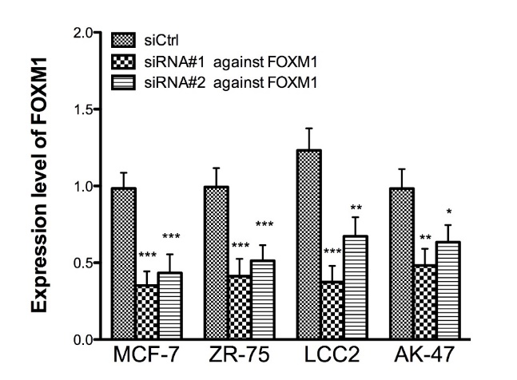
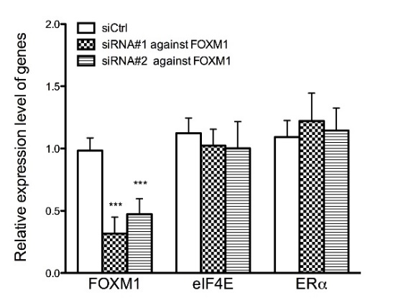
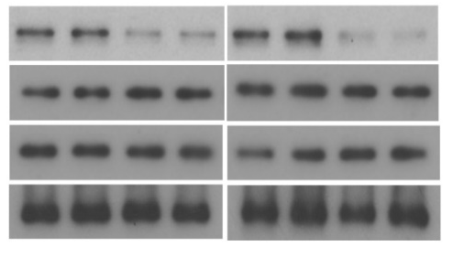
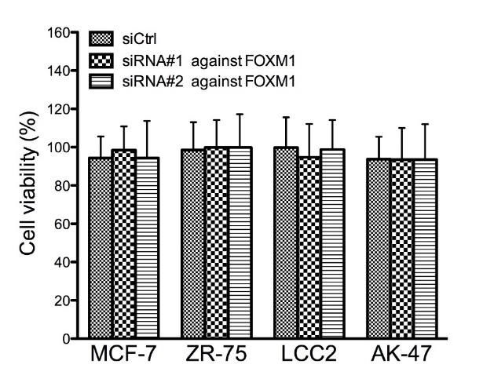
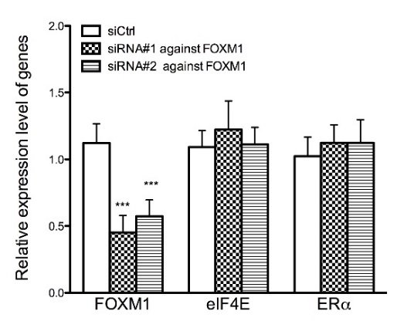
Figure S5
a
c
e
MCF-7
ZR-75
MCF-7
siRNA#1
siRNA#2
siRNA#1
siCtrl
siCtrl
siRNA#2
-
-
FOXM1
110 kDa
eIF4E
25 kDa
ERα
66 kDa
Tubulin
55 kDa
b
d
ZR-75

