Slide 1
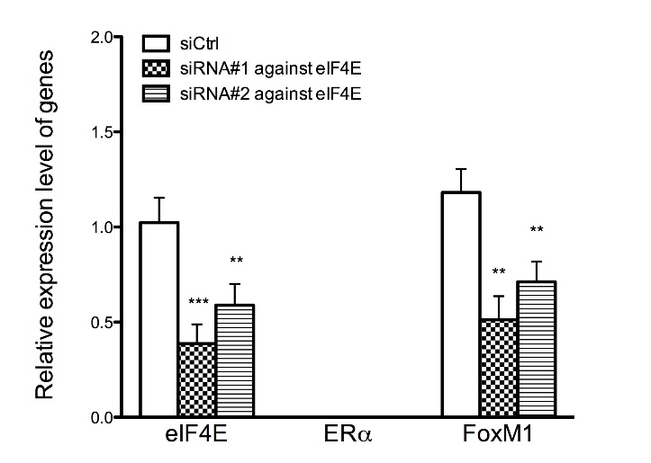
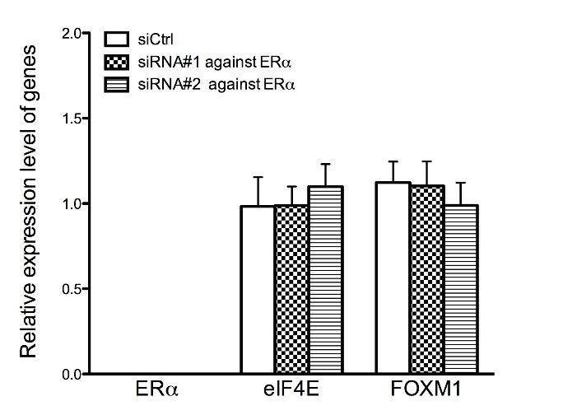
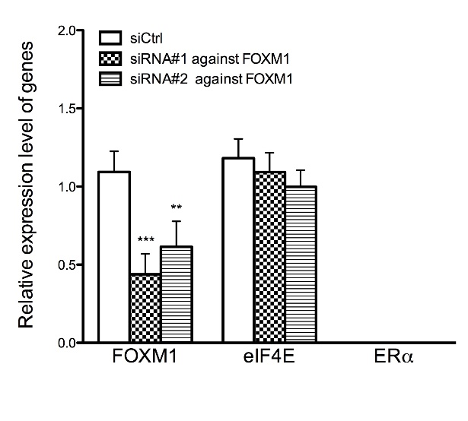
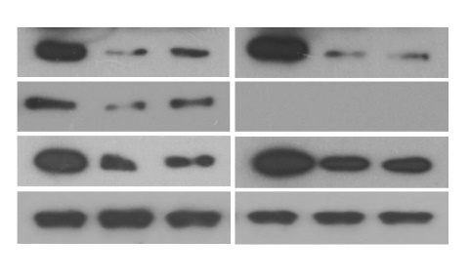
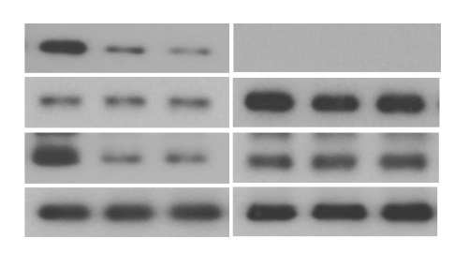
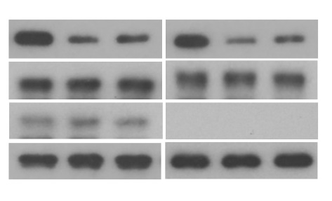
Figure S7
a
c
e
b
d
f
siRNA#1
siRNA#1
siRNA#2
siRNA#2
siRNA#1
siRNA#2
siCtrl
siCtrl
siCtrl
eIF4E
25 kDa
ERα
66 kDa
FOXM1
110 kDa
ERα
66 kDa
eIF4E
25 kDa
eIF4E
25 kDa
FOXM1
110 kDa
FOXM1
110 kDa
ERα
66 kDa
Tubulin
55 kDa
Tubulin
55 kDa
Tubulin
55 kDa

