Slide 1
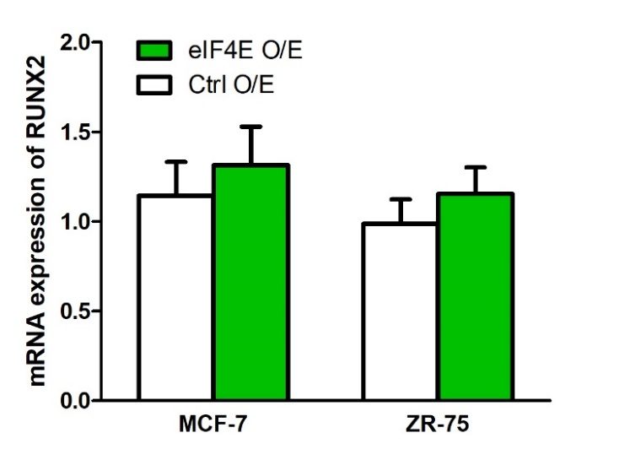
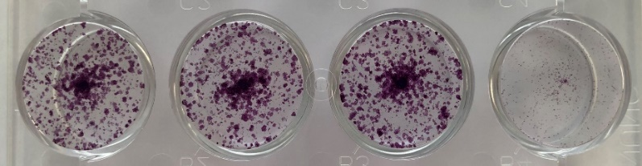
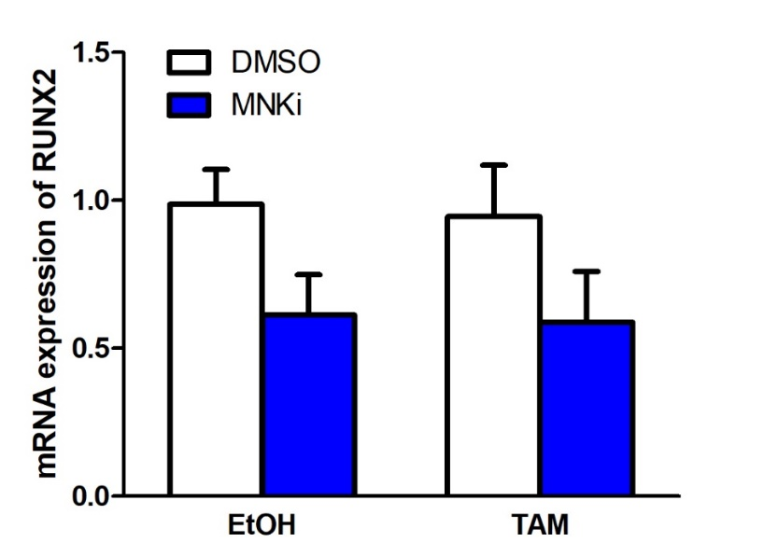
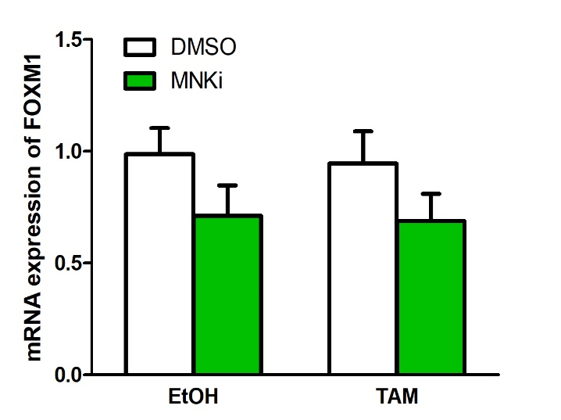
Figure S10
a
c
EtOH
TAM
DMSO
MNKi
DMSO
MNKi
b
d
*
*
**
*

