Slide 1
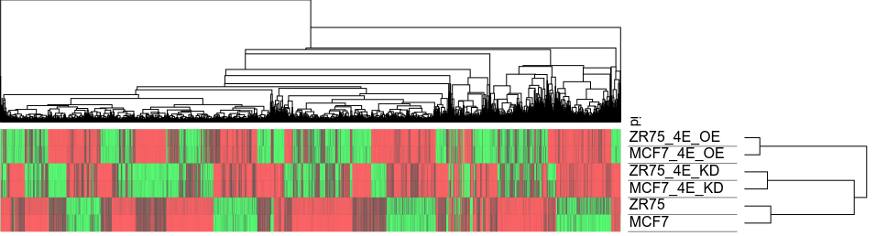
Figure S1
a
b
P value | Enriched pathways in eIF4E overexpressing cells
1.19E-13 | Ribosome - Homo sapiens (human)
1.40E-13 | Spliceosome - Homo sapiens (human)
4.41E-13 | RNA transport - Homo sapiens (human)
1.36E-12 | Estrogen signaling pathway - Homo sapiens (human)
3.83E-12 | Cell cycle (G2/M)- Homo sapiens (human)
9.44E-12 | Huntington disease - Homo sapiens (human)
9.65E-12 | FOXM1 signaling pathway - Homo sapiens (human)
2.41E-11 | Pathways in cancer - Homo sapiens (human)
5.82E-11 | mRNA surveillance pathway - Homo sapiens (human)
6.57E-11 | Thermogenesis - Homo sapiens (human)

