Slide 1
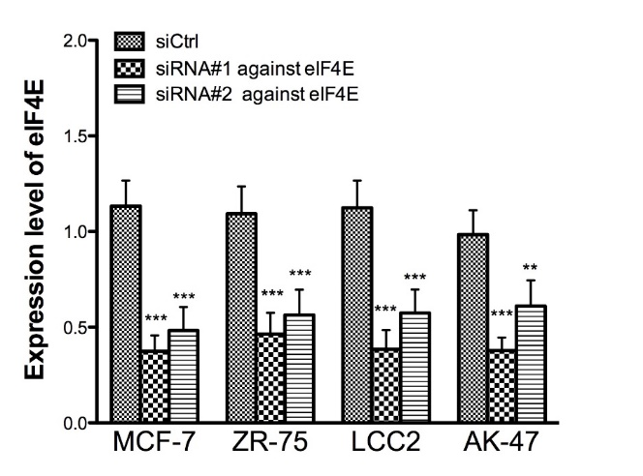
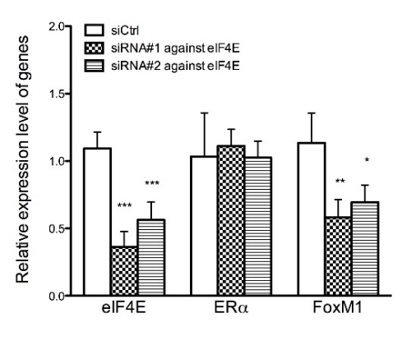
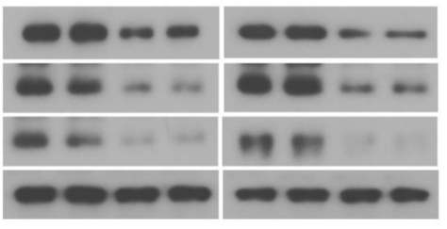
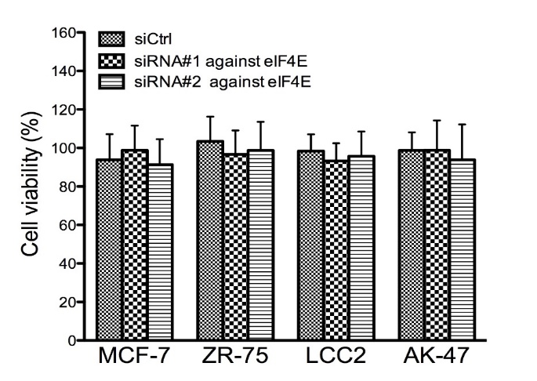
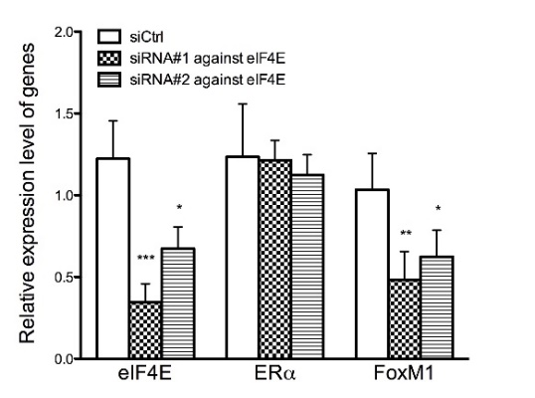
Figure S3
a
c
e
MCF-7
MCF-7
ZR-75
siRNA#1
siRNA#1
siRNA#2
siCtrl
siRNA#2
siCtrl
-
-
eIF4E
25 kDa
ERα
66 kDa
FOXM1
110 kDa
Tubulin
55 kDa
b
d
ZR-75

