Slide 1
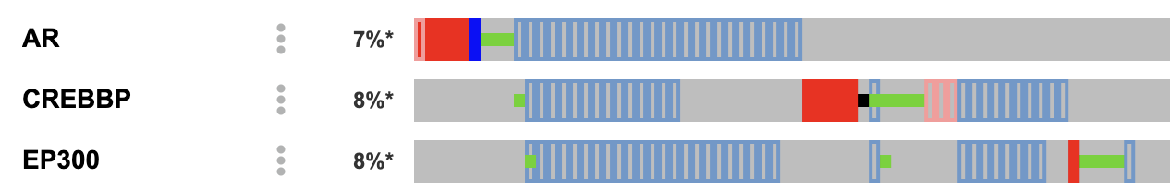
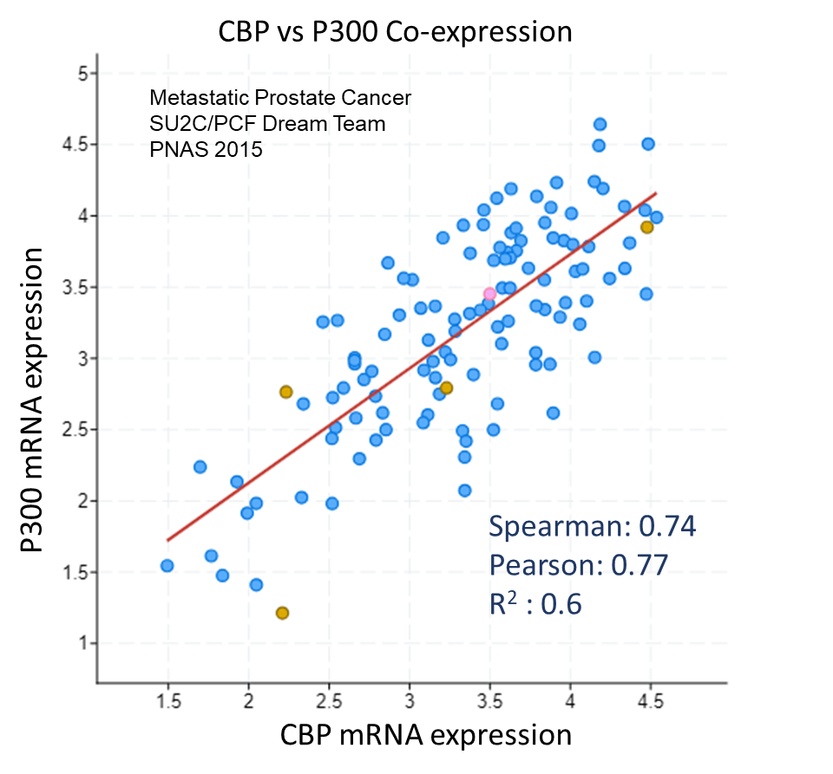
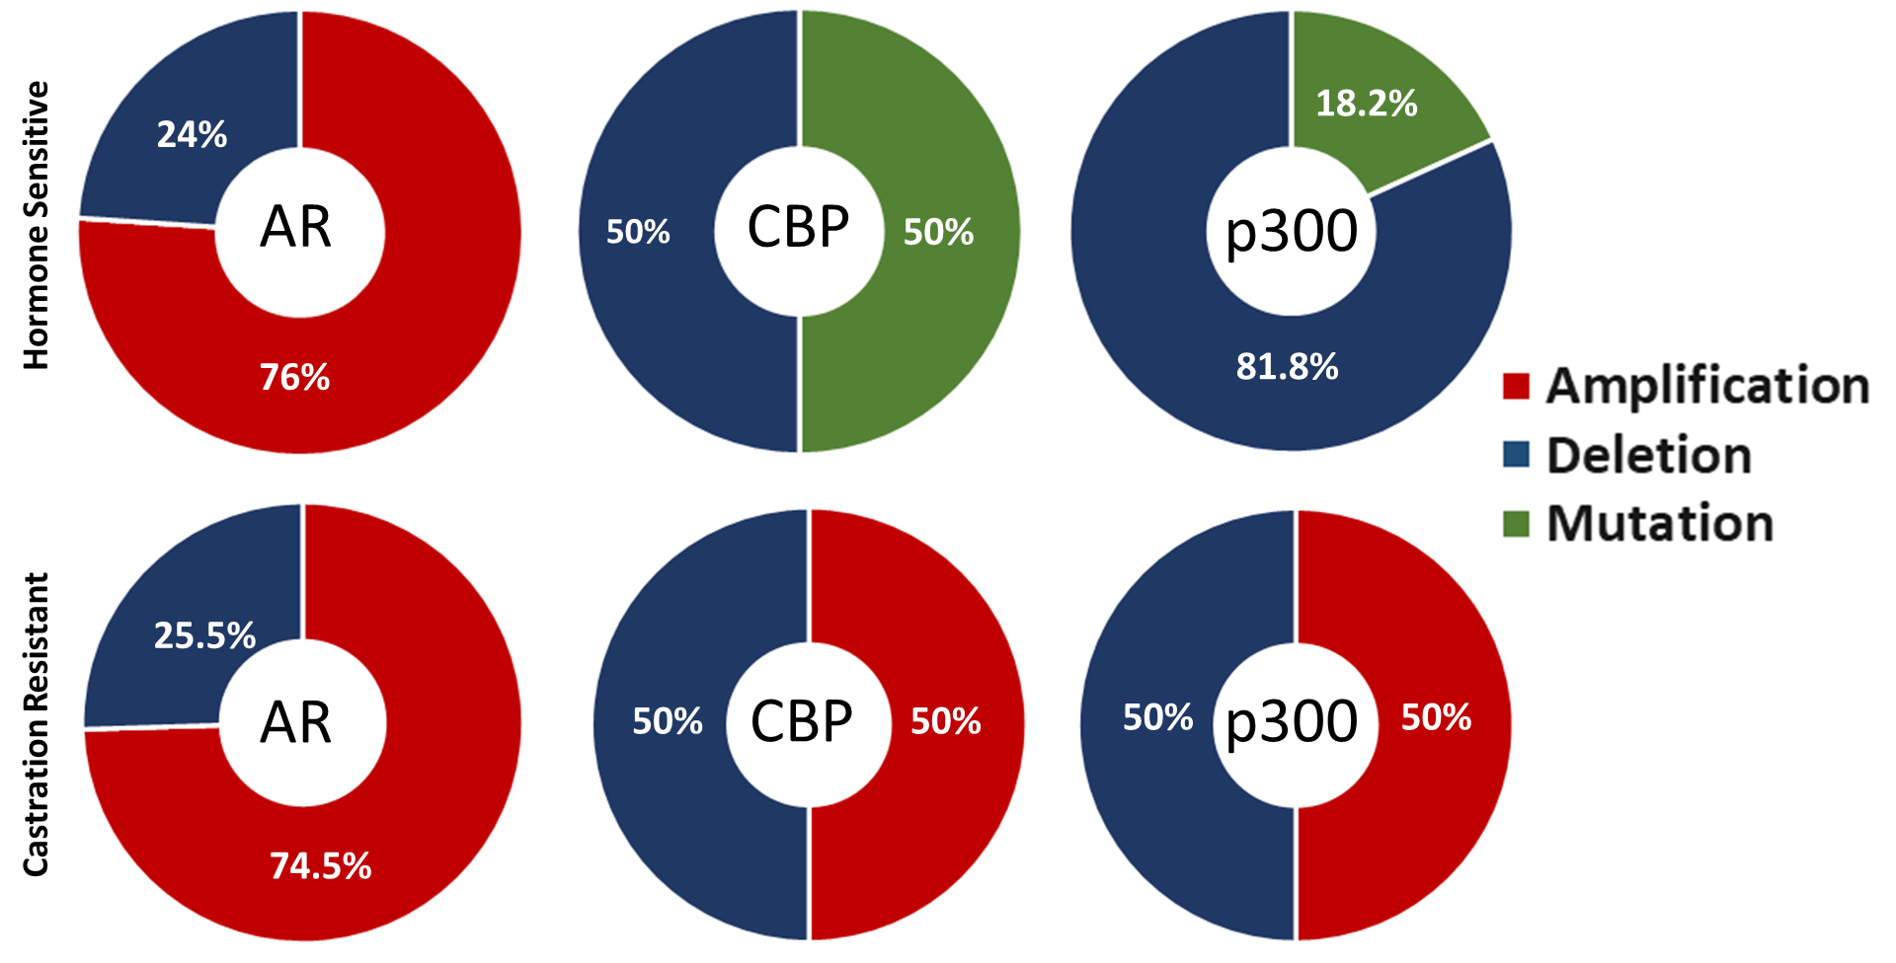
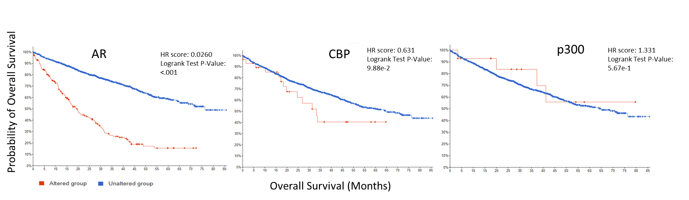
Supp Figure 1
A.
Gene Alteration Frequencies in PCa
(TCGA, Firehose legacy)
Metastatic Prostate Adenocarcinoma (SU2C/PCF Dream Team, PNAS 2019)
B.
C.
D.

Slide 2
Supplementary Figure 1. Altered CBP/p300 expression correlates with aggressive disease. A. Frequency of AR, CBP, and p300 alterations in primary PCa. B-C. Correlation of CBP and p300 mRNA expression in metastatic PCa patient tumors from the Prostate Adenocarcinoma (MSK/DFCI, Nature Genetics 2018 and Metastatic Prostate Cancer (SU2C/PCF Dream Team, Cell 2015) data sets from cBioportal. Hormone sensitive PCa total alterations AR n= 167, CBP n=26, and p300 n=11, and castration-resistant PCa AR n=94, CBP n=8, and p300 n=2. D. cBioportal analyses for overall survival from the Prostate Adenocarcinoma (MSK, Clin Cancer Res. 2022) data set.

Slide 3
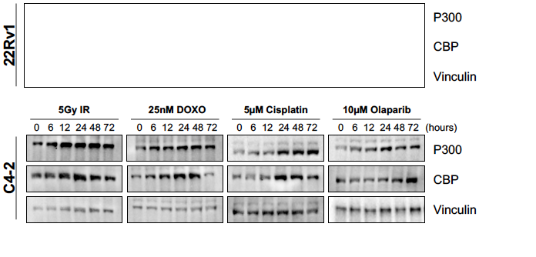
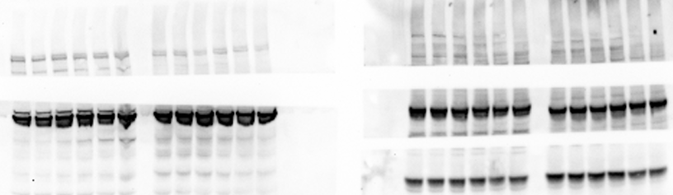
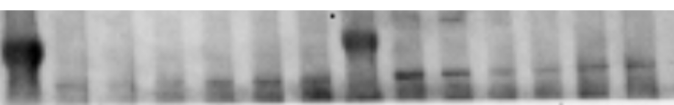
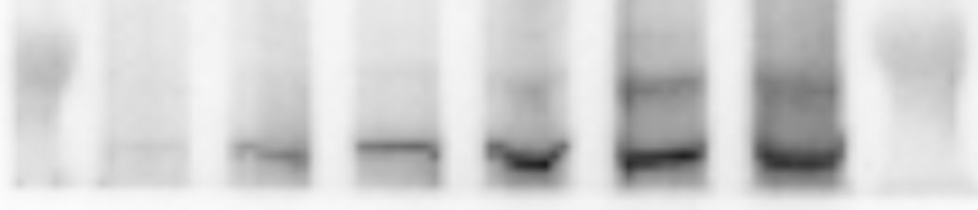
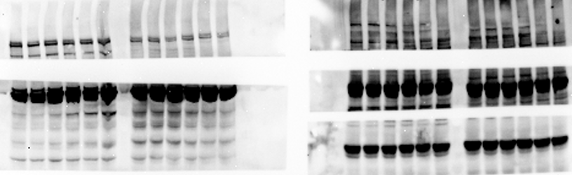

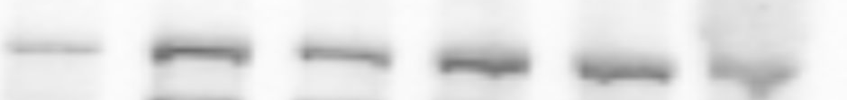

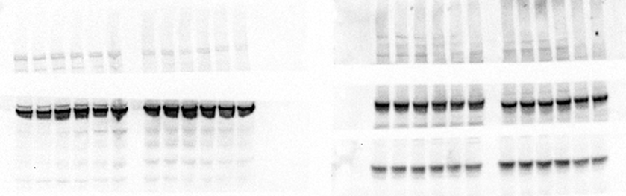
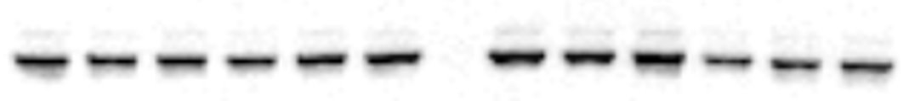
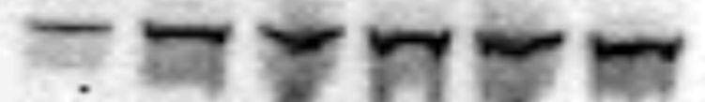
Supp Figure 2
A.
B.
C.
D.
E.
Notes:
D) 22Rv1 – AS.573 (Olap and Doxo), AS.579 (Cis), AS.597 (IR)

Slide 4
Supplementary Figure 2. CCS1477 sensitizes CRPC cells to AR-dependent DNA repair. A-B. 22Rv1 and C4-2 cells treated with CBP/p300 inhibitor (CCS1477) for increasing time (4-72 hours). A. Cells were harvested and analyzed for cell cycle analyses with flow cytometry. B. Cells were harvested, RNA isolated, and qPCR analyses of key target genes. B. Cells were harvested and analyzed for cell cycle analyses with flow cytometry C. 22Rv1 (top) and C4-2 (bottom) cells were treated with increasing dosages of indicated DDR agents (IR, cisplatin, olaparib, or doxorubicin) with or without CCS1477, and drug sensitivity assays were performed on Day 5 using Picogreen. Combination Index (CI) analyses were performed for conditions performed above. D. 22Rv1 (top) and C4-2 (bottom) cells were treated with or without CCS1477 (250 nM) and IR (5 Gy) at Day 0. Cells were harvested for growth assays analyses on Days 0, 3, and 5 using Picogreen. E. WB analyses of AR, CBP, p300, c-MYC, and Vinculin in response to IR, cisplatin, olaparib, and doxorubicin in 22Rv1 and C4-2 cells. n=3, *p<0.05, **p<0.01, & ***p<0.001.

Slide 5
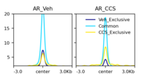
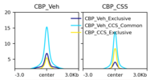
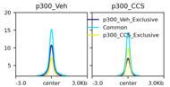
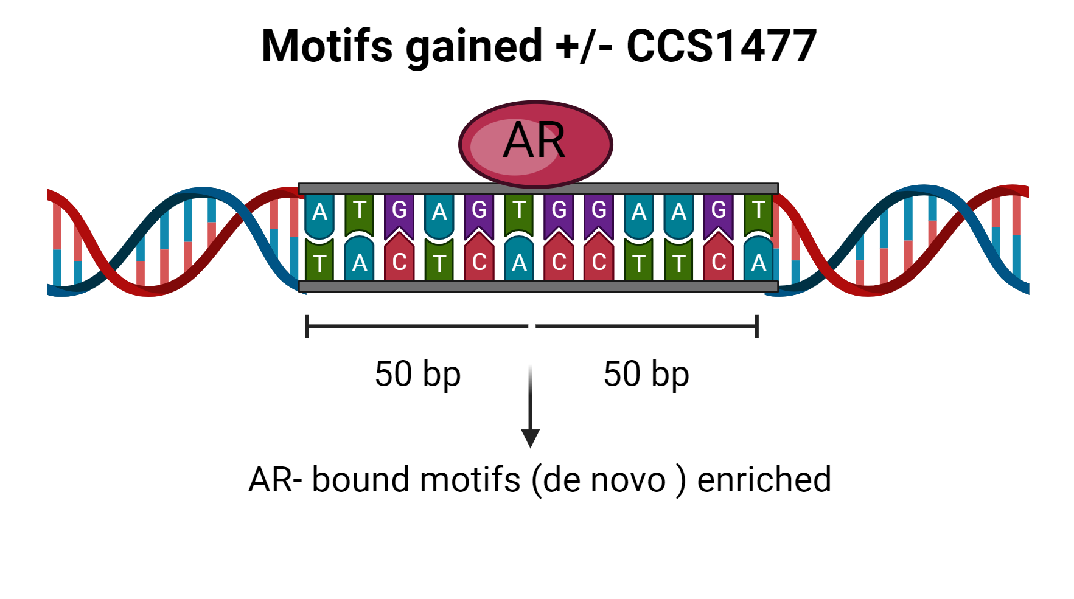
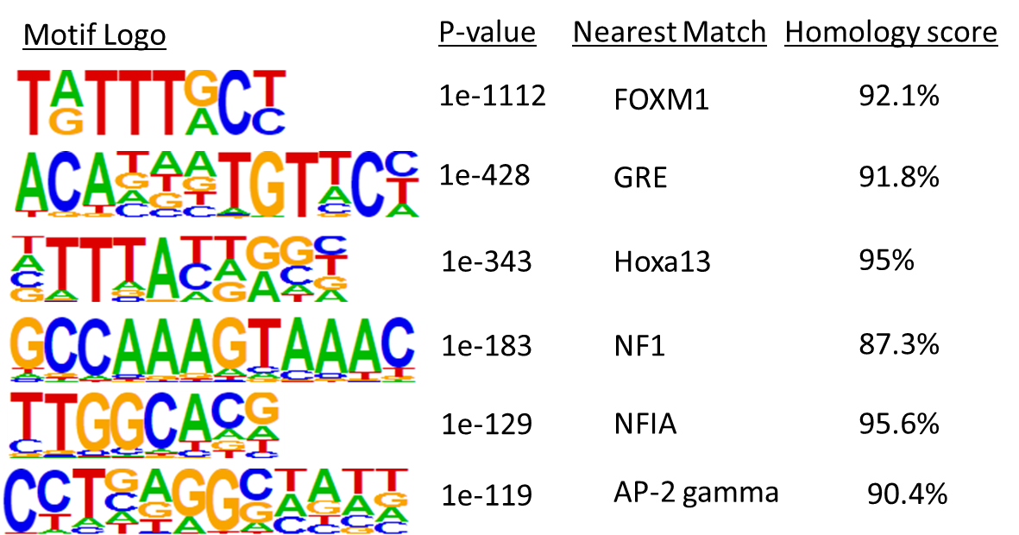

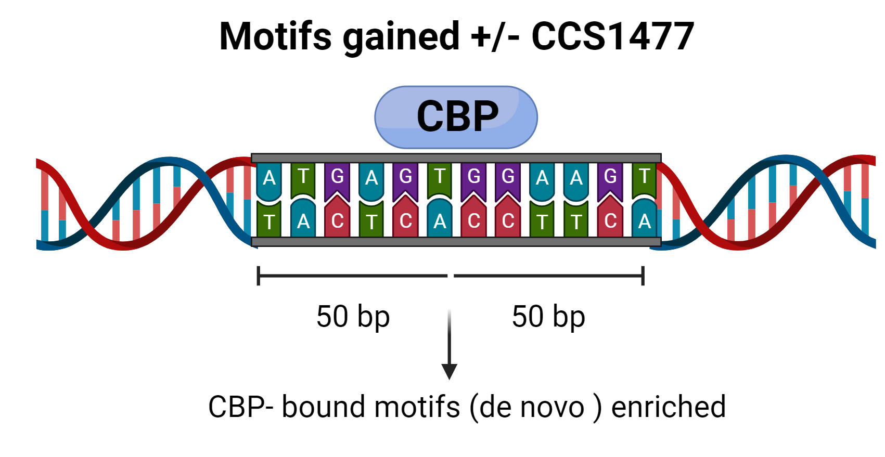
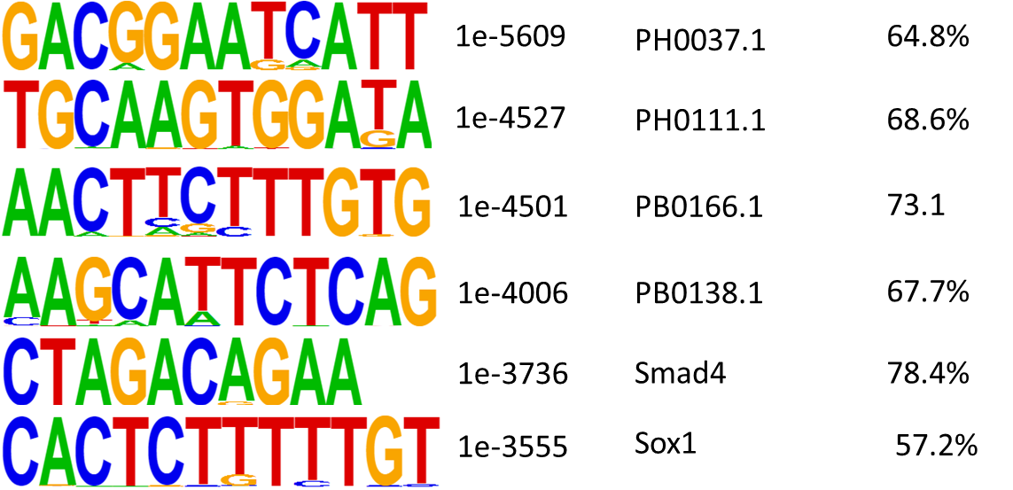

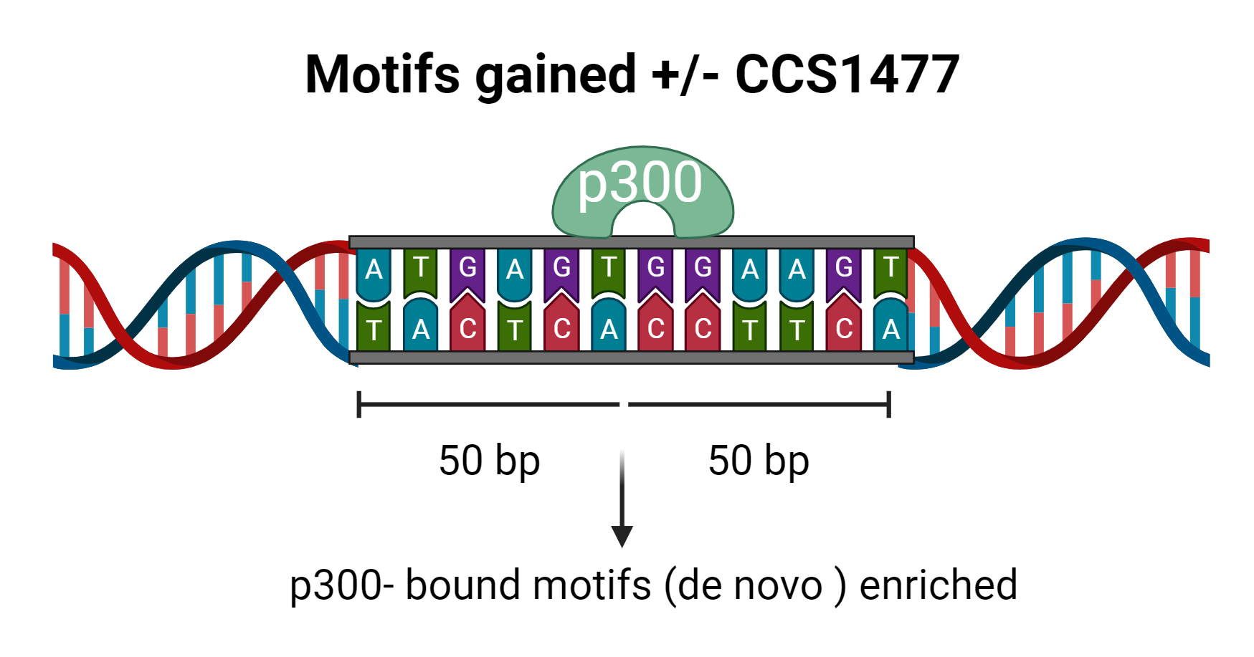
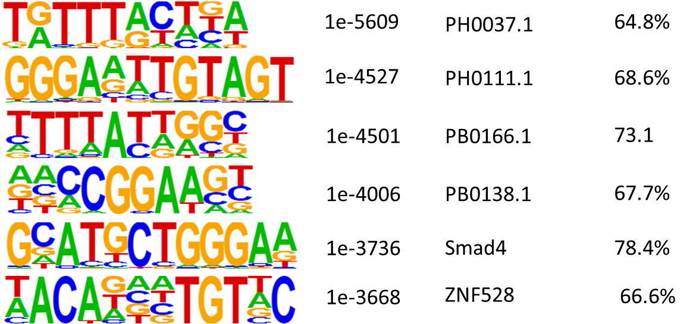

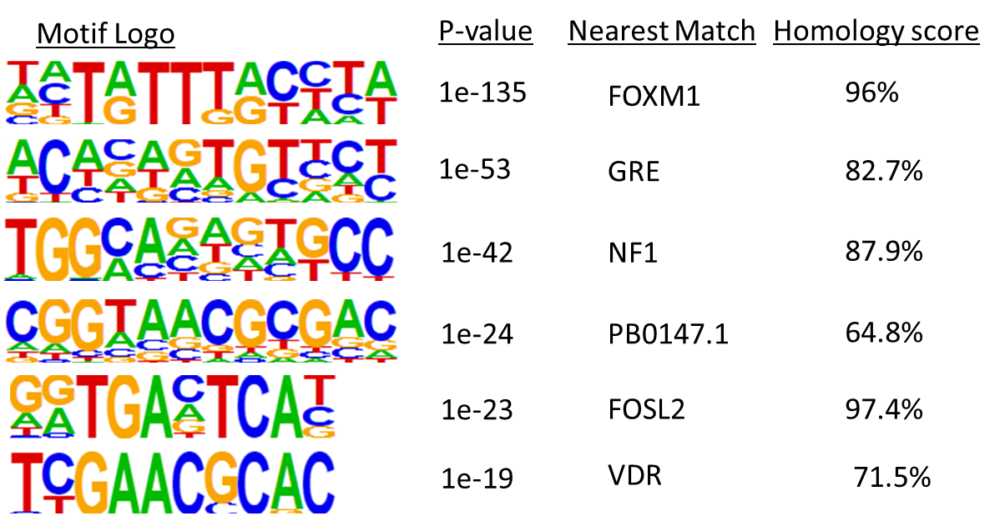


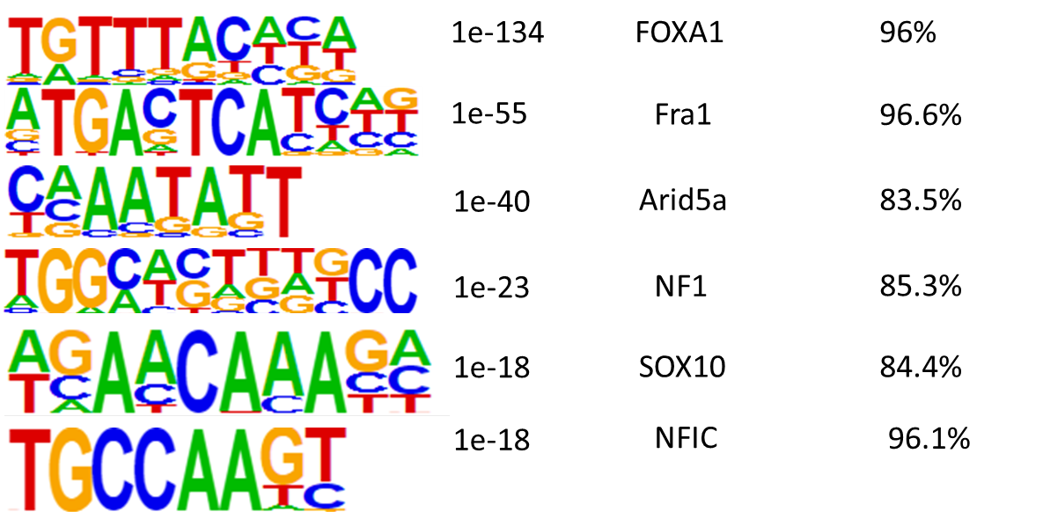



Supp Figure 3
A.
B.
Vehicle Binding Overlap
CCS1477 Binding Overlap
AR
CBP
AR
CBP
16846
11184
20955
12210
5885
4611
19
2928
520
5
1455
157
59
41
p300
p300
D.
Hallmarks GSEA
E.
KEGG GSEA
AR
CBP
C.
5x10⁻⁴
1x10⁻¹⁰
p-value
KEGG GSEA
AR
4x10⁻³
4x10⁻³¹
p-value
p300
1x10⁻²
3x10⁻⁹
p-value
1x10⁻²
1x10⁻⁵
p-value

Slide 6
Supplementary Figure 3. CBP/p300 inhibition drastically reduces the AR , CBP, p300 cistromic landscape. A. Overview of bindings sites of AR, CBP, & p300 in Vehicle treated 22Rv1 cells. B. Overlap of bindings sites of AR, CBP, & p300 in Vehicle condition and CCS1477 treated condition in 22Rv1 cells. C. Motifs of binding regions of AR, CBP, and p300 exclusive to Veh or CCS1477 conditions visualized for top 6 highest p-values. E. Hallmarks and KEGG GSEA pathways regulated by AR. E. KEGG GSEA pathways regulated by CBP and p300 in CCS1477 treated 22Rv1 cells.

Slide 7
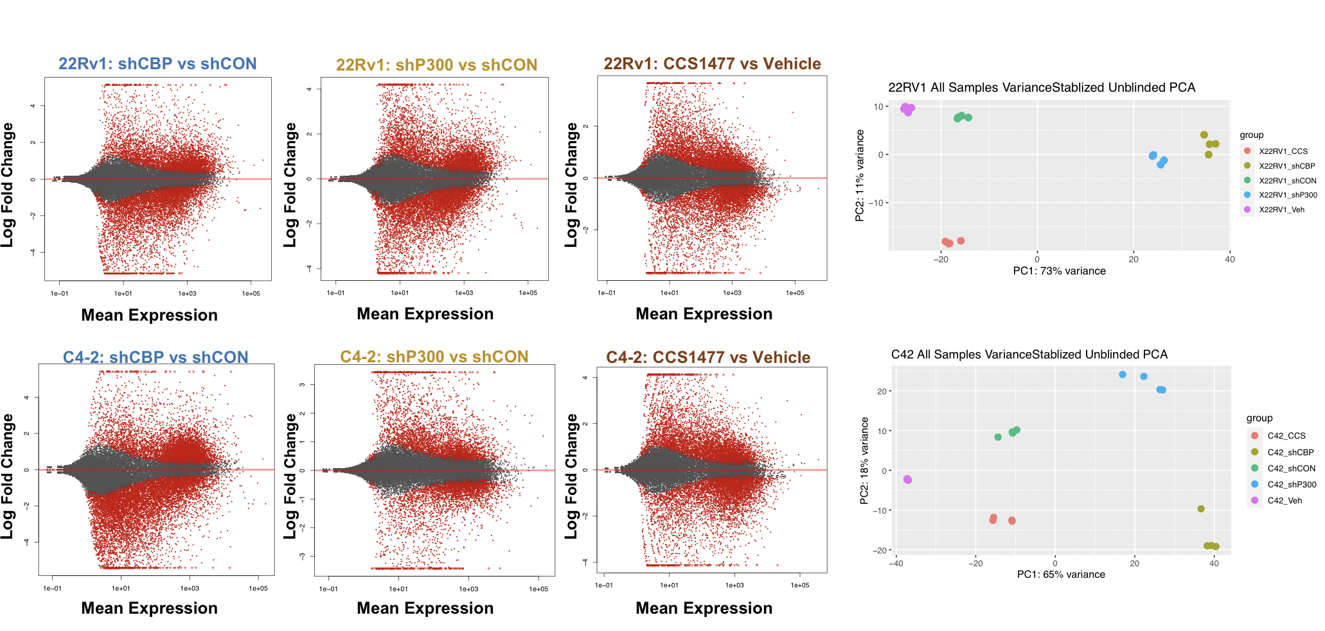


Supp Figure 4
A.
B.
n=1417
n=1732
C.
UPregulated genes in 22Rv1 with CBP/P300 knockdown
KEGG pathway analysis
D.
shCBP
shP300
1x10⁻²
1x10⁻²³
1x10⁻²
p-value
1x10⁻⁸
Notes:
C. SC33

Slide 8
Supplementary Figure 4. CBP/p300 bromodomain knockdown alters global transcriptome and regulates cell cycle & DDR. A. 22Rv1 cells treated with Vehicle or 100 nM CCS1477 treatment for 24 hours as detailed in previously published data in Welti et al, Cancer Discovery 2021. MA plot depicts gene expression modulation with the number of significant upregulated and downregulated transcripts with p<0.001 and fold change (FC)> 2.0. B. PCA blot of RNA-Seq analysis was performed on quadruplet samples for 22Rv1-shCON, 22Rv1-shCBP, and 22Rv1-shP300 in addition to 22Rv1 with CCS1477 treatment. C. GSEA pathway analyses (KEGG) of upregulated in 22Rv1 cells with CBP and p300 knockdown treatment using FDR<0.25, p<0.0001, FC>2. D. C4-2 and 22Rv1-shCON, -shCBP, and –shp300 cells were treated with doxycycline to knockdown CBP and p300. Then cells were treated with 10 nM Doxorubicin (DOXO). Flow analysis was performed to determine changes in cell cycle progression.. n=3, *p<0.05, **p<0.01, & ***p<0.001.

Slide 9
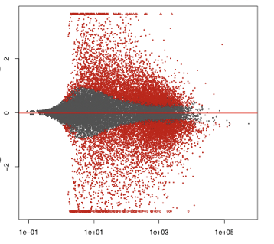
Supp Figure 5
A.
CBP/p300-Regulated DDR Genes
22Rv1 (Veh vs CCS1477)
MSigDB DNA Repair-Related Pathways
n=1417
Log Fold Change
8%
4%
MMR
10%
n=1732
NER
DDR pathways
HR
Other DDR Genes
9%
4%
CBP/p300 Regulated DDR Genes
B.
BER
NHEJ

Slide 10
Supp Figure 5. CBP/p300 inhibition impacts double-strand DNA break repair. A. Schematic describing the comparison of RNA-Seq data sets. Briefly, transcriptions with p<0.001 and fold change (FC) > 2.0 were identified and then organized into specific DDR pathways. B. Validation of HR gene targets in CRPC cells with increasing time of CCS1477 treatment. n=3, *p<0.05, **p<0.01, & ***p<0.001.

Slide 11







Supp Figure 6
A.
B.
DOXO + CCS1477
DOXO + CCS1477
IR + CCS1477
CCS1477
DOXO
CCS1477
Veh
IR
IR + CCS1477
DOXO
Veh
IR
CBP
CBP
p300
p300
AR
AR
c-MYC
c-MYC
Vinculin
Vinculin
22Rv1
C4-2
Notes:
B) 22Rv1 – SS.47
B) C4-2 – SS.48

Slide 12
Supp Figure 6. CBP/p300 inhibition and knockdown decreases HR efficiency. A. Validation of HR gene targets in CRPC cells with increasing time of CCS1477. B. 22Rv1 & C4-2 cells were treated with with CBP/p300 inhibitor with or without genotoxic insult of 5 Gy IR or 10 nM Doxorubicin treatment for 24 hours. Changes in HR factors protein expression were analyzed. n=3, *p<0.05, **p<0.01, & ***p<0.001.

Slide 13
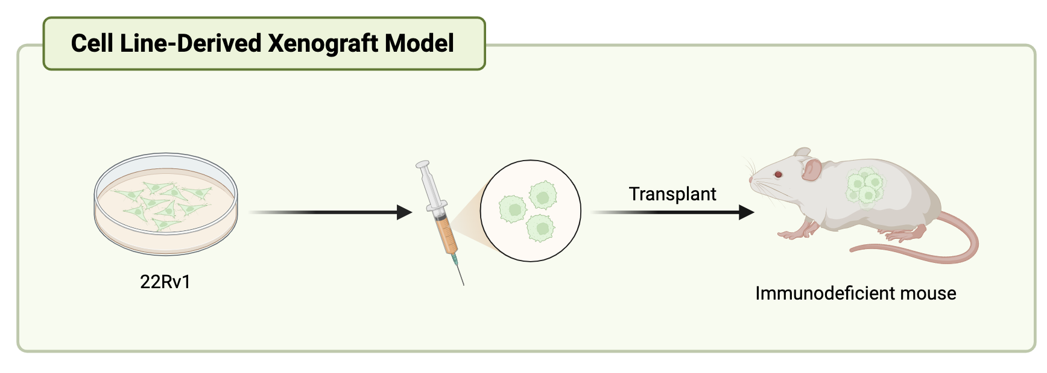
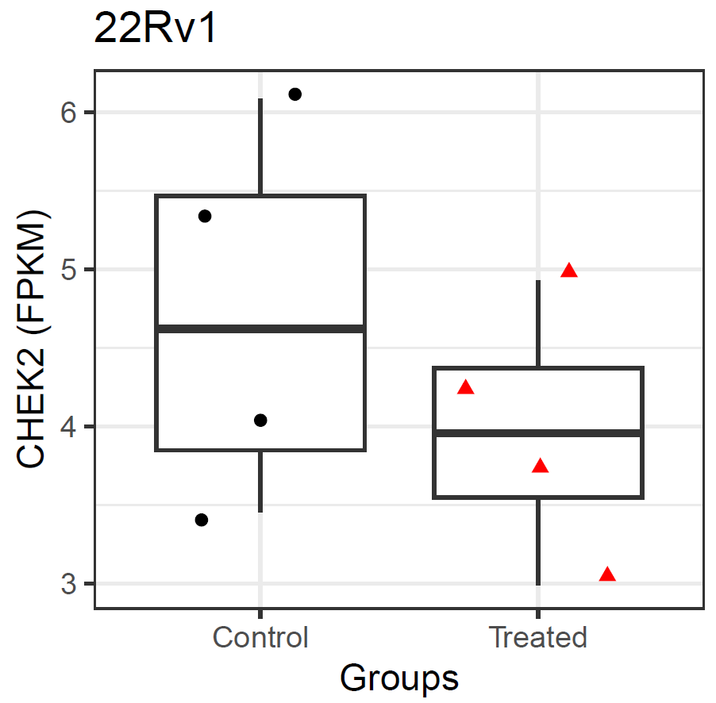
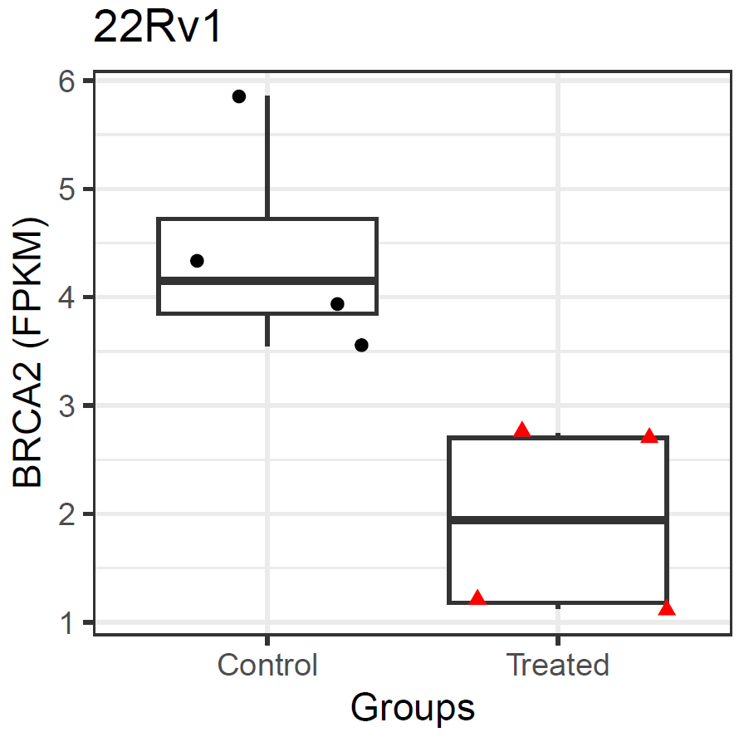
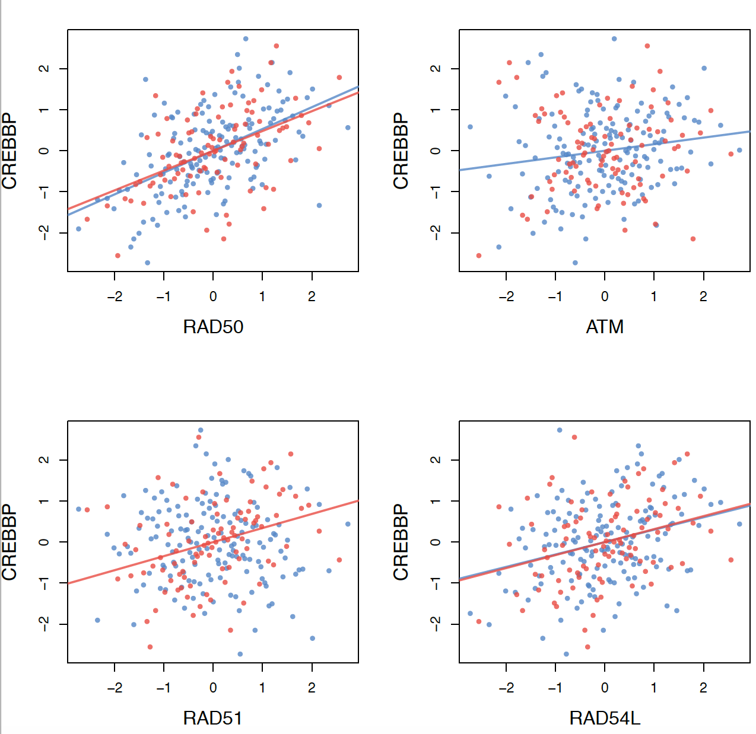
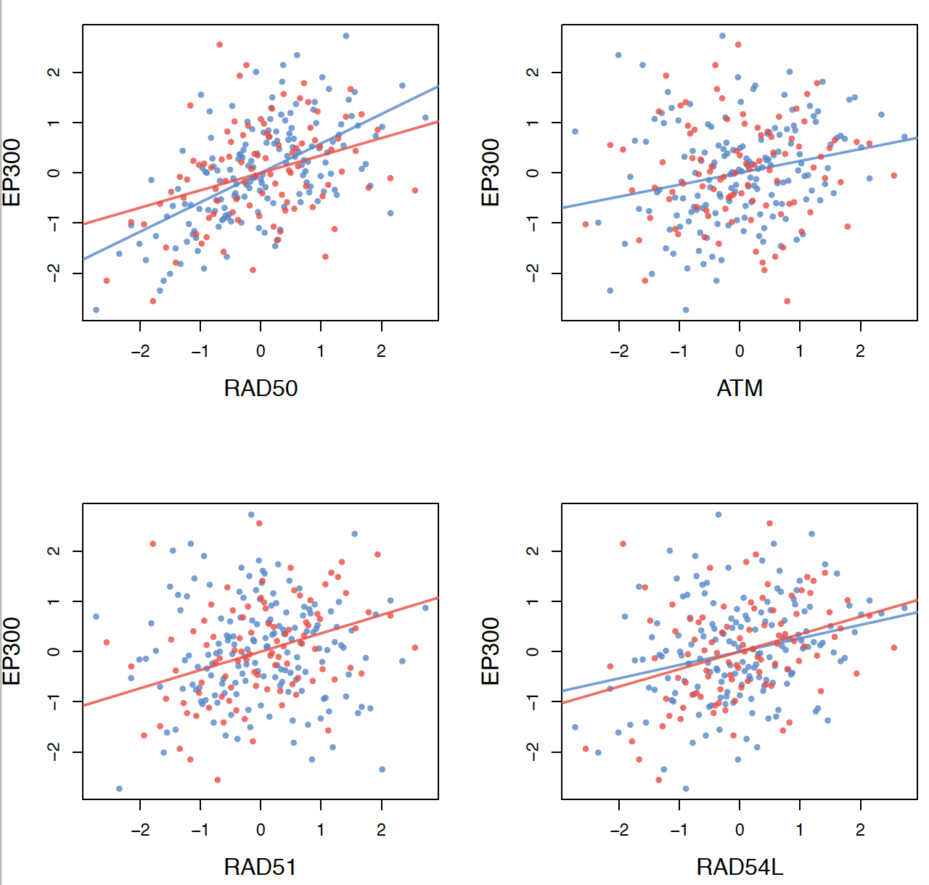
Supp Figure 7
A.
B.

Slide 14
Supp Figure 7. CBP/p300 inhibition mediates HR repair and impacts patient outcome. A. HR expression in 22Rv1 xenografts with CCS1477 (20mg/mL). Tissue harvested, RNA isolated, and analyzed for HR gene expression. B. Correlation of HR genes (RAD50, ATM, RAD51, RAD54L) with CBP and EP300 mRNA expression in patient cohorts.

