Slide 1
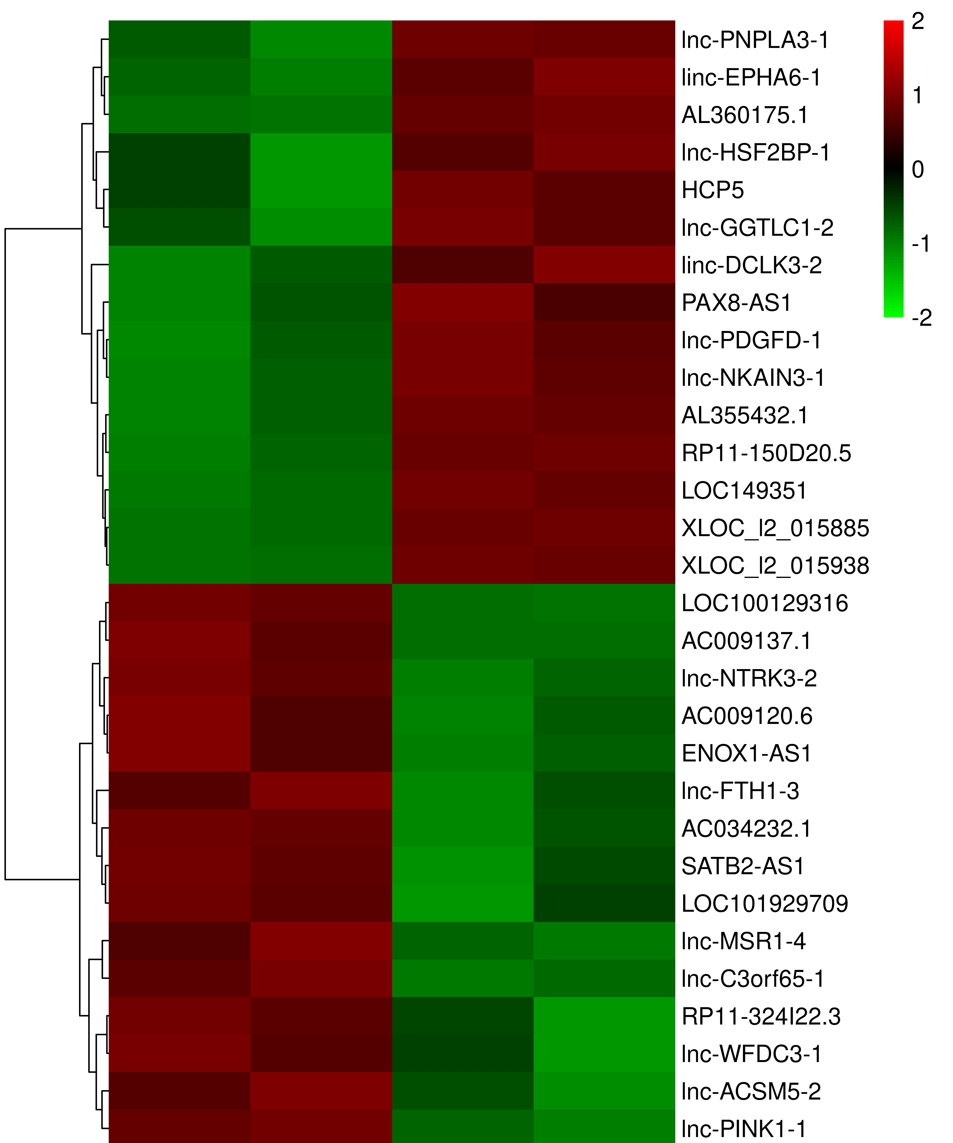
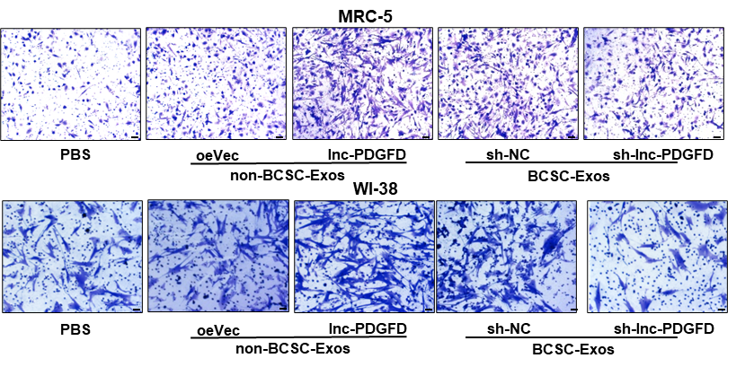
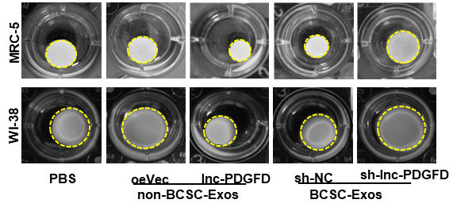
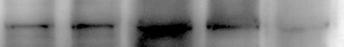
A
B
C
D
Exos-2
Exos-1
Exos-1
Exos-2
non-BCSC BCSC
E
F
G
H
I
J
K
Fibronectin
FAP
αSMA
Vimentin
GAPDH
PBS
oeVec
lnc-PDGFD
sh-NC
sh-lnc-PDGFD
non-BCSC-Exos
BCSC-Exos

