Slide 1
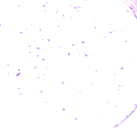



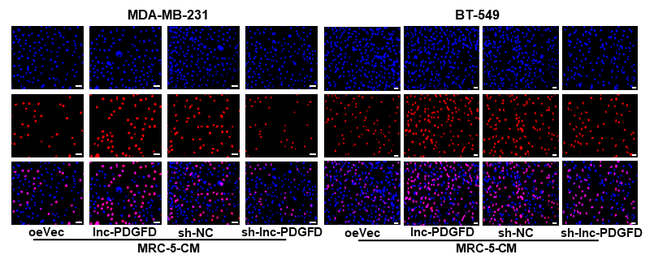


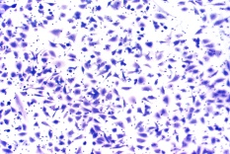
A
B
BT-549
C
oeVec
lnc-PDGFD
sh-NC
sh-lnc-PDGFD
D
MRC-5-CM
E
F
G
H
Nanog
Sox2
Oct4
oeVec
lnc-PDGFD
ALDH1A1
GAPDH
lnc-
PDGFD
sh-lnc-PDGFD
Ctrl
lnc-PDGFD-KO
oeVec
sh-NC
MRC-5-CM
I
MRC-5-CM
J
Migration
MDA-MB-231
Invasion
oeVec
lnc-PDGFD
MRC-5-CM
sh-NC
sh-lnc-PDGFD
K
Migration
BT-549
Invasion
oeVec
lnc-PDGFD
MRC-5-CM
sh-NC
sh-lnc-PDGFD

